Slide 1



Mapping precipitation extremes for pluvial flood risk management in the Sirba river basin, Burkina Faso
Francesco Saretto¹ and Daniele Ganora¹
¹Department of Environmental, Land and Infrastructure Engineering, Politecnico di Torino, Corso Duca degli Abruzzi 24, 10129 Turin, Italy. francesco.saretto@polito.it
Flash presentation

Slide 2
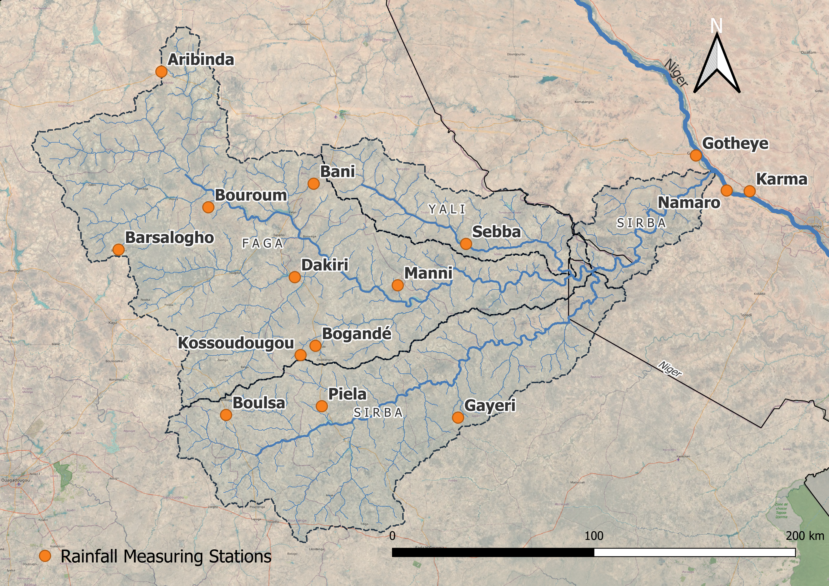
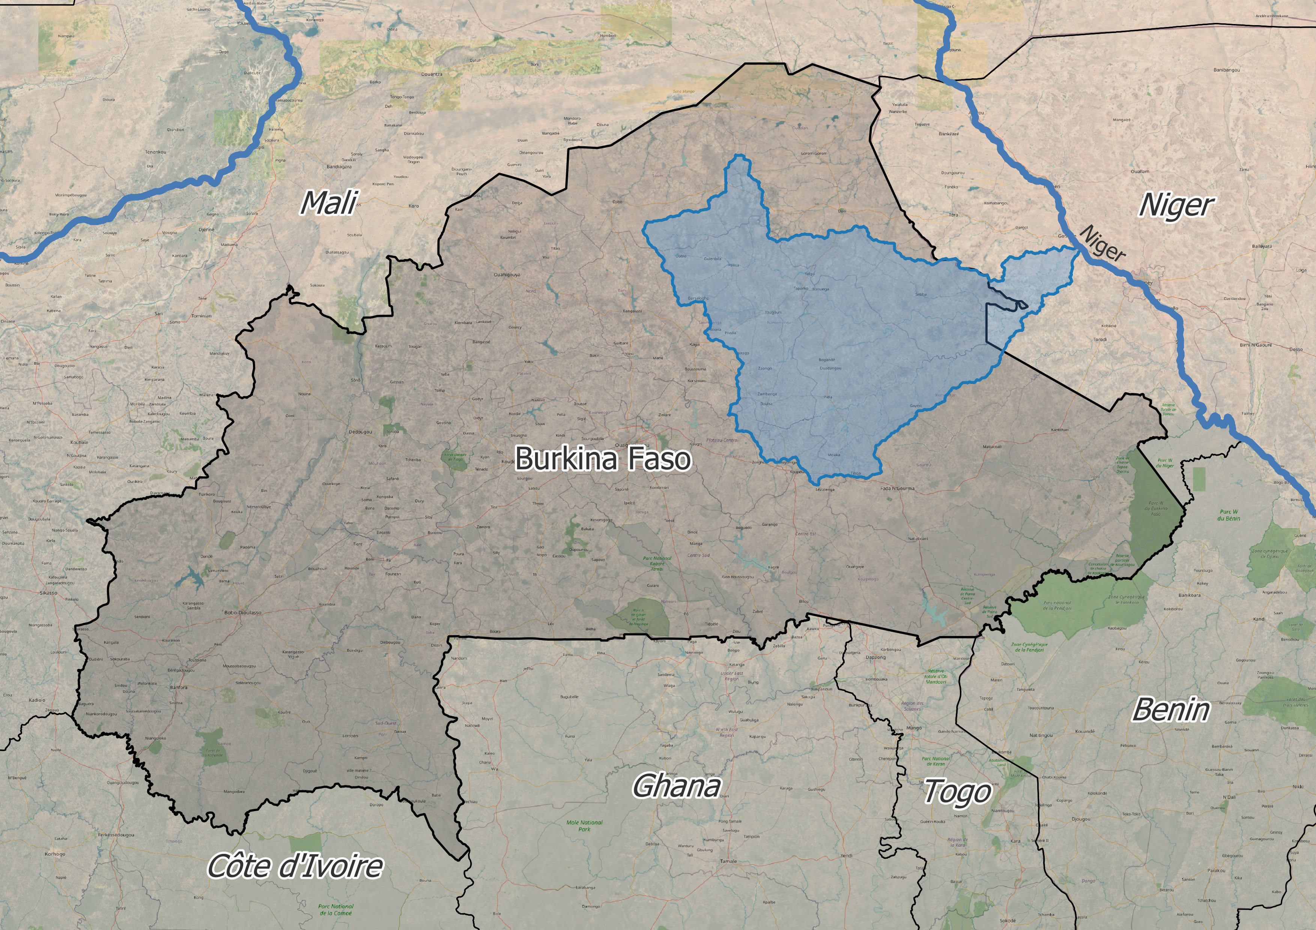
Mapping precipitation extremes for pluvial flood risk management in the Sirba river basin, Burkina Faso
Francesco Saretto¹ and Daniele Ganora¹
¹Department of Environmental, Land and Infrastructure Engineering, Politecnico di Torino, Corso Duca degli Abruzzi 24, 10129 Turin, Italy. francesco.saretto@polito.it
From Point Daily Rainfall Measurements

Slide 3
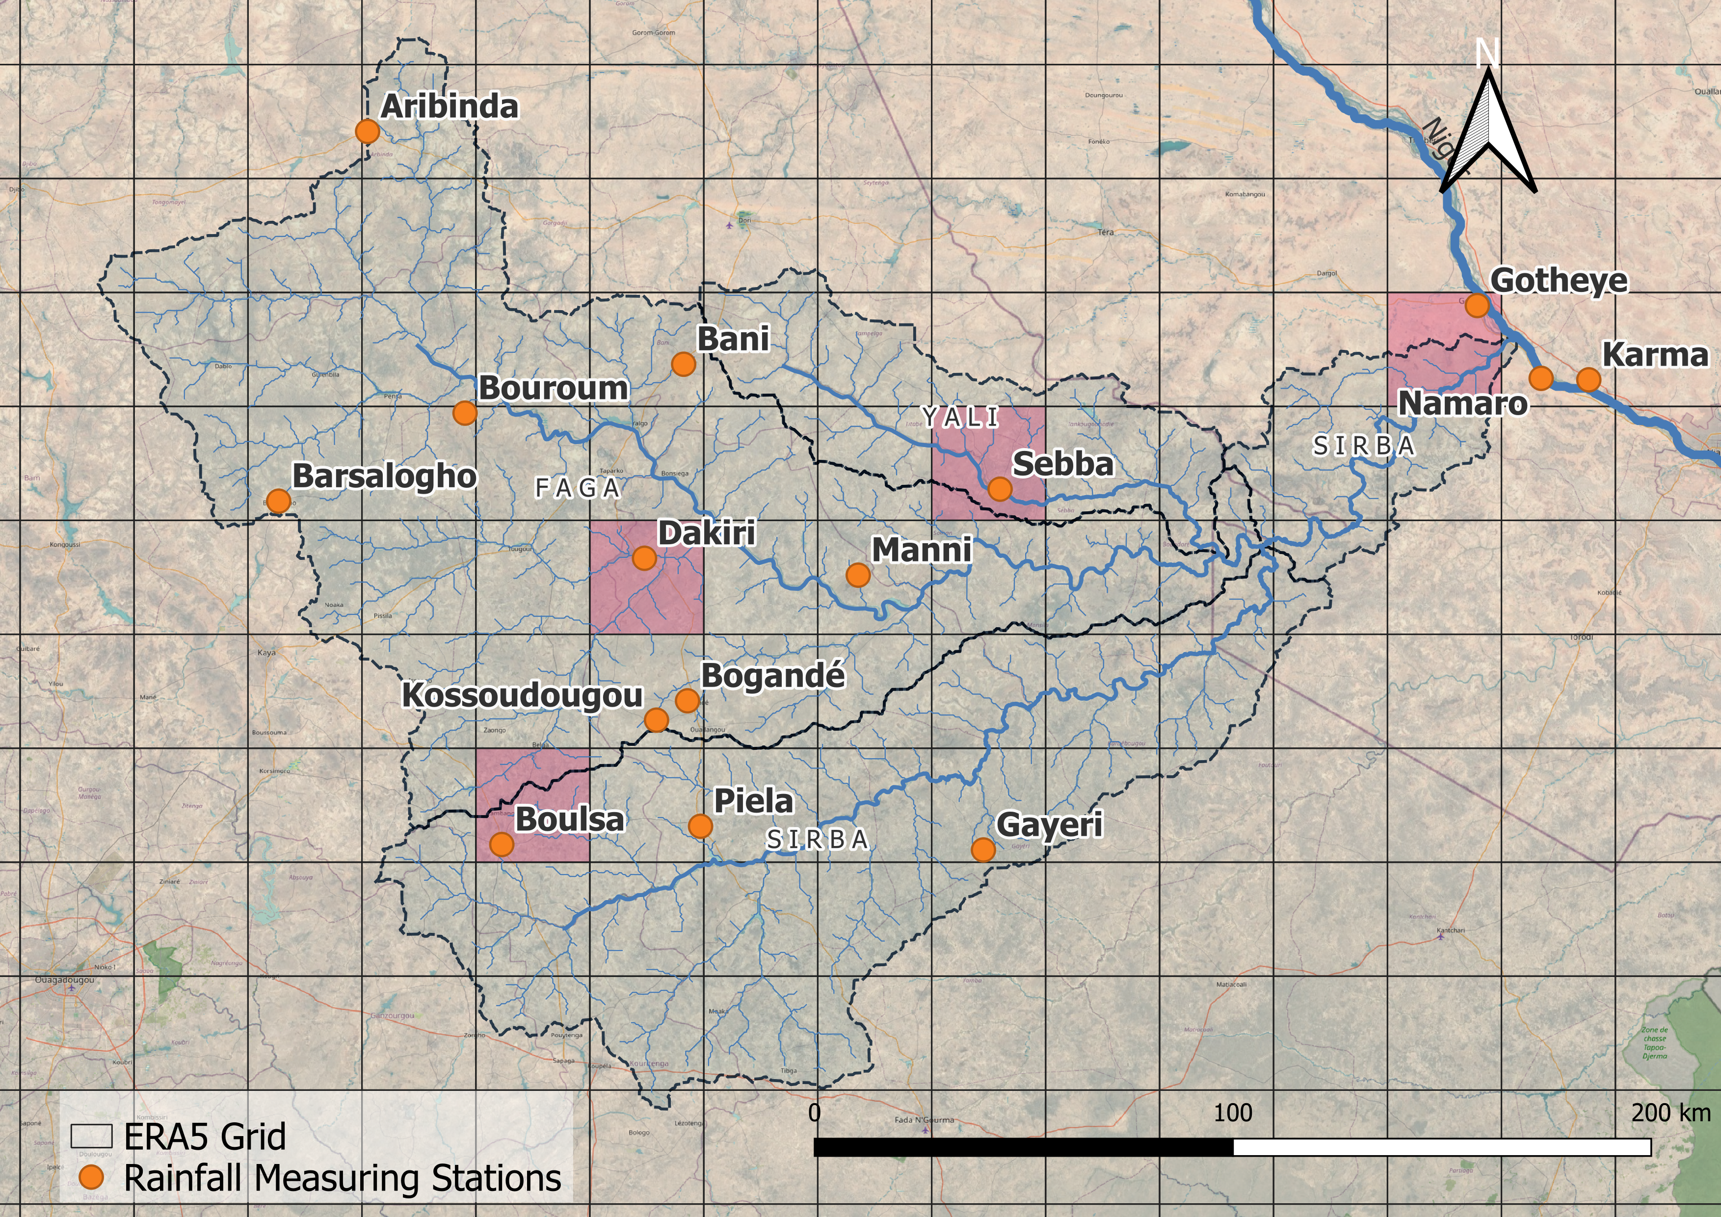
Mapping precipitation extremes for pluvial flood risk management in the Sirba river basin, Burkina Faso
Francesco Saretto¹ and Daniele Ganora¹
¹Department of Environmental, Land and Infrastructure Engineering, Politecnico di Torino, Corso Duca degli Abruzzi 24, 10129 Turin, Italy. francesco.saretto@polito.it
From Point Daily Rainfall Measurements
To Gridded Sub-Daily Extremes

Slide 4
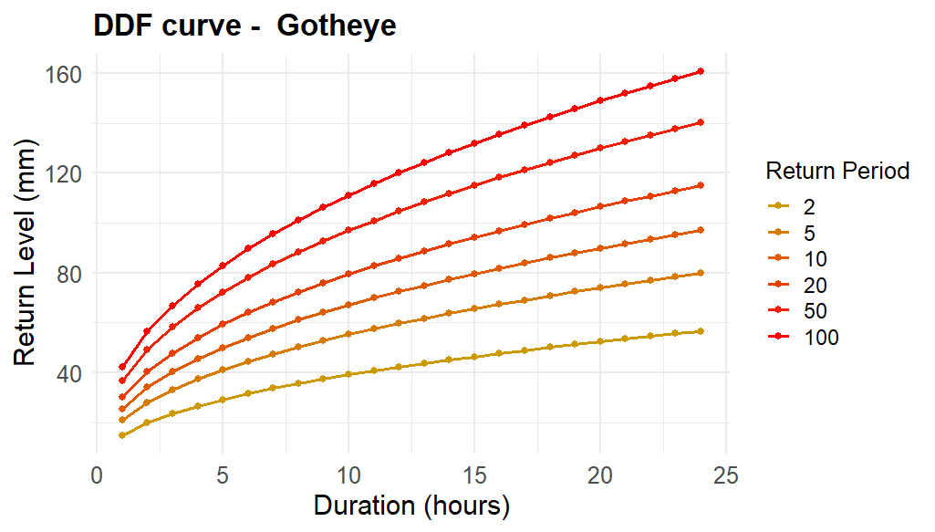
Mapping precipitation extremes for pluvial flood risk management in the Sirba river basin, Burkina Faso
Francesco Saretto¹ and Daniele Ganora¹
¹Department of Environmental, Land and Infrastructure Engineering, Politecnico di Torino, Corso Duca degli Abruzzi 24, 10129 Turin, Italy. francesco.saretto@polito.it
From Point Daily Rainfall Measurements
To Gridded Sub-Daily Extremes

Slide 5

Mapping precipitation extremes for pluvial flood risk management in the Sirba river basin, Burkina Faso
Francesco Saretto¹ and Daniele Ganora¹
¹Department of Environmental, Land and Infrastructure Engineering, Politecnico di Torino, Corso Duca degli Abruzzi 24, 10129 Turin, Italy. francesco.saretto@polito.it
From Point Daily Rainfall Measurements
To Gridded Sub-Daily Extremes

Slide 6
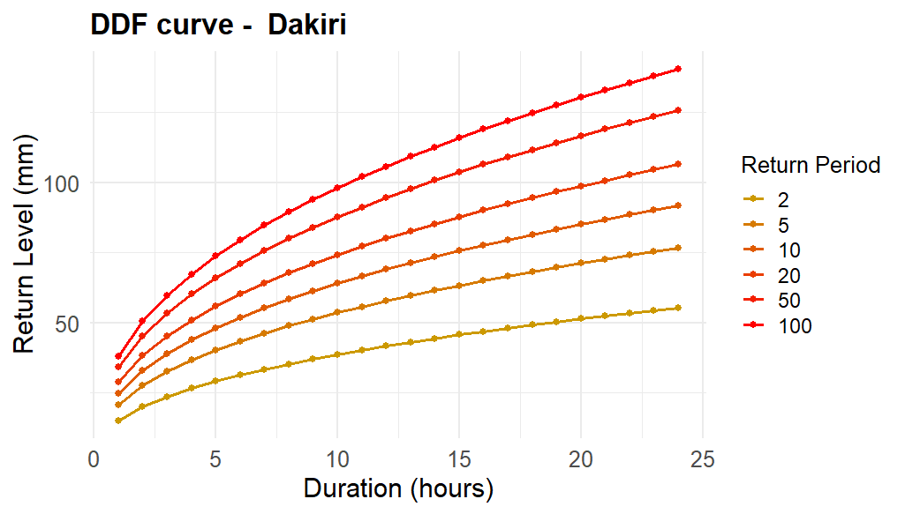

Mapping precipitation extremes for pluvial flood risk management in the Sirba river basin, Burkina Faso
Francesco Saretto¹ and Daniele Ganora¹
¹Department of Environmental, Land and Infrastructure Engineering, Politecnico di Torino, Corso Duca degli Abruzzi 24, 10129 Turin, Italy. francesco.saretto@polito.it
From Point Daily Rainfall Measurements
To Gridded Sub-Daily Extremes

Slide 7
Mapping precipitation extremes for pluvial flood risk management in the Sirba river basin, Burkina Faso
Francesco Saretto¹ and Daniele Ganora¹
¹Department of Environmental, Land and Infrastructure Engineering, Politecnico di Torino, Corso Duca degli Abruzzi 24, 10129 Turin, Italy. francesco.saretto@polito.it
From Point Daily Rainfall Measurements
To Gridded Sub-Daily Extremes
Methods
1. Gridded products evaluation
2. Metastatistical Extreme Value Analysis
3. Pixel – by – pixel DDF curve computation

Slide 8
Mapping precipitation extremes for pluvial flood risk management in the Sirba river basin, Burkina Faso
Francesco Saretto¹ and Daniele Ganora¹
¹Department of Environmental, Land and Infrastructure Engineering, Politecnico di Torino, Corso Duca degli Abruzzi 24, 10129 Turin, Italy. francesco.saretto@polito.it
Extended presentation

Slide 9
Mapping precipitation extremes for pluvial flood risk management in the Sirba river basin, Burkina Faso
Francesco Saretto¹ and Daniele Ganora¹
¹Department of Environmental, Land and Infrastructure Engineering, Politecnico di Torino, Corso Duca degli Abruzzi 24, 10129 Turin, Italy. francesco.saretto@polito.it
From Daily Point Rainfall Measurements
To Gridded Sub-Daily Extremes
Methods
1. Gridded products evaluation
2. Metastatistical Extreme Value Analysis
3. Pixel – by – pixel DDF curve computation

Slide 10
Mapping precipitation extremes for pluvial flood risk management in the Sirba river basin, Burkina Faso
Francesco Saretto¹ and Daniele Ganora¹
¹Department of Environmental, Land and Infrastructure Engineering, Politecnico di Torino, Corso Duca degli Abruzzi 24, 10129 Turin, Italy. francesco.saretto@polito.it
The SLAPIS project is a multi-stakeholder effort aimed at strengthening the capacities of the hydro-meteorological services of Burkina Faso and Niger. Its goal is to develop a transboundary flood early warning system for the Sirba River basin and to enhance the understanding of fluvial and pluvial flood dynamics and risks in the Sirba River basin and along the Niger River north of Niamey.
From Daily Point Rainfall Measurements
To Gridded Sub-Daily Extremes
Methods
1. Gridded products evaluation
2. Metastatistical Extreme Value Analysis
3. Pixel – by – pixel DDF curve computation

Slide 11
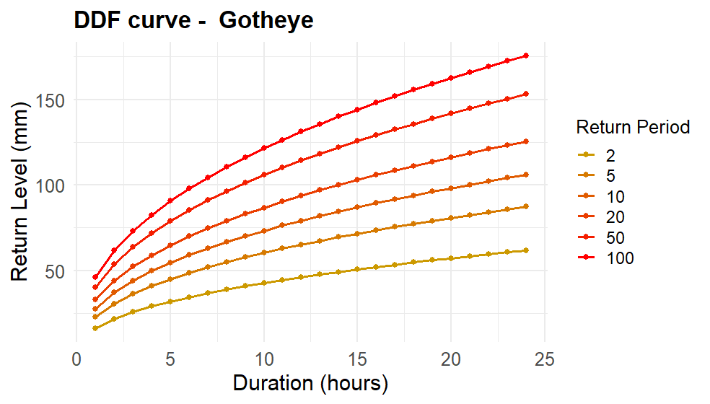
Mapping precipitation extremes for pluvial flood risk management in the Sirba river basin, Burkina Faso
Francesco Saretto¹ and Daniele Ganora¹
¹Department of Environmental, Land and Infrastructure Engineering, Politecnico di Torino, Corso Duca degli Abruzzi 24, 10129 Turin, Italy. francesco.saretto@polito.it
From Daily Point Rainfall Measurements
To Gridded Sub-Daily Extremes
Methods
1. Gridded products evaluation
2. Metastatistical Extreme Value Analysis
3. Pixel – by – pixel DDF curve computation

Slide 12
Mapping precipitation extremes for pluvial flood risk management in the Sirba river basin, Burkina Faso
Francesco Saretto¹ and Daniele Ganora¹
¹Department of Environmental, Land and Infrastructure Engineering, Politecnico di Torino, Corso Duca degli Abruzzi 24, 10129 Turin, Italy. francesco.saretto@polito.it
From Daily Point Rainfall Measurements
To Gridded Sub-Daily Extremes
Methods
1. Gridded products evaluation
2. Metastatistical Extreme Value Analysis
3. Pixel – by – pixel DDF curve computation

Slide 13
Mapping precipitation extremes for pluvial flood risk management in the Sirba river basin, Burkina Faso
Francesco Saretto¹ and Daniele Ganora¹
¹Department of Environmental, Land and Infrastructure Engineering, Politecnico di Torino, Corso Duca degli Abruzzi 24, 10129 Turin, Italy. francesco.saretto@polito.it
From Daily Point Rainfall Measurements
To Gridded Sub-Daily Extremes
Methods
1. Gridded products evaluation
2. Metastatistical Extreme Value Analysis
3. Pixel – by – pixel DDF curve computation

Slide 14
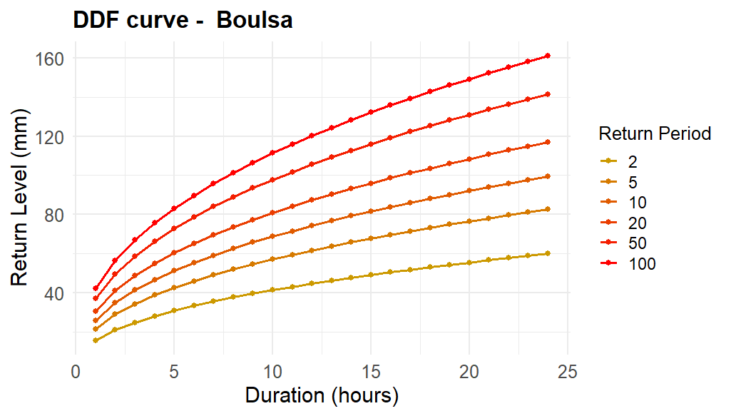
Mapping precipitation extremes for pluvial flood risk management in the Sirba river basin, Burkina Faso
Francesco Saretto¹ and Daniele Ganora¹
¹Department of Environmental, Land and Infrastructure Engineering, Politecnico di Torino, Corso Duca degli Abruzzi 24, 10129 Turin, Italy. francesco.saretto@polito.it
From Daily Point Rainfall Measurements
To Gridded Sub-Daily Extremes
Methods
1. Gridded products evaluation
2. Metastatistical Extreme Value Analysis
3. Pixel – by – pixel DDF curve computation

Slide 15
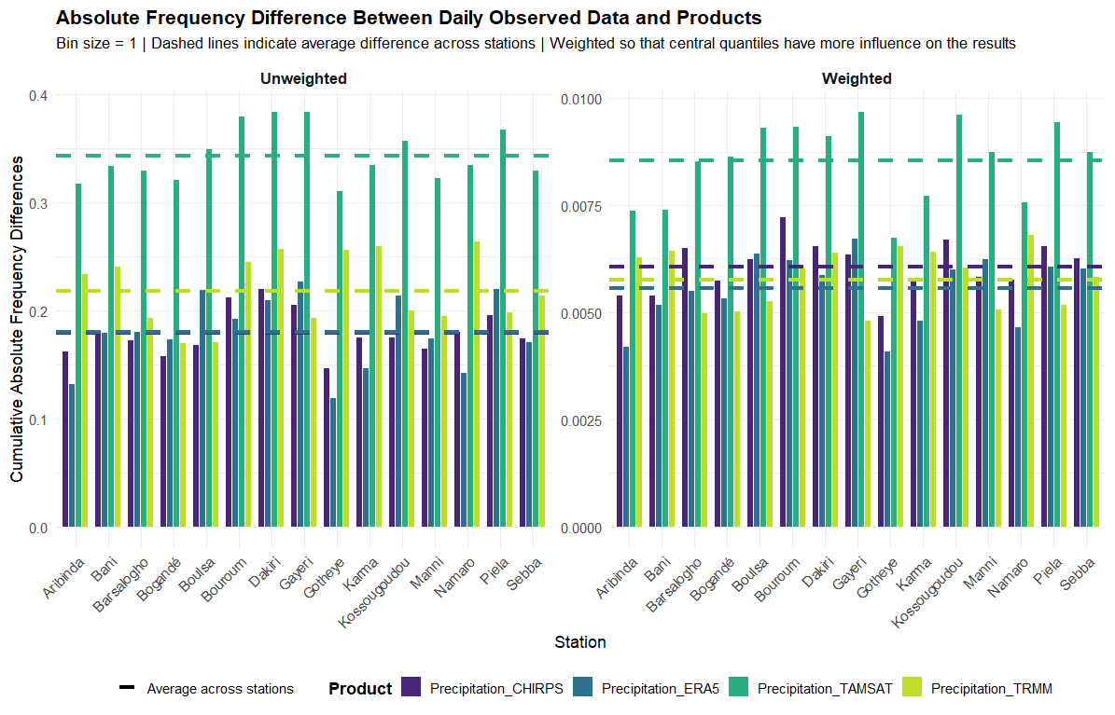

Gridded products evaluation
Available Datasets
Product | Temporal Resolution | Spatial Resolution | Availability | Product type
CHIRPS | From 6 Hours to 3 Months | 0.05° | 1981 –present | Satellite-based
ERA5 | Hourly | 0.25° | 1940 - present | Reanalysis
IMERG | Half Hourly to Monthly | 0.1° | 1998- present | Satellite-based
TAMSAT | Daily | 0.0375° | 1983 - present | Satellite-based
The most suitable dataset was not identified as the one with the highest correlation or the one with superior predictive performance. Instead, it was chosen based on the degree to which its distribution aligned with that of the observed data.
This because we applied the Metastatistical Extreme Value distribution, relying on the bulk of the distribution rather than the block maxima alone
↓
Overall, while other datasets (IMERG, CHIRPS), better represent the tail of the data, ERA5 hourly data were find to be those who better represent the overall distribution of the data.

Slide 16
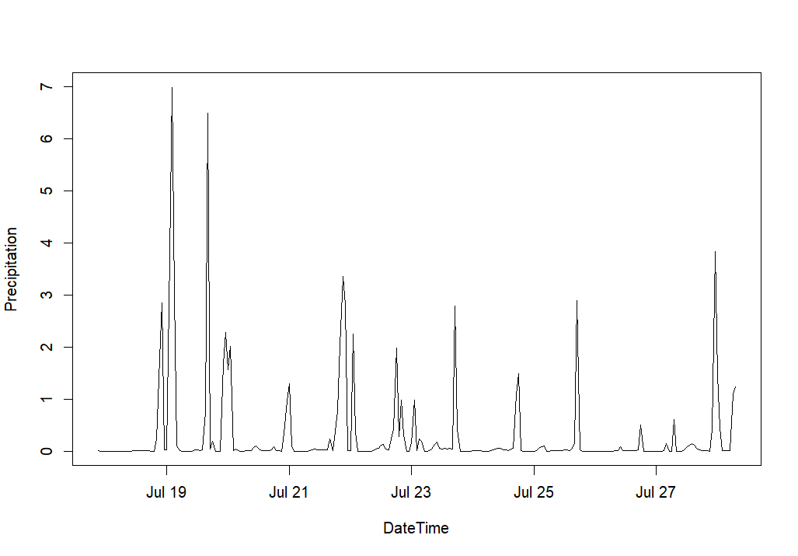


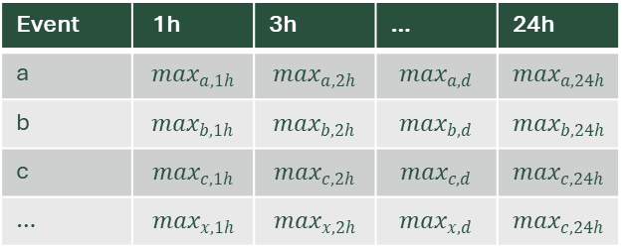
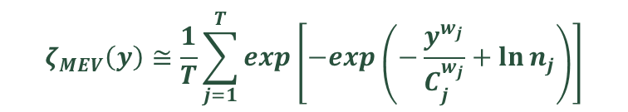


Application of the Metastatistical Extreme Value distribution
Event-based analysis on ERA5 hourly data
$$ζ_{MEV}\left(y\right)≅\frac{1}{T}\sum_{j=1}^{T}{exp\left[−exp\left(−\frac{y^{w_{j}}}{C_{j}^{w_{j}}}+\ln{n_{j}}\right)\right]}$$
a
b
Introduced by Marani and Ignaccolo (2015), the method does not require an asymptotic assumption, and accounts for the influence of the bulk of the distribution of ordinary events on the distribution of maximum values¹
c
Separation of independent events and maxima calculation for each duration and each event
$$μ_{1h}$$
$$μ_{3h}$$
$$μ_{d}$$
$$μ_{24h}$$
Event | 1h | 3h | … | 24h
a | $$\max_{a,1h}$$ | $$\max_{a,2h}$$ | $$\max_{a,d}$$ | $$\max_{a,24h}$$
b | $$\max_{b,1h}$$ | $$\max_{b,2h}$$ | $$\max_{b,d}$$ | $$\max_{b,24h}$$
c | $$\max_{c,1h}$$ | $$\max_{c,2h}$$ | $$\max_{c,d}$$ | $$\max_{c,24h}$$
… | $$\max_{x,1h}$$ | $$\max_{x,2h}$$ | $$\max_{x,d}$$ | $$\max_{c,24h}$$
Theoretical means of the rainfall heights for different durations calculated using the MEV
Used for
$$h_{d,T}=μ_{d}K_{t}$$
¹Marani, M.; Ignaccolo, M. A metastatistical approach to rainfall extremes. Adv. Water Resour. 2015, 79, 121–126

Slide 17
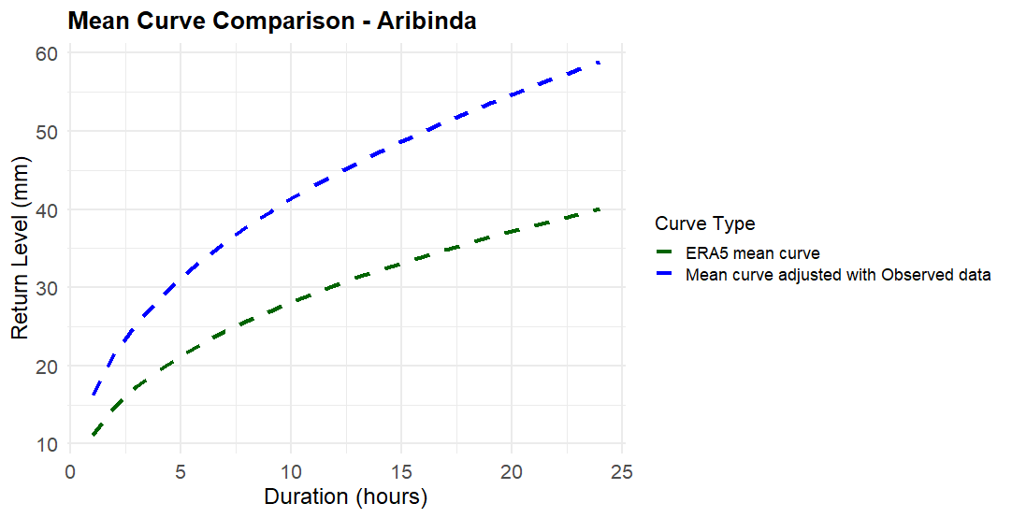
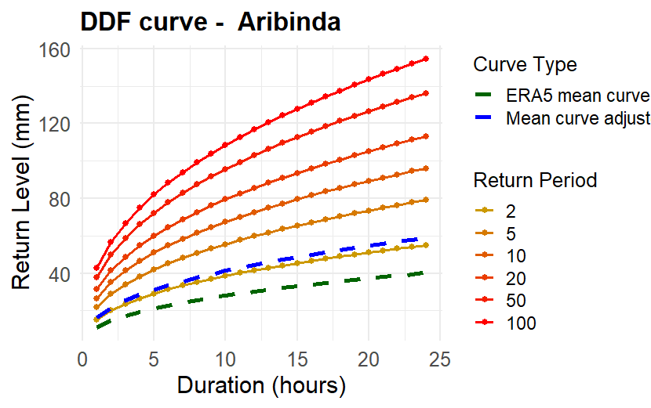




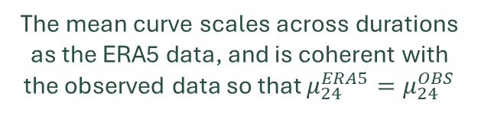
Adjusted DDF curves for each pixel
Canonical mathematical form of IDF/DDF curves
$$h_{d,T}=μ_{d}K_{t}=ad^{n}K_{t}$$
$$a^{′}=\frac{μ_{24h}^{Obs.}}{{24}^{n}}$$
$K_{T}$=$\frac{h_{24,T}^{Obs}}{μ_{24}^{Obs}}$
$n$→ from $μ_{d}^{ERA5}=ad^{n}$
The mean curve scales across durations as the ERA5 data, and is coherent with the observed data so that $μ_{24}^{ERA5}=μ_{24}^{OBS}$
The growth factor is coherent with the observed growth of daily data across return periods

Slide 18
Mapping precipitation extremes for pluvial flood risk management in the Sirba river basin, Burkina Faso
Francesco Saretto¹ and Daniele Ganora¹
¹Department of Environmental, Land and Infrastructure Engineering, Politecnico di Torino, Corso Duca degli Abruzzi 24, 10129 Turin, Italy. francesco.saretto@polito.it
Summary

Slide 19
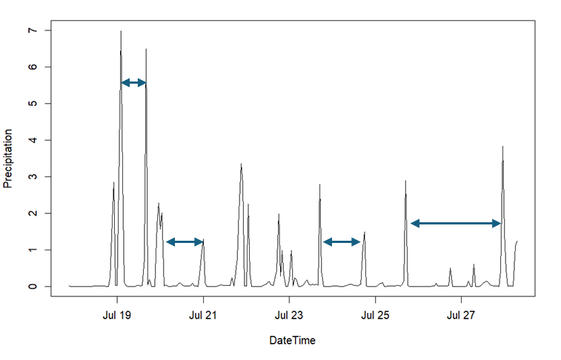
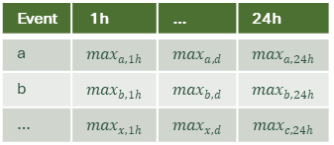
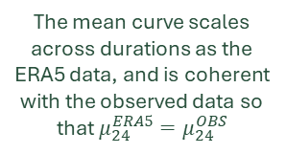


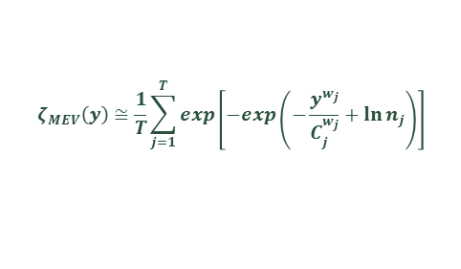
Mapping precipitation extremes for pluvial flood risk management in the Sirba river basin, Burkina Faso
Francesco Saretto¹ and Daniele Ganora¹
¹Department of Environmental, Land and Infrastructure Engineering, Politecnico di Torino, Corso Duca degli Abruzzi 24, 10129 Turin, Italy. francesco.saretto@polito.it
Daily Point Rainfall Measurements
Gridded Sub-Daily Extremes
The SLAPIS project is a multi-stakeholder effort aimed at strengthening the capacities of the hydro-meteorological services of Burkina Faso and Niger. Its goal is to develop a transboundary flood early warning system for the Sirba River basin and to enhance the understanding of fluvial and pluvial flood dynamics and risks in the Sirba River basin and along the Niger River north of Niamey.
1. Gridded products evaluation
2. Metastatistical Extreme Value Analysis
3. Adjusted DDF curves
Different gridded datasets have been evaluated on a pixel-to-point basis to assess their similarity to observed daily data. The products analysed were:
CHIRPS
ERA5
IMERG
TAMSAT
The analysis focused on the overall similarity between daily data distributions, with an emphasis on the bulk of the distribution. This approach stems from the use of a non-traditional Extreme Value Analysis method that does not focus solely on extreme values.
Event-based analysis
$$h_{d,T}=μ_{d}K_{t}=ad^{n}K_{t}$$
Event | 1h | … | 24h
a | $$\max_{a,1h}$$ | $$\max_{a,d}$$ | $$\max_{a,24h}$$
b | $$\max_{b,1h}$$ | $$\max_{b,d}$$ | $$\max_{b,24h}$$
… | $$\max_{x,1h}$$ | $$\max_{x,d}$$ | $$\max_{c,24h}$$
The mean curve scales across durations as the ERA5 data, and is coherent with the observed data so that $μ_{24}^{ERA5}=μ_{24}^{OBS}$
$n$→ from $μ_{d}^{ERA5}=ad^{n}$
$$a^{′}=\frac{μ_{24h}^{Obs.}}{{24}^{n}}$$
$K_{T}$=$\frac{h_{24,T}^{Obs}}{μ_{24}^{Obs}}$ →
$$ζ_{MEV}\left(y\right)≅\frac{1}{T}\sum_{j=1}^{T}{exp\left[−exp\left(−\frac{y^{w_{j}}}{C_{j}^{w_{j}}}+\ln{n_{j}}\right)\right]}$$
The growth factor is coherent with the observed growth of daily data across return periods
To avoid information loss, the MEV distribution has been used, leveraging all data rather than relying solely on block maxima.

