Slide 1
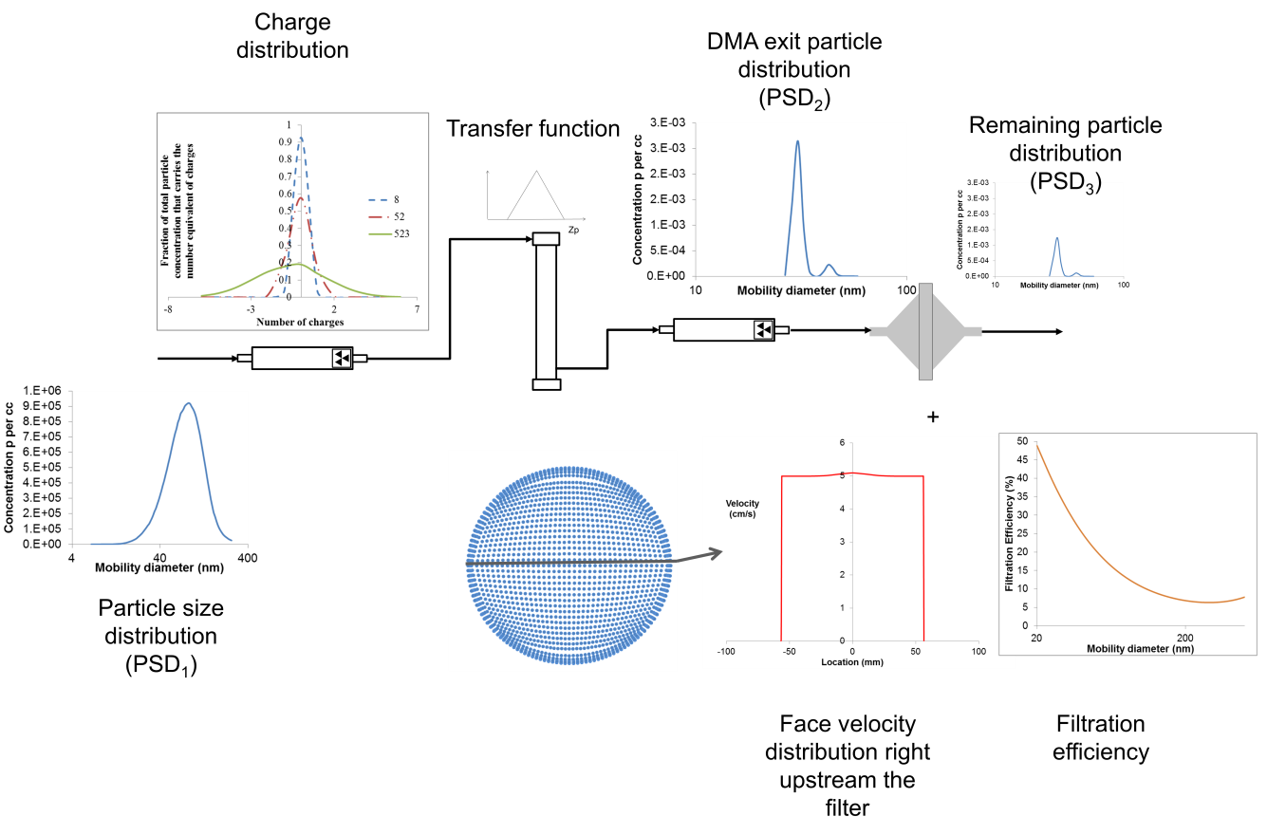


Sensitivity studies for the test method to measure the efficiency of air filtration media against nanomaterials
Panagiota Sachinidou^{1,2}, Shawn S.C. Chen³, David Y.H. Pui³, Paolo Tronville⁴, Thomas Mosimann⁵, Mikael Eriksson⁶, Jing Wang^{1,2}
¹Advanced Analytical Technologies, Empa, Dubendorf, 8600, Switzerland, ²Institute of Environmental Engineering, ETH Zurich, Zurich, 8093, Switzerland, ³University of Minnesota, USA, ⁴Politecnico di Torino, Italy, ⁵Unifil, Switzerland, ⁶Camfil, Sweden
The filtration efficiency is dependent on an assortment of physical parameters, including the face velocity, particle size, density, charging status, air temperature, pressure and relative humidity, etc. A sensitivity study investigates the change of the filtration efficiency corresponding to variation of these parameters. Part of the sensitivity study was based on the round robin test results among five different laboratories (six different filter media were measured). The aim of the study is to reveal what parameters could affect the filtration efficiency and possibly explain the deviation among the experimental data reported in the round robin test report. In addition the results are important for specification of the range of the parameters in the test method.
  Particle density effect on filtration efficiency
    Figure of merit of the tested filters /Filter inhomogeneity
The particle density plays a role in determining the inertia of the particles and therefore the impaction and gravitational settling mechanisms. The effects are not substantial for nanoparticles. Laboratories A, B and C carried out experiments for both DEHS (0.9 g/cm3) and silver particles (10.49 g/cm3) in the size range of 20–30 nm and the filtration efficiencies were compared.
DEHS and silver particles of the same electrical mobility size had almost the same filtration efficiencies (with the differences below 3->particle density did not notably affect the filtration efficiency in the size range well below 100 nm.
The averaged values of figure of merit (three different tested samples per filter) at different velocities and for the particle sizes of 45, 100, and 150 nm was calculated. The comparison can be performed for the same filter media at the same velocity and particle size. NO clear indication that the higher deviations among the experimental results were exclusively due to filter inhomogeneity.
5 cm/s |  |  |  |  |  |  | 10 cm/s |  |  | 2 cm/s
45 nm
 | wire mesh | F9 | F7 PET | F7 glass | E11 | H13 | wire mesh | F9 | F7 glass | E11 | H13
A | 0.4 | 3.9 | 6.2 | 6.6 | 3.8 | 2.9 | 0.14 | 1.7 | 2.7 | 11.8 | 9.5
E | 0.3 | 3.4 | 8.4 | 6.6 | 3.1 | 2.6 | 0.07 | 1.4 | 2.6 | 9.3 | 7.5
C | 0.3 | 4.8 | 9.9 | 8.9 | 4.8 | 3.4 | 0.12 | 1.9 | 3.4 | 15.9 | 10.9
D | 0.4 | 5.4 | 8.5 | 7.7 | 4.7 | 3.9 | 0.10 | 1.7 | 2.6 | 16.5 | 11.6
B | 0.4 | 5.2 | 9.5 | 8.1 | 4.9 | 3.1 | 0.15 | 1.8 | 3.0 | 16.0 | 10.8
100 nm
 | wire mesh | F9 | F7 PET | F7 glass | E11 | H13 | wire mesh | F9 | F7 glass | E11 | H13
A | 0.2 | 2.3 | 5.3 | 3.6 | 3.1 | 2.2 | 0.07 | 1.1 | 1.6 | 9.0 | 7.2
E | 0.1 | 2.6 | 8.1 | 4.7 | 3.3 | 2.5 | 0.05 | 1.2 | 1.9 | 8.3 | 6.3
C | 0.2 | 2.9 | 8.3 | 4.7 | 4.3 | 2.6 | 0.05 | 1.1 | 1.9 | 12.6 | 8.3
D | 0.2 | 3.0 | 6.6 | 3.9 | 3.8 | 2.8 | 0.04 | 1.0 | 1.3 | 11.9 | 8.6
B | 0.2 | 3.1 | 8.2 | 4.1 | 3.9 | 2.4 | 0.07 | 1.1 | 1.6 | 11.5 | 8.0
150nm
 | wire mesh | F9 | F7 PET | F7 glass | E11 | H13 | wire mesh | F9 | F7 glass | E11 | H13
A | 0.2 | 2.1 | 5.6 | 2.9 | 3.3 | 2.1 | 0.05 | 1.0 | 1.4 | 8.6 | 6.7
E | 0.1 | 2.2 | 8.7 | 3.8 | 3.2 | 2.1 | 0.03 | 1.0 | 1.5 | 8.2 | 6.5
C | 0.1 | 2.7 | 8.3 | 4.0 | 4.6 | 2.6 | 0.05 | 1.1 | 1.7 | 12.8 | 8.0
D | 0.1 | 2.6 | 6.2 | 3.3 | 4.1 | 2.7 | 0.04 | 1.0 | 1.1 | 11.6 | 8.1
B | 0.1 | 2.7 | 8.9 | 3.4 | 4.1 | 2.5 | 0.05 | 1.0 | 1.4 | 11.6 | 7.5
A S1 Silver
A S2 Silver
A S3 Silver
C S1 Silver
C S2 Silver
C S3 Silver
B S1 Silver
B S2 Silver
A S1 DEHS
A S2 DEHS
A S3 DEHS
C S1 DEHS
C S2 DEHS
C S3 DEHS
B S1 DEHS
B S2 DEHS
A S1 Silver
A S2 Silver
A S3 SilverB
B S1 Silver
B S2 Silver
A S1 DEHS
A S2 DEHS
A S3 DEHS
B S1 DEHS
B S2 DEHS
    Temperature and relative humidity effect on filtration efficiency
The temperature affects the diffusion coefficient of the particles affecting the filtration efficiency. The variation was not expected to be wide since the tests were at room conditions, thus the temperature effect was expected to be limited. The relative humidity affects the air density, thus, it might also affect the filtration efficiency.
The range of temperature was about 20-30 ◦C and 7-50 % for relative humidity. Results were analyzed with multiple regression, using the built-in function in Excel, so as to quantify the relationship among the parameters and the filtration efficiency. No definitive indication that temperature and relative humidity affected the filtration efficiency in these ranges, as Kim et al. (2006) and Yang and Lee (2004) concluded as well.
 | P-value
 | Temperature [°C] | RH [%]
20 | 0.51 | 0.96
30 | 0.43 | 0.38
45 | 0.11 | 0.13
67 | 0.62 | 0.99
100 | 0.92 | 0.64
150 | 0.13 | 0.13
224 | 0.07 | 0.23
335 | 0.92 | 0.09
500 | 0.06 | 0.34
    Challenging particle size distribution, SAFR and neutralization efficiency
Indicative regression analysis results ( wire mesh at 5cm/s)
When the DMA is used as a classifier, its set parameters should be studied to ensure the minimization of the measurement artifacts.
Sheath to aerosol flow ratio (SAFR) could affect the monodispersity of the challenging particle flow based on the generated particle size distribution. According to Sachinidou et al. (2017), a SAFR ratio above five could minimize the artifacts due to this factor for the investigated filtration tests. In addition, neutralization efficiency for the particles entering the DMA was crucial so as to avoid bigger multiply charged particles to enter the challenging particle flow. Challenging particle distribution can affect the results for a SFAR below 5.
Concentration of the challenging aerosol effect on filtration efficiency
Concentration may affect the filtration efficiency depending on the range. If the challenging aerosol concentration was too high, there could be particle agglomeration or loading effect on the filter which might affect the filtration efficiency (Kim et al. (2009), Buha et al. (2013)).The correlation coefficient was calculated using the correlation function in Excel-> No clear indication that the challenging particle concentration affected the filtration efficiency in the range of tens to tens of millions particles per cc(correlation coefficient below 0.5).
Integrative model developed in MATLAB to study challenging particle distribution, SFAR and neutralization efficiency in filtration efficiency
Concentration range
 | Wire mesh 5 cm/s |  | Wire mesh 10 cm/s |  | F7 PET 5cm/s |  | F7 PET 10cm/s |  | F7 glass 5cm/s |  | F7 glass 10cm/s |  | F9 5 cm/s |  | F9 10 cm/s |  | E11 2 cm/s |  | E11 5 cm/s |  | H13 2cm/s |  | H13 5 cm/s
 | min | max | min | max | min | max | min | max | min | max | min | max | min | max | min | max | min | max | min | max | min | max | min | max
20 | 141 | 3000 | 140 | 18019 | 62 | 7611 | 54 | 1884 | 57 | 5588 | 61 | 2521 | 55 | 7074 | 110 | 2521 | 48 | 1576341 | 63 | 8753 | 53 | 1576341 | 425 | 5959
30 | 687 | 11856 | 664 | 101202 | 638 | 20109 | 387 | 8602 | 548 | 24542 | 331 | 8279 | 793 | 19222 | 444 | 9938 | 910 | 3824784 | 764 | 21589 | 795 | 3824784 | 727 | 18578
45 | 1538 | 51569 | 3215 | 347868 | 5426 | 35418 | 962 | 27437 | 3033 | 60091 | 1463 | 27734 | 4130 | 34020 | 3114 | 30264 | 7334 | 9047887 | 4123 | 37781 | 6684 | 9047887 | 3981 | 36640
67 | 2626 | 118583 | 4532 | 637926 | 8297 | 46759 | 6330 | 35399 | 6949 | 46414 | 2177 | 40807 | 4671 | 44936 | 8299 | 31245 | 23368 | 11264414 | 9113 | 46329 | 21617 | 11264414 | 7454 | 47356
100 | 1067 | 155967 | 3886 | 473329 | 5093 | 43415 | 2749 | 44390 | 6424 | 40444 | 1871 | 44925 | 927 | 17632 | 5030 | 39441 | 32765 | 4866278 | 3084 | 49584 | 32004 | 4866278 | 1744 | 46300
150 | 106 | 83695 | 50 | 1755276 | 116 | 23006 | 98 | 22492 | 119 | 20287 | 90 | 23589 | 99 | 8598 | 89 | 21844 | 5749 | 55606 | 97 | 31778 | 5749 | 56627 | 296 | 25658
224 | 107 | 37473 | 50 | 707953 | 115 | 39430 | 126 | 23256 | 119 | 34175 | 172 | 14556 | 100 | 37591 | 170 | 27504 | 3686 | 124200 | 99 | 40995 | 5317 | 65583 | 299 | 39567
335 | 52 | 15326 | 25 | 109787 | 58 | 16102 | 105 | 7604 | 59 | 13496 | 142 | 4348 | 50 | 15471 | 140 | 8190 | 635 | 46040 | 49 | 16412 | 913 | 24601 | 138 | 16602
500 | 35 | 6967 | 15 | 15257 | 38 | 3723 | 21 | 4044 | 39 | 2711 | 30 | 714 | 33 | 4634 | 54 | 1861 | 186 | 9960 | 20 | 3618 | 204 | 5218 | 93 | 4101
 | wire mesh |  | NP 3 μm |  | F7 PET |  | F7 PET discharged |  | M5 |  | F9 |  | F7 glass |  | E11 |  | H13
 | 5 cm/s | 10cm/s | 5 cm/s | 10cm/s | 5 cm/s | 10cm/s | 5 cm/s | 10cm/s | 5 cm/s | 10cm/s | 5 cm/s | 10cm/s | 5 cm/s | 10cm/s | 2cm/s | 5 cm/s | 2cm/s | 5 cm/s
20 | 0.12 | 0.84 | -0.23 | 0.02 | -0.19 | -0.14 | 0.07 | 0.30 | 0.04 | 0.24 | -0.32 | 0.17 | 0.06 | 0.19 | -0.47 | -0.47 | -0.99 | 0.40
30 | 0.13 | 0.88 | -0.51 | -0.06 | -0.10 | -0.33 | 0.00 | 0.36 | 0.09 | 0.13 | -0.17 | -0.10 | -0.07 | 0.20 | -0.95 | -0.95 | -0.99 | 0.07
45 | 0.09 | 0.71 | -0.70 | -0.11 | -0.29 | -0.20 | -0.10 | 0.18 | -0.67 | -0.01 | -0.05 | -0.22 | -0.20 | -0.06 | -0.93 | -0.93 | -1.00 | 0.21
67 | 0.36 | 0.75 | -0.47 | -0.07 | 0.06 | 0.21 | 0.06 | 0.23 | -0.63 | 0.24 | 0.32 | 0.56 | 0.09 | 0.25 | 0.11 | 0.11 | -1.00 | 0.40
100 | 0.13 | 0.86 | 0.43 | 0.17 | 0.39 | 0.49 | -0.18 | 0.52 | 0.29 | 0.32 | 0.64 | 0.53 | 0.31 | 0.46 | -0.04 | -0.04 | -0.99 | 0.44
150 | 0.28 | -0.23 | 0.41 | -0.80 | -0.06 | 0.18 | -0.42 | 0.34 | 0.50 | 0.11 | 0.36 | 0.61 | 0.23 | 0.39 | 0.49 | 0.49 | 0.64 | 0.57
224 | -0.04 | 0.34 | 0.48 | 0.15 | -0.84 | 0.46 | -0.46 | -0.04 | -0.17 | 0.46 | 0.08 | 0.07 | -0.61 | -0.40 | -0.78 | -0.78 | 0.50 | 0.51
335 | 0.01 | 0.28 | 0.29 | 0.52 | -0.90 | 0.23 | -0.47 | 0.17 | -0.42 | 0.60 | -0.67 | -0.46 | -0.75 | -0.43 | -0.73 | -0.73 | 0.43 | 0.40
500 | 0.72 | -0.11 | -0.06 | 0.79 | -0.87 | -0.43 | -0.65 | -0.08 | -0.51 | 0.69 | -0.57 | -0.42 | -0.80 | -0.68 | -0.10 | -0.10 | 0.27 | 0.44
Correlation coefficient
Results
    Flow distribution
    Charge on the filter
Flow distribution depends on the filter holder geometry, thus the filter holder size and shape could possibly affect the flow velocity distribution. No obvious link between the filter surface area and filtration efficiency if the filter medium was highly uniform according to the experimental and CFD results (Sachinidou et al. (2017).
Filtration efficiency is highly reduced by discharging the filter when diffusion is not the main filtration mechanism.
Filtration efficiency of the wire mesh at 5 cm/s measured in filter holders with different areas
Profile of the face velocity distribution immediately upstream the filter (CFD analysis`). X is the radial distance from the filter center.
References:
[1] Buha J, Fissan H, Wang J (2013). Filtration behavior of silver nanoparticle agglomerates and effects of the agglomerate model in data analysis. J Nanopart Res 15:1709. doi:10. 1007/s11051-013-1709-zDhaniyala, S., and Liu, B. Y. H. (1999). Investigations of Particle Penetration inFibrous Filters: Part II. Theoretical, Journal of the IEST42(2):40-46.
[2] Kim, C.S., Bao, L. Okuyama, K., Shimada, M., Niinuma, H. (2006). Filtration efficiency of a fibrous filter for nanoparticles. Journal of Nanoparticle Research, 8 p. 215–221.
[3] Kim SC, Wang J, Emery M, Shin WG, Mulholland G, Pui DYH (2009). Structural property effect of na-noparticle agglomerate on particle penetration through fibrous filter. AerosolSci Technol 43:344–355. doi:10.1080/02786820802653763.
[4] Sachinidou, P., Bank, Y.K, Wang, J. (2017) An integrative model for the filtration efficiencies in realistic tests with consideration of the filtration velocity profile and challenging particle size distribution. Aerosol Science and Technology, 51:2, 178 – 187, DOI: 10.1080/02786826.2016.1254720.
[5] Yang, Shinhao & Lee, Grace W.M. (2004). Filtration characteristics of a fibrous filter pretreated with anionic surfactants for monodisperse solid aerosols. J. Aerosol Science 36 (2005) 419–437.
Professor Dr. Jing Wang
Chair of Air Quality & Particle Technology

