Slide 1
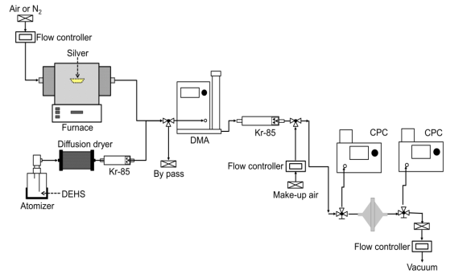
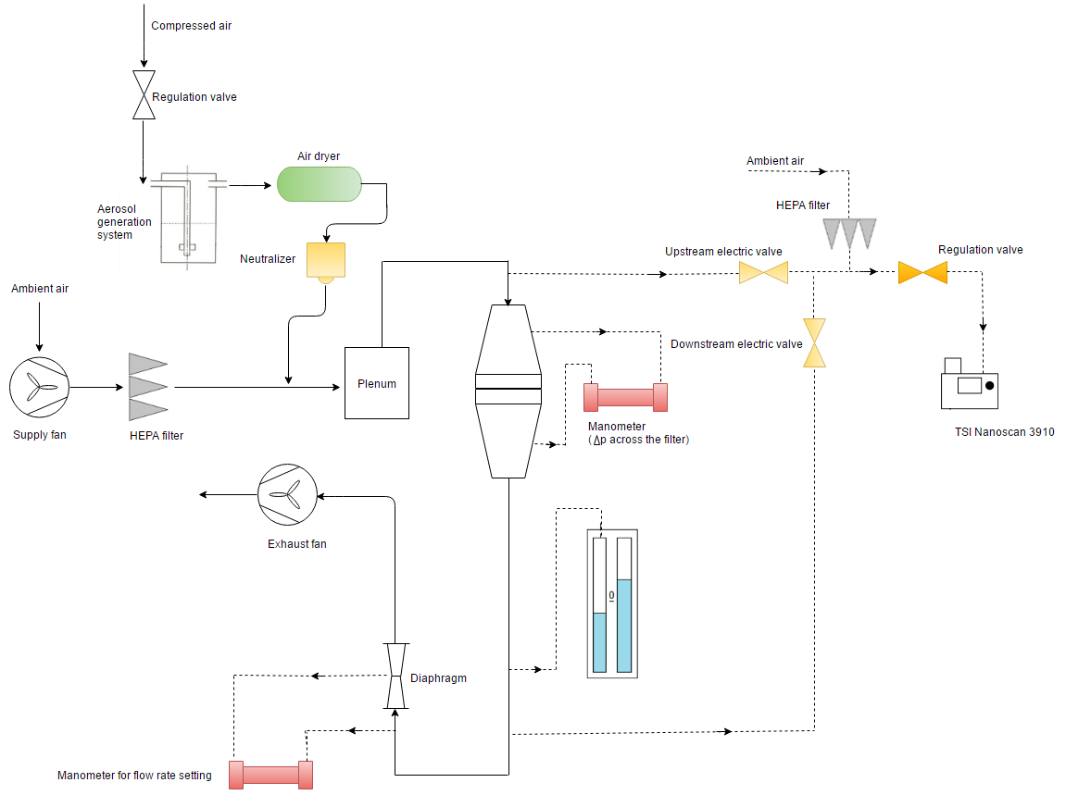



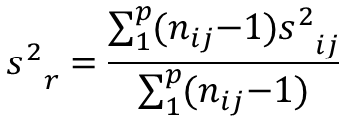
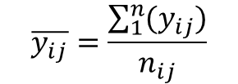
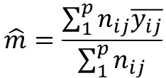



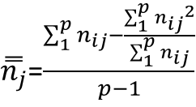
Test method to measure the efficiency of air filtration media against spherical nanomaterials from 3 to 500 nm
Panagiota Sachinidou^{1,2}, Shawn S.C. Chen³, David Y.H. Pui³, Paolo Tronville⁴, Thomas Mosimann⁵, Mikael Eriksson⁶ , Jing Wang^{1,2}
¹Advanced Analytical Technologies Empa, Dubendorf, 8600, Switzerland, ²Institute of Environmental Engineering, ETH Zurich, Zurich, 8093, Switzerland, ³University of Minnesota, USA, ⁴Politecnico di Torino, Italy, ⁵Unifil, Switzerland, ⁶Camfil, Sweden
The filtration of airborne nanoparticles is becoming an important issue as they are produced in large quantities from material synthesis and combustion emission. Current international standards dealing with efficiency test for filters and filter media focus on measurement of the minimum efficiency at the most penetrating particle size. The available knowledge and instruments provide a solid base for development of test methods to determine the effectiveness of filtration media against airborne nanoparticles down to single-digit nanometer range. An interlaboratory evaluation is performed under the Technical Committee 195 of European Committee for Standardization (CEN/TC195) for the development of the methodology to determine effectiveness of filtration media against air-borne particles in the 3 – 500 nm range. Five different laboratories, ETH/Empa, University of Minnesota (UMN), Politecnico di Torino (Polito), Unifil and Camfil participate in the round robin test in order to ensure the accuracy of the test method and provide a characterization of the filter media filtration efficiency by performing statistical analysis according to ISO 5725-2.
Test setup schematics with monodisperse challenging aerosol & with polydisperse challenging aerosol
Statistical Analysis
Statistical analysis is performed based on ISO 5725-2. In the beginning, statistical tests, to note the stragglers and/or outliers, are implicated. Into more details, three different tests are used; Mandel’s h & k statistics, Cohran’s and Grubb’s test.
Compute:
Mandel’s h & k statistics
Cohran’s & Grub’s statistics
monodisperse
Test statistics
≤ h_{5%,}k_{5%} ,C_{5%} ,G_{5%}
No
Test statistics ≤ h_{1%,}k_{1%} ,C_{1%} ,G_{1%}
No
Test item is a statistical outlier ; Should be excluded
Yes
Yes
Laboratory A, B, C and D
Test item accepted as correct
Test item is called straggler
The approved data from the aforementioned tests are applied to calculate the final filtration efficiency $\overline{y_{ij}}$ and the standard deviation $S_{ij}$ of each lab.
$$\overline{y_{ij}}=\frac{\sum_{1}^{n}{{(y}_{ij})}}{n_{ij}}$$
The subscript i is for the lab, j is for the particle size.n_{ij} represents the number of the tested samples.
$S_{ij}=\frac{\sum_{1}^{n}{{{(y}_{ij}−\overline{y_{ij}})}^{2}}}{n_{ij}−1}$
polydisperse
Using the final filtration efficiency and standard deviation of each lab the characterization of filter media is performed.
$$\hat{m}=\frac{\sum_{1}^{p}{n_{ij}\overline{y_{ij}}}}{\sum_{1}^{p}{n_{ij}}}$$
$${s_{}^{2}}_{r}=\frac{\sum_{1}^{p}{{(n}_{ij}{{−1)s}_{}^{2}}_{ij}}}{\sum_{1}^{p}{{(n}_{ij}−1)}}$$
${s_{}^{2}}_{L}$=$\frac{{s_{}^{2}}_{d}−{s_{}^{2}}_{r}}{\overset{̿}{n_{j}}}$
${s_{}^{2}}_{R}={s_{}^{2}}_{r}$+${s_{}^{2}}_{L}$
General mean
Repeatability variance within lab and averaged between all participated labs
Between laboratory variance
Reproducibility variance
Laboratory E
$\overset{̿}{n_{j}}$=$\frac{\sum_{1}^{p}{n_{ij}−\frac{\sum_{1}^{p}{{n_{ij}}^{2}}}{\sum_{1}^{p}{n_{ij}}}}}{p−1}$
Indicative filtration efficiency test results
${s_{}^{2}}_{d}$=$\frac{\sum_{1}^{p}{{n_{ij}\overline{{(y}_{ij}}−\overset{̿}{y_{j}})}^{2}}}{p−1}$
Six different filters were tested in five different laboratories at 2, 5 and 10 cm per s. Three different filters samples were tested from each filter and the filtration efficiency was measured three times for each particle diameter. Two different types of challeging particles were used ; DEHS in the size range of 20-500 nm and Silver in the size range of 3-30nm.
Relative reproducibility and repeatibilty deviation as a fraction of the average efficiency
Average filtration efficiency for every tested filter media
DEHS
Silver
 | wire mesh |  | F7 PET |  | F7 glass |  | F9 |  | E11 |  | H13
Velocity (cm/s) | 5 | 10 | 5 | 10 | 5 | 10 | 5 | 10 | 2 | 5 | 2 | 5
DEHS
20 | 43.2 | 25.5 | 96.9 | 91.5 | 97.2 | 94.6 | 97.8 | 94.6 | 99.8 | 98.6 | 100.0 | 100.0
30 | 27.0 | 18.4 | 92.4 | 86.5 | 92.1 | 87.2 | 94.6 | 87.2 | 99.3 | 96.4 | 100.0 | 100.0
45 | 17.0 | 11.7 | 88.7 | 77.1 | 83.2 | 76.7 | 88.3 | 76.7 | 97.5 | 93.2 | 100.0 | 100.0
67 | 11.7 | 7.9 | 84.2 | 73.3 | 73.5 | 67.6 | 80.2 | 67.6 | 95.6 | 90.9 | 100.0 | 100.0
100 | 8.1 | 5.7 | 83.8 | 71.6 | 63.8 | 62.0 | 71.0 | 62.0 | 94.4 | 90.3 | 100.0 | 99.9
150 | 7.2 | 4.7 | 85.4 | 68.4 | 57.0 | 58.1 | 66.7 | 58.1 | 94.2 | 91.4 | 100.0 | 99.9
224 | 6.3 | 4.5 | 86.0 | 66.9 | 54.1 | 61.3 | 67.5 | 61.3 | 95.6 | 94.6 | 100.0 | 100.0
335 | 7.6 | 4.2 | 88.0 | 69.5 | 57.7 | 69.5 | 73.4 | 69.5 | 97.4 | 97.2 | 100.0 | 100.0
Silver
3 | 98.7 |  | 100.0 |  |  |  | 100.0 |  |  | 100.0
5 | 98.8 |  |  |  |  |  | 100.0
8 | 89.8 |  | 100.0 |  | 100.0 |  | 100.0 |  | 100.0 | 100.0
10 | 81.0 |  | 99.9 |  | 99.9 |  | 99.9 |  | 100.0 | 99.9 | 100.0 | 100.0
15 | 60.6 |  | 99.5 |  | 99.4 |  | 99.6 |  | 100.0 | 99.6 | 100.0 | 100.0
20 | 47.3 |  | 98.3 |  | 98.7 |  | 98.8 |  | 99.9 | 98.8 | 100.0 | 100.0
25 | 37.6 |  | 96.8 |  | 97.3 |  | 97.6 |  | 99.7 | 97.9 | 100.0 | 100.0
30 | 31.3 |  | 95.1 |  | 95.7 |  | 96.1 |  | 99.4 | 96.5 | 100.0 | 100.0
The experimental results from laboratories A, B and C had low variances. The results from Laboratory D showed high within laboratory deviation, regardless the particle size or face velocity, which could be attributed to a problem in their setup affecting the repeatability. Laboratory E often measured lower filtration efficiency compared to other laboratories.
There were limited outliers for all the filters and in the whole particle size range regardless the challenging particle material. The repeatability deviation was mostly less than 0.1 of the absolute efficiency regardless the particle size, face velocity or challenging particle material. The only exception is for the wire mesh because filtration efficiency is low, thus, the error can highly contribute to the deviation. The reproducibility deviation was more significant. Deviations for the silver particles were smaller compared to the DEHS because only the three laboratories with the same setup (monodisperse challenging particles) participated. Also, the filtration efficiency is higher for smaller particles, thus, experimental errors are not so important compared to the absolute magnitude of the efficiency. Possible contributors of these deviations included the inhomogeneity of the filter media samples, different instruments and experimental setups in the participating laboratories, inherent instrument uncertainties, etc.
References:
[1] International Organization for Standardization (1994) ISO 5725-2:1994(E) “Accuracy (trueness and precision) of meas-urement methods and results -- Part 1: General principles and definitions”.
[2] International Organization for Standardization (1994) ISO 5725-2:1994(E) “Accuracy (trueness and precision) of meas-urement methods and results -- Part 2: Basic method for de-termination of repeatability and reproducibility of a standard measurement method”.
[3] International Organization for Standardization (2016) ISO/FDIS 16890-2:2016(E)“ Air filters for general ventilation -- Part 4: Conditioning method to determine the minimum fractional test efficiency ”.
Professor Dr. Jing Wang
Chair of Air Quality & Particle Technology

