Slide 1
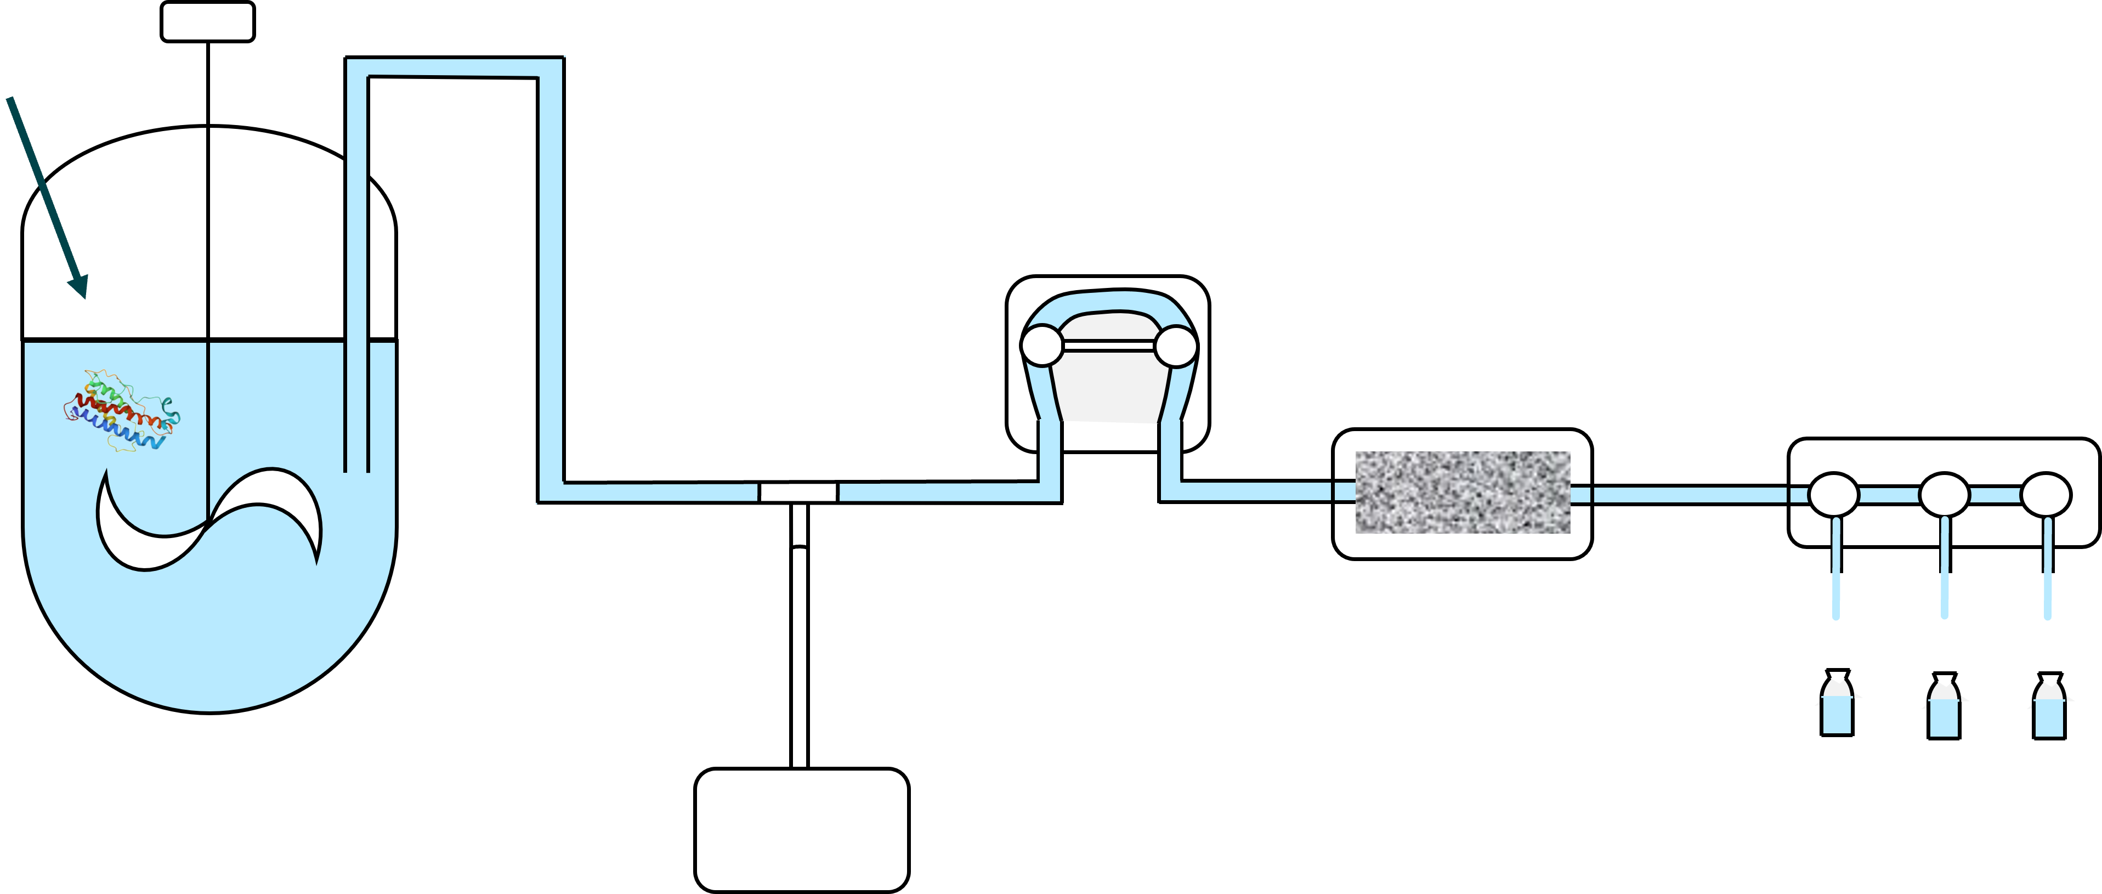
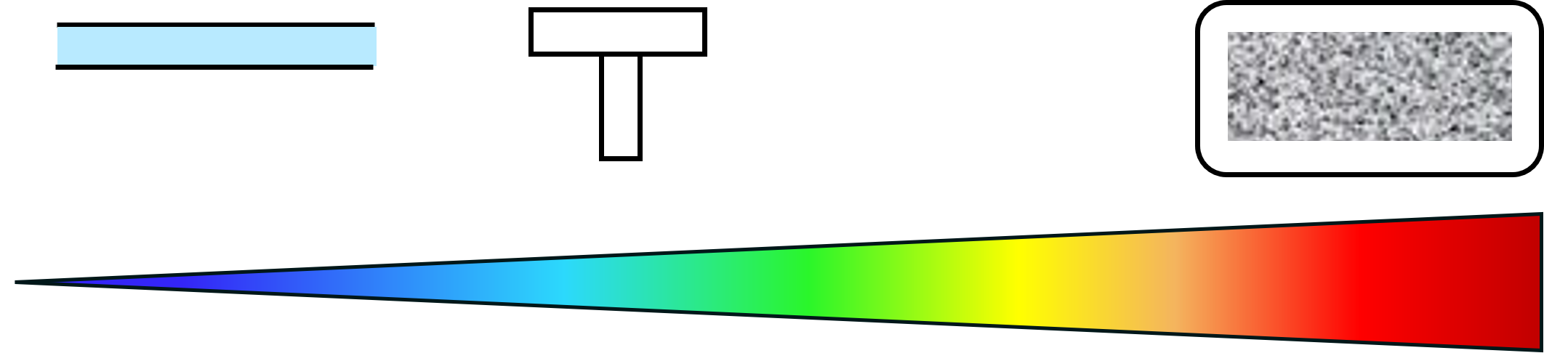
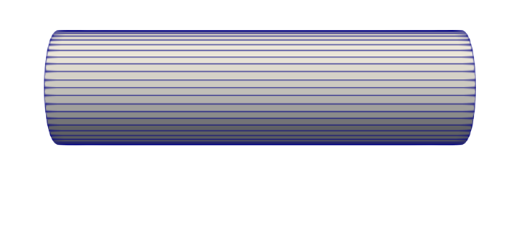
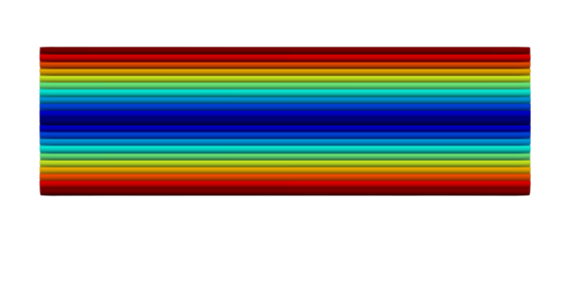
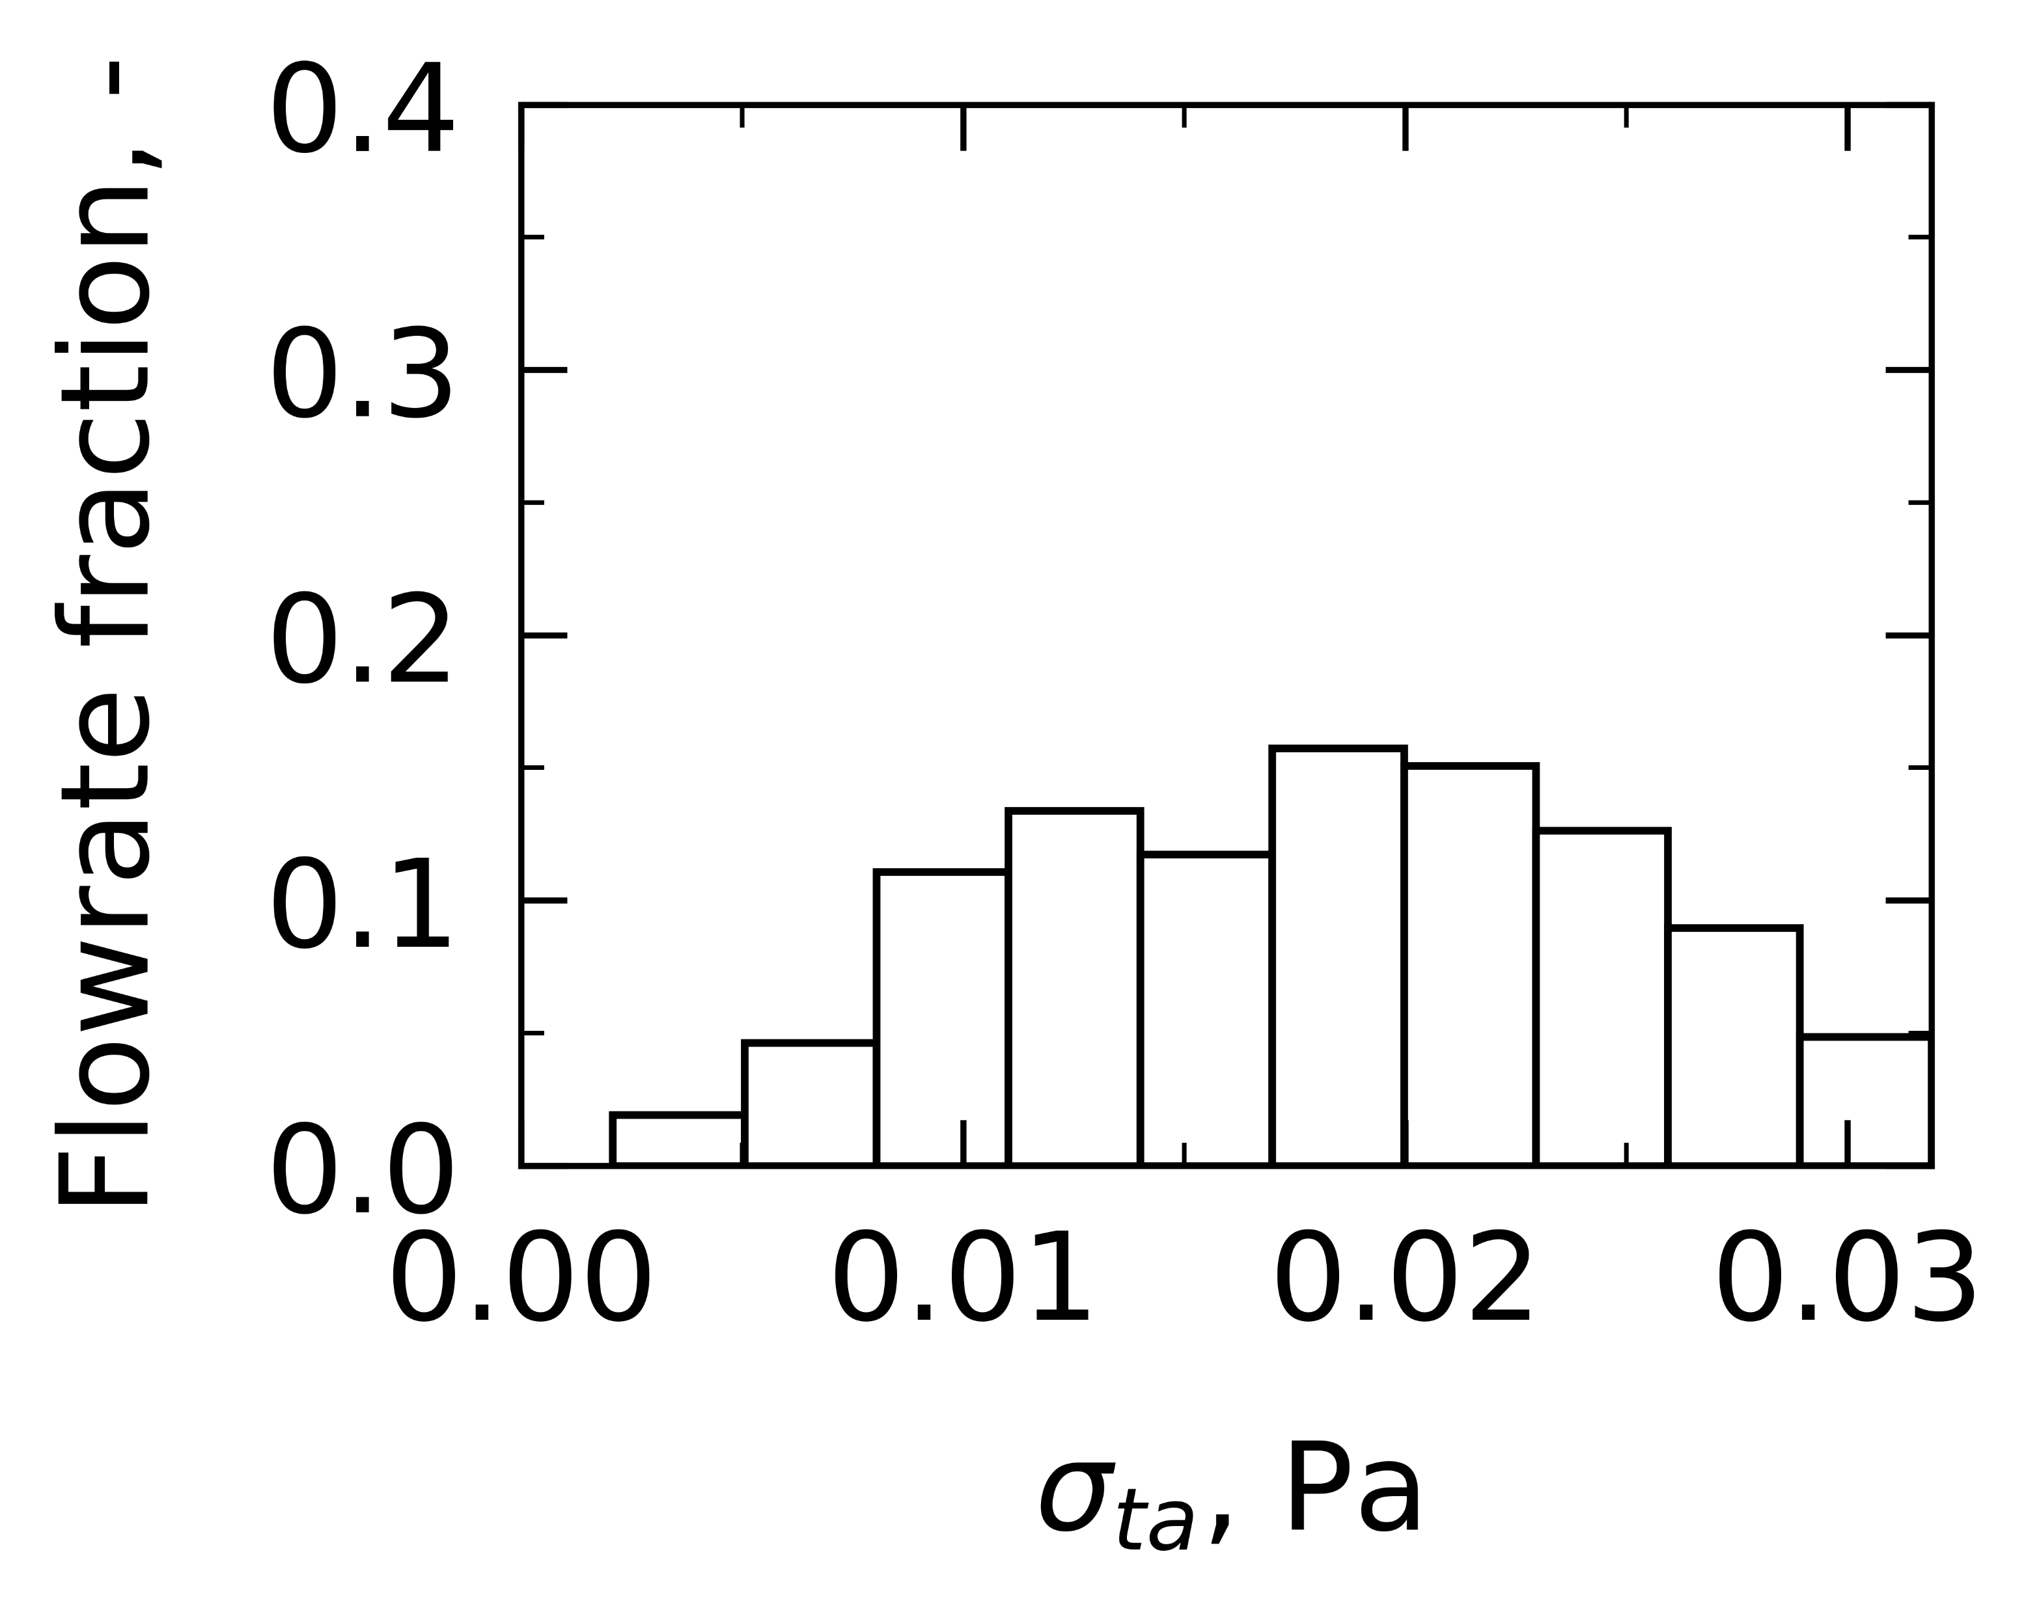
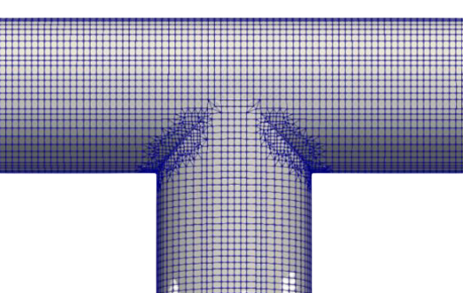
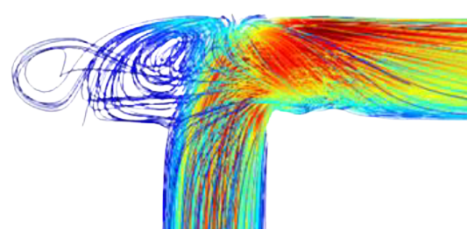
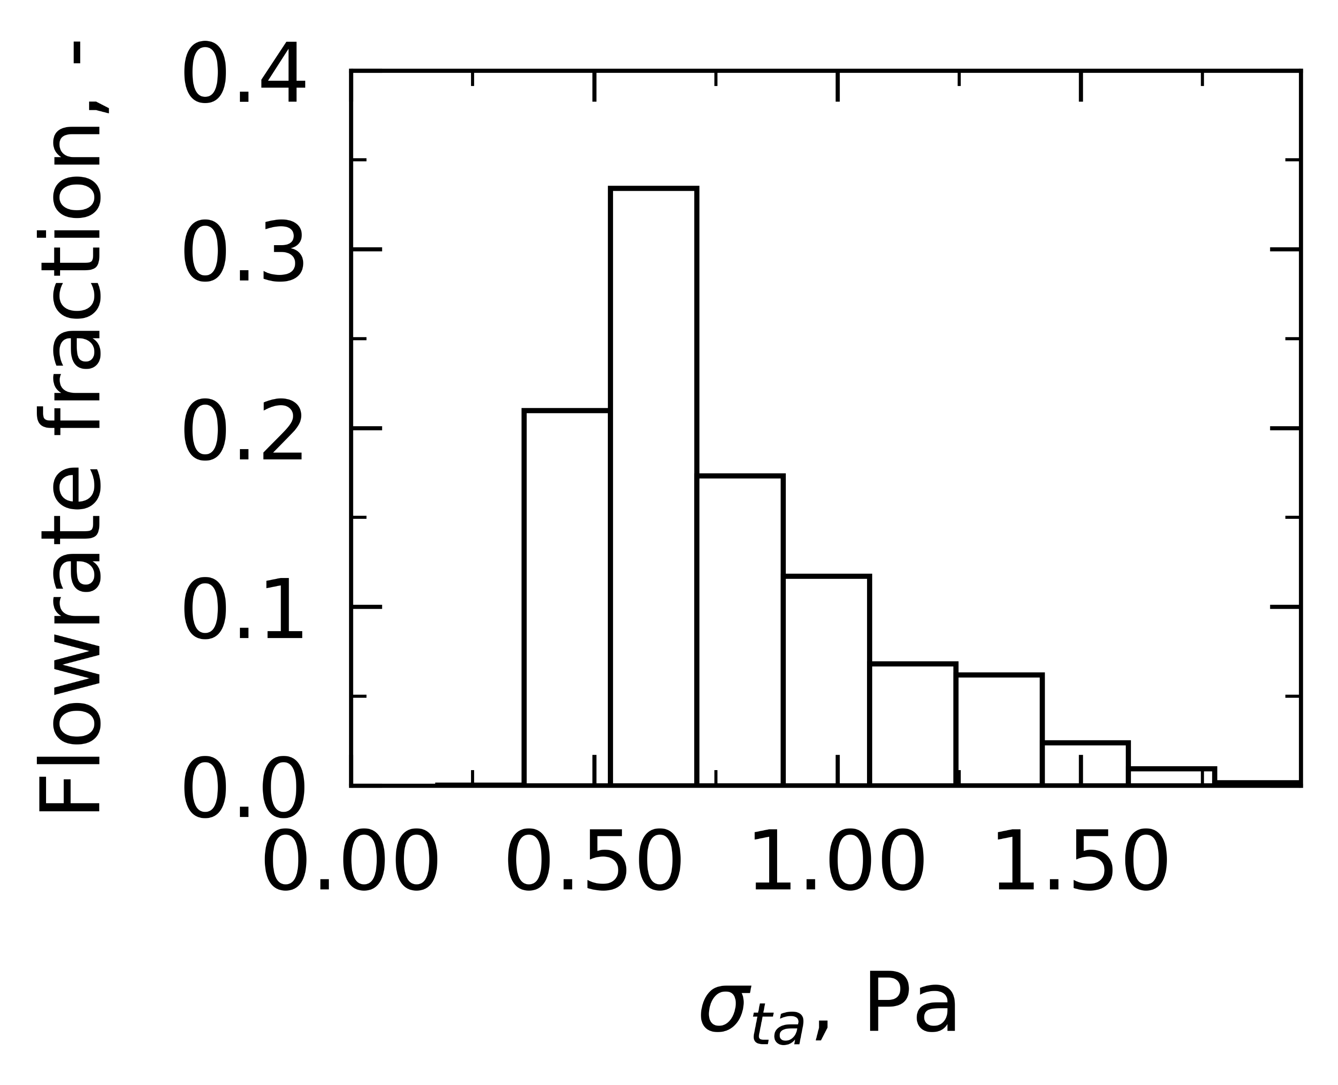
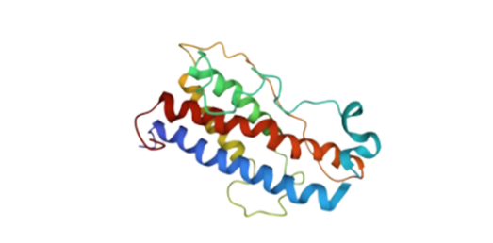
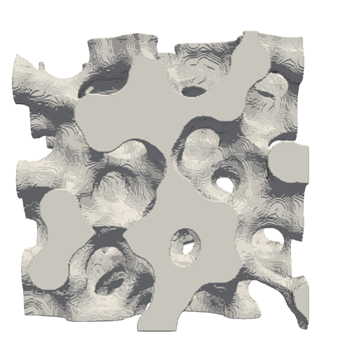
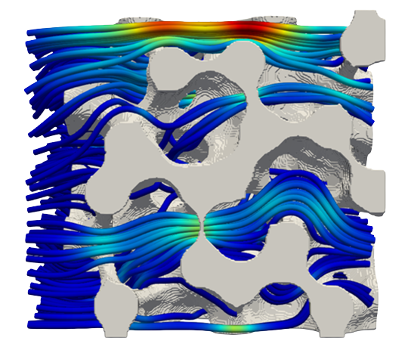


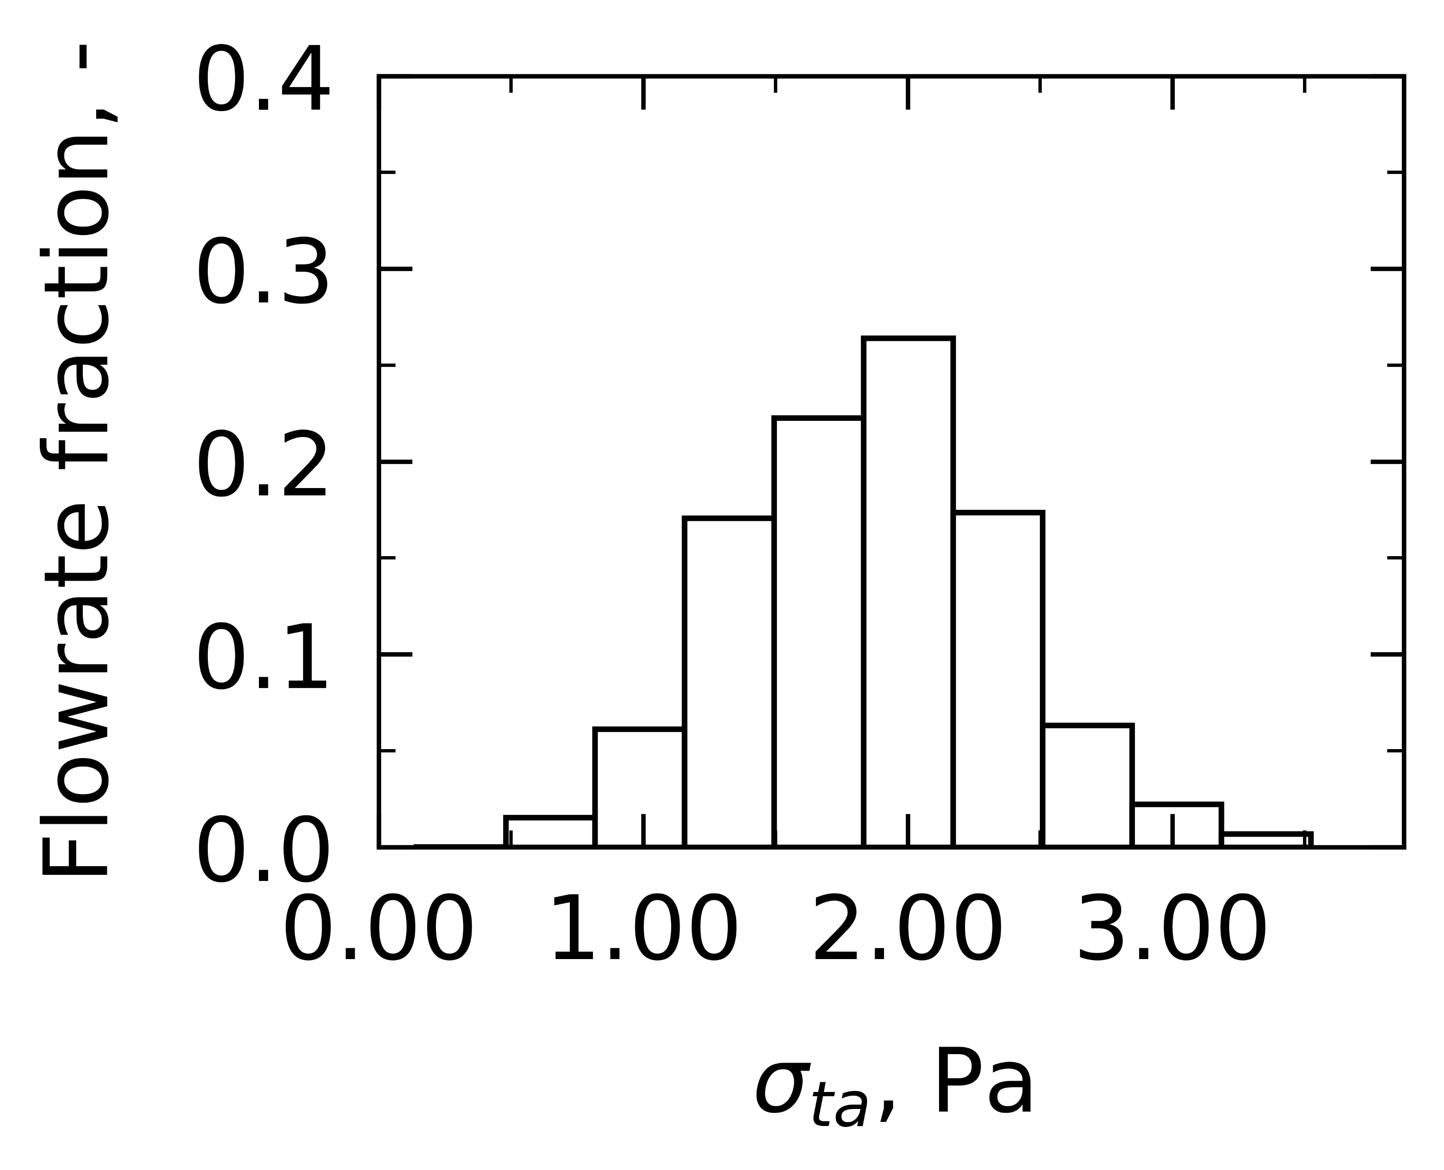


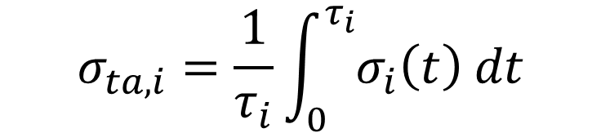
M0930-09-61
Scale-down modeling of the filling process for protein-based parenteral drug products
Camilla Moino 1, Bernadette Scutellà 2, Andrea Albano 3, Marco Bellini 2, Erwan Bourlès 2, Gianluca Boccardo 1, Roberto Pisano 1
1 DISAT, Politecnico di Torino, Italy
2 GSK, Rixensart, Belgium
3 GSK, Siena, Italy
camilla.moino@polito.it, bernadette.z.scutella@gsk.com, roberto.pisano@polito.it
PURPOSE
Protein-based parenteral drug products are exposed to high velocity gradients during standard filling operations. These gradients result in high shear stresses, generally believed to affect product stability.
Here, Computational Fluid Dynamics (CFD) modeling is used to analyse the fluid dynamics within some of these operations and quantify shear stress exposure, as a first step for broader experimental investigation.
In addition, scale-down strategies are proposed to scale the industrial process down to the laboratory scale while preserving the shear stress exposure to the product.
RESULT(S)
As the product flows through the line, a workflow is developed to model the component and analyse the fluid dynamics. Particles are tracked through their trajectories and their shear history is detected and accounted to estimate an average shear stress.
Conclusion(s)
Shear stress exposure has been estimated for a product when processed through a filling line.
It was found that the extent of shear stress is variable, with the filtration being the most stressing operation yet for a short period of time.
Next, the effect of such shear stresses on the product stability could be further investigated with experimental campaigns.
PROTEIN-BASED PARENTERAL DRUG PRODUCT
TUBING
Geometrical information from supplier.
Case study is developed.
Appropriate mesh is further built with CFD mesher.
CFD is used to analyse the fluid dynamics.
Particles are tracked through their trajectories.
Local properties, i.e., shear stress, are detected.
Some shear stress distribution statistics are proposed.
Numerical validations and comparisons are drawn.
TUBING
FITTING
FILTRATION
PUMP
FITTING
FILLING
LOW SHEAR STRESS
HIGH SHEAR STRESS
FILTRATION
$$σ_{ta, i}=\frac{1}{τ_{i}}\int_{0}^{τ_{i}}{σ_{i}\left(t\right) dt}$$
AGITATION TANK
PURGING BAG
Geometry and mesh design
CFD simulation and post-processing
CONFLICT OF INTEREST AND FUNDING
B.S., A.A., and M.B. are employees of the GSK group of companies. E.B. was an employee of the GSK group of companies at the time of the study. C.M. is holding a Doctorate studentship and collaborates with GSK as part of her PhD.
This work was sponsored by GlaxoSmithKline Biologicals SA.
Mathematical modeling
TUBING
references
Moino, C., et al., Analysis of the shear stresses in a filling line of parenteral products: The role of tubing. Processes 11, 833 (2023).
Moino, C., et al., Analysis of the shear stresses in a filling line of parenteral products: The role of fittings. Processes 11, 1797 (2023).
Method(s)
Fluid with water-like
density and viscosity.
Incompressible, Newtonian fluid.
FITTING
PROTEIN-BASED PARENTERAL DRUG PRODUCT
FILTRATION
OpenFOAM is used to solve and analyse the fluid dynamics.
Laminar and turbulent flow conditions are investigated.
Python is used to write the post-processing codes.
LOW VELOCITY
HIGH VELOCITY

