Slide 1

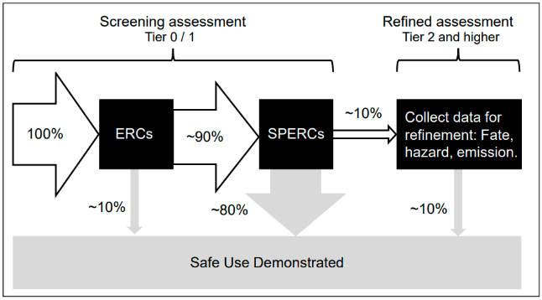
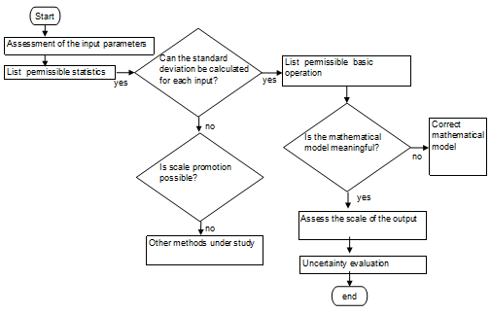
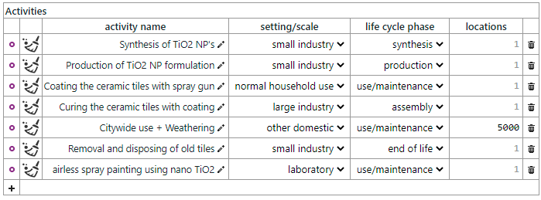


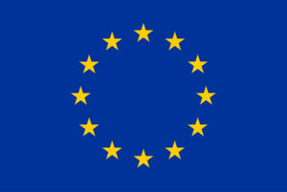


Streamlining models and tools for release, fate and exposure assessment of NFs/NEPs for Safe by Design (SbD) purposes
James Hanlon¹, William Brown¹, Rebecca Nebbia¹, Sam Harrison², Araceli Sánchez Jiménez³, Nathan Bossa⁴, Camilla Delpivo⁴, Apostolis Salmatonidis⁴, Ralph Vanhauten⁵ and Socorro Vázquez⁴
¹ Institute of Occupational Medicine (IOM), Edinburgh, UK, ² UK Centre for Ecology & Hydrology (UKCEH), Lancaster, UK, ³ Instituto Nacional de Seguridad y Salud en el Trabajo (INSST), Barakaldo, Spain, ⁴ LEITAT technological center, Terrassa, Spain ⁵ ThinkWorks, Delft, The Netherlands
Background
There is a requirement to improve the usability of existing human exposure models (both occupational and consumer exposure) and environmental release and fate models and tools for the SbD of nanoforms (NFs) and nanoenabled products (NEPs) throughout their life cycle. As part of the SAbyNA project, we firstly developed criteria for selecting relevant tools and models for assessment. The shortlisted tools and models were then assessed, relevant elements distilled and potential improvements identified. We are currently streamlining tools and models for SbD with a particular focus on the GUIDEnano tool for two case studies (3D printing and paints sectors).
Method
Criteria were developed to identify and shortlist models and tools for (a) human exposure and (b) environmental release and fate. The inclusion criteria included:
Environmental release and fate: in a “ready to use” format and nano-specific
Human exposure: inhalation models/tools for occupational and consumer settings, dermal models/tools relevant for SAbyNA, qualitative or quantitative models/tools
The exclusion criteria included:
Environmental release and fate: closed-access, non transparent and poorly documented
Human exposure: Generic inhalation exposure models, dermal models not relevant for SAbyNA and those models/tools which would be difficult to implement in a ready to use format
These shortlisted models and tools were distilled in Excel spreadsheets to identify streamlining and potential improvement for SbD purposes in the SAbyNA project.
Shortlisted environmental release and fate models/tools for streamlining
Type | Model/tool
Exposure | NanoFASE
 | SimpleBox4nano
 | GUIDEnano
 | MendNano
 | nanoFate
Release and grouping | LearNano
 | NanoApp
 | LICARA NanoSCAN
Shortlisted human exposure models/tools for streamlining
Precautionary Matrix for NMs
Control Banding Tool
Stoffenmanager Nano
Nanosafer CB
SUNDS
GUIDEnano
LICARA NanoSCAN
ART
ConsExpo Nano
Environmental release and fate models and tools
Human exposure models and tools
Ten environmental release fate and fate models/tools were shortlisted and distilled. Elements distilled included a description, spatial resolution, temporal resolution, fate processes considered, model/tool variables, access, format, required expertise, computational requirements and materials for which the tool has been used/parameterised for.
Nine human exposure models and tools were shortlisted and distilled. Elements distilled included the format, required expertise, applicability, output, exposure route and spatial resolution for exposure of input parameters, inter-user availability (performed on a case study example), uncertainty and how the model/tool could contribute to SbD.
Potential improvements for SbD include:
Potential improvements for SbD include:
Accessibility: Some models/tools are not readily accessible.
Geographical considerations: Creation of a set of theoretical scenarios, such as the release from one WWTP/factory and the downward movement of engineered nanomaterials.
Model run times: Creation of simplified geographical scenarios to help run times.
Improved release data: The use of Specific Environmental Release Categories (SPERCs) could be used to provide sector-specific release estimates.
Uncertainty and sensitivity analysis: Few environmental fate models have published uncertainty and/or sensitivity analysis. SPERCs could help to reduce uncertainty.
Input parameters: Minimise the input parameters required to be entered by the user, inclusion of uncertainty values and establishing the sensitivity of parameters for SbD use.
Inter-user variability: Potential inclusion of a “check” scenario to allow the user to compare their results and to check how parameters are being interpreted.
Model algorithms: These could be amended as appropriate, available however information can be limited.
Uncertainty: Need to consider model, parameter and scenarios for uncertainty. A Standard Operating Procedure and a flow chart are being developed for uncertainty.
Above: Flow for SPERCs (ECHA, “SPERC Fact Sheet Format with Explanations”)
Above: Uncertainty flow chart
Key Outcome: From our assessment, we have concluded that none of the models and tools are currently ideally suited for SbD
Updating GUIDEnano for SbD
From our assessment, GUIDEnano is the most promising model for SbD for environmental release and fate and human exposure. The current focus of our work is on improving the environmental and human exposure modules of GUIDEnano for use for SbD. For example, this includes the inclusion of SPERCs, improved dissolution and transformation dynamics, inclusion of temporal dynamics, inclusion of background measurement data, the potential effect of air humidity and including default input parameters.
Development of pre-defined activities: User-friendly pre-defined activities (such as in the shown image) are being developed for the two SAbyNA case studies (additive manufacturing and paints) along the life cycle. These will include default data which can be used and will allow the user to supply their own data. Work is ongoing on developing a common list of activities and the development of an environmental exposure activity card for spray painting.
Key Outcome: We are updating the human exposure and the environmental release and fate modules in GUIDEnano for SbD use
This project has received funding from the European Union’s Horizon 2020 research and innovation programme under grant agreement No 862419. This publication reflects only the author’s views and the European Union is not liable for any use that may be made of the information contained therein.

