Slide 1
Experimentation for Different Stall Control Strategies with Synthetic Jet Actuators
  Eng. D. Andreoli, PhD. M. Cassaro, Prof. M. Battipede Politecnico di Torino
  Prof. P. Marzocca RMIT Melbourne
  Prof. G. Ahmadi Clarkson University Potsdam NY

Slide 2
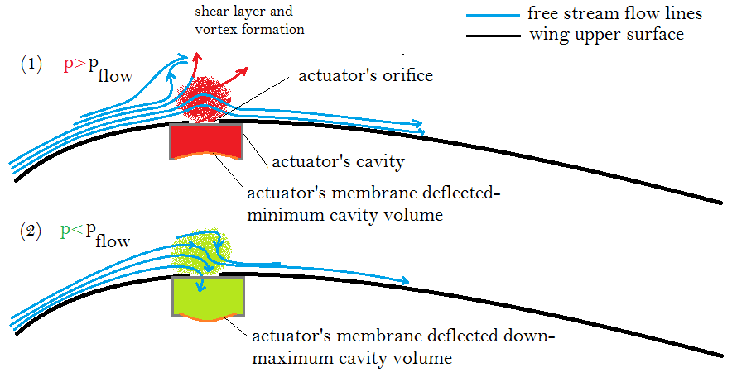
Objectives and Approaches
Active Flow Control Type : FLUIDIC
      Zero-net-mass-flux actuators
      Energy Transfer by the Piezo-Electric Membrane periodic vibrations (control in frequency)
    Objectives
      Extending Flight Envelope Higher Stall AoA
      Improving System Efficiency Energy Saving
    Approaches
      Open-loop wind tunnel test for SJA parameters’ TUNING purpose
      Experimental determination of pressure distribution signature for controller TRIGGERING
      Closed-Loop wind tunnel test for STALL DELAY purpose
Notes:
SJAs concept introduction
energy saving criticalities description→ need of a closed-loop strategies

Slide 3
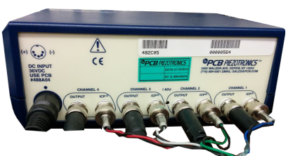
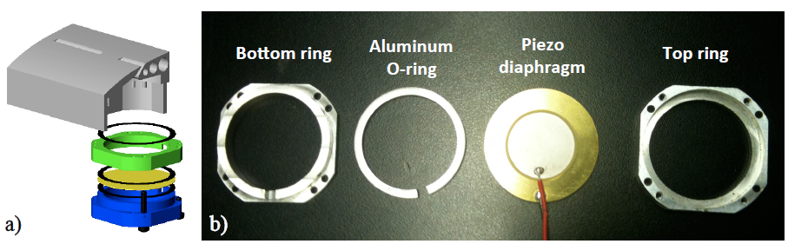

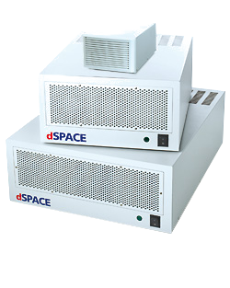
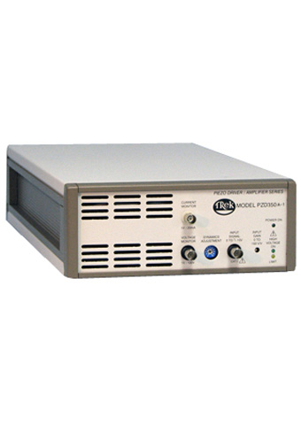
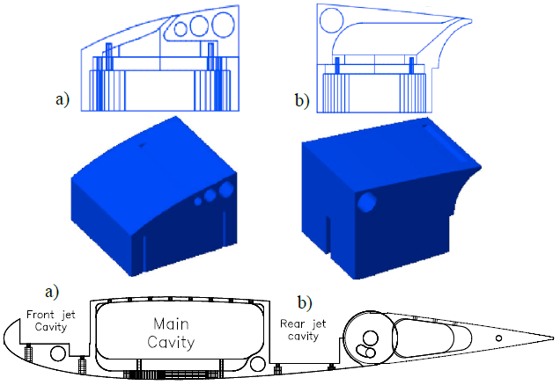
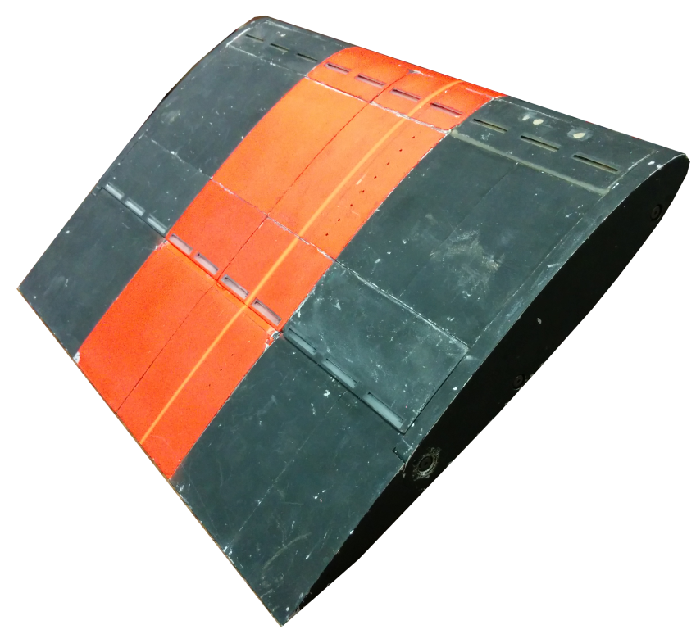

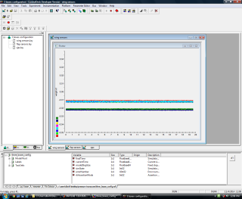

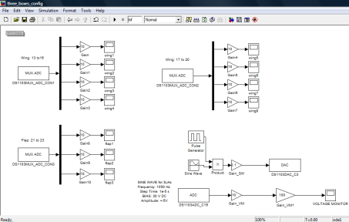
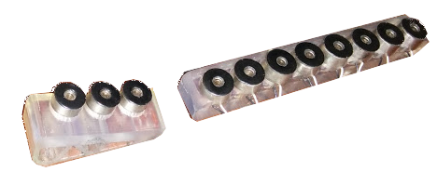

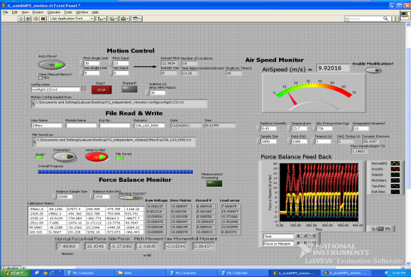
Experimental Setup: complexity and integration
SJA Piezo-Memebrane Assembly
Pressure Transducers Signal
SJAs Command Signal
Trek 350A Piezo-Driver Amplifier
Software Suite: Control&Sensing
α,β Command
Pressure Transducers
3Forces, 3Moments
Notes:
Overall system architecture description with particular attention on the differences if sensing alpha or pressure field

Slide 4
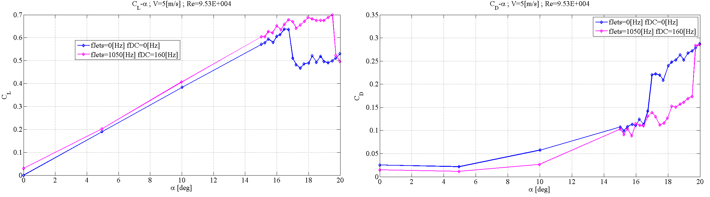
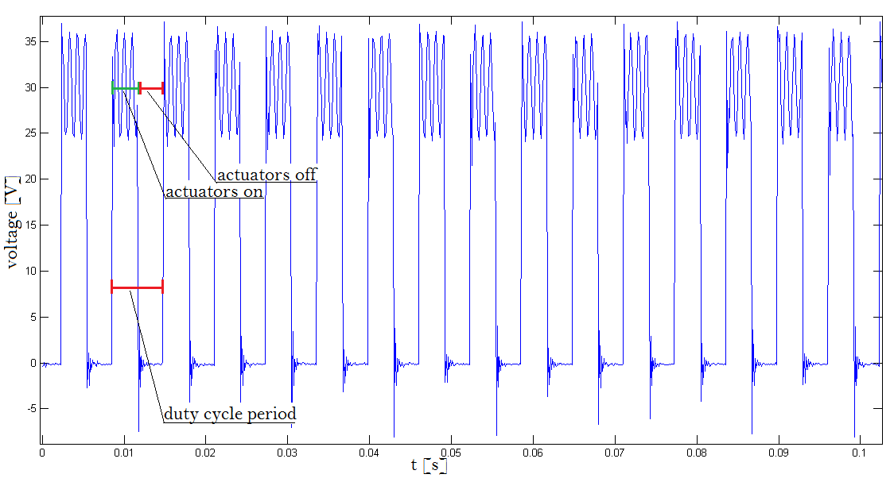
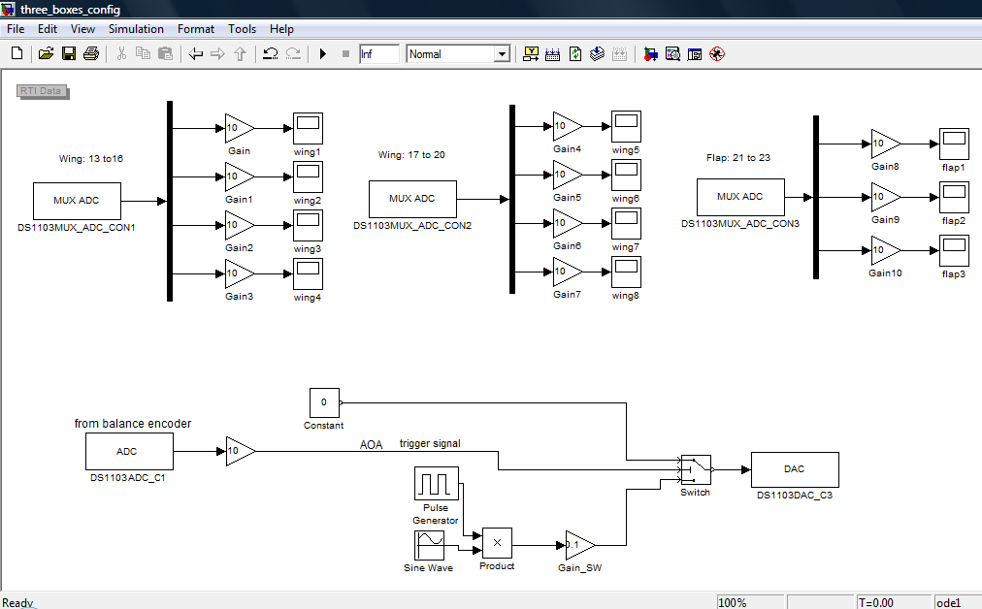
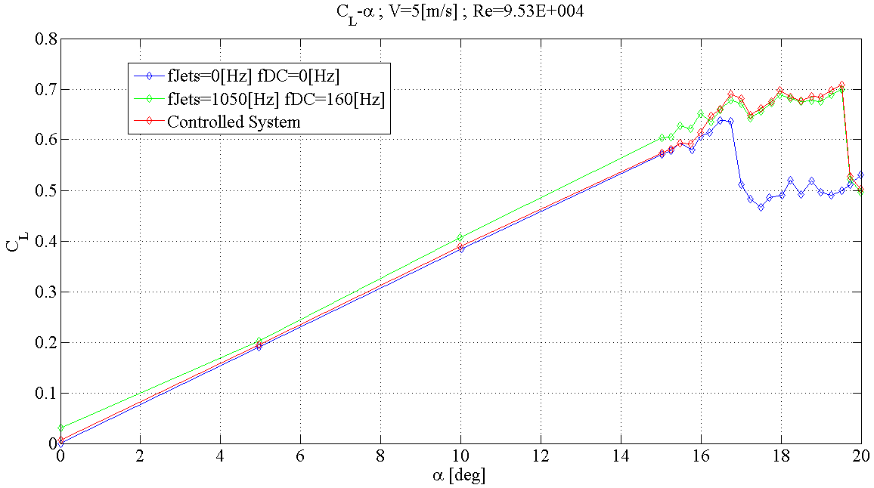
Main Outcomes
Open-Loop Control Aerodynamic Results –
STALL DELAY
    The efficacy of SJAs as mean for stall delay has been proven. A post-position of 3 degrees is achieved by operating the SJAs with an optimized power signal @ U = 5 m/s;
    A closed-loop control system based on the AoA feedback signal has been realized. Energy saving has been taken into account in the activation strategy definition.
    Flow field pressure characterization for triggering closed-loop controller
SJA Input:
Sine Wave Signal +
50% Duty Cycle
Simulink AOA Feedback
Control Scheme
Block Diagram
CL-AOA curves comparison OPEN / CLOSED LOOP
Notes:
Optimal stall delay achieved without energu losses in the linear CL-alpha curve.

Slide 5

Thank you for your attention…
…Any question?

