Slide 1





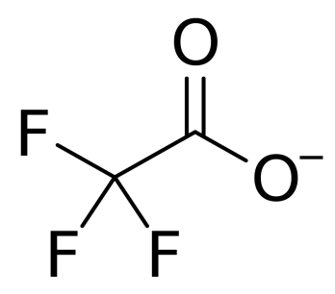
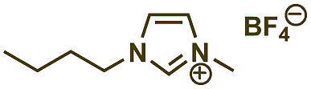
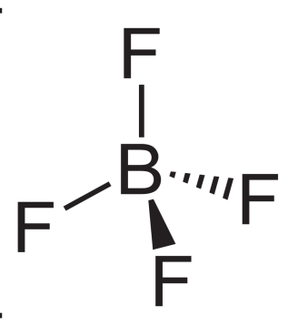
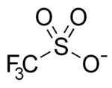
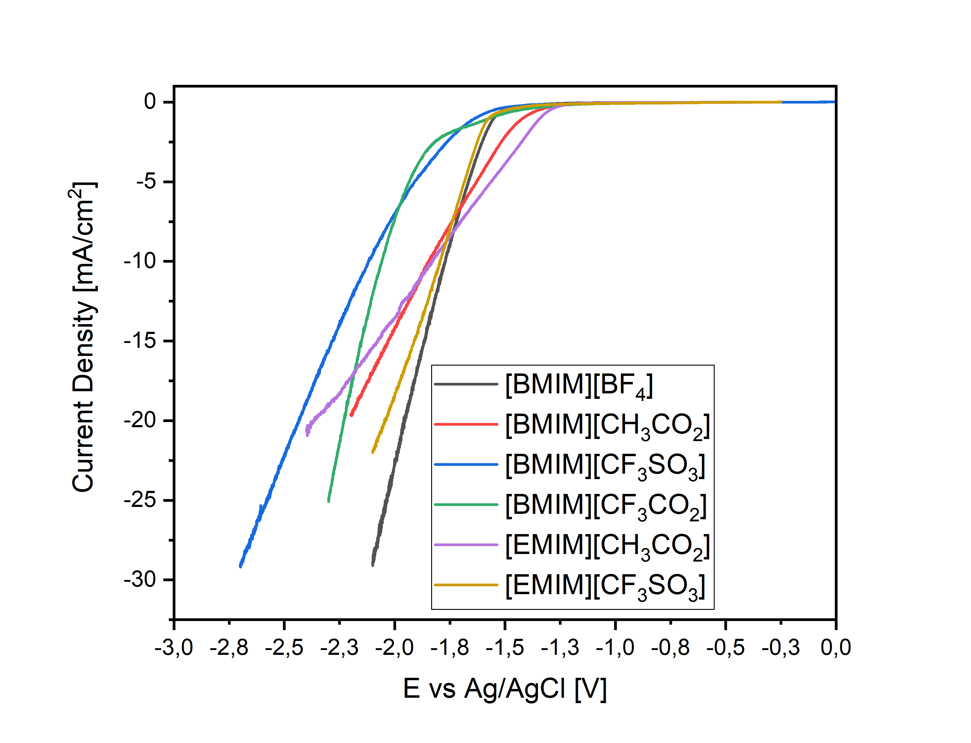
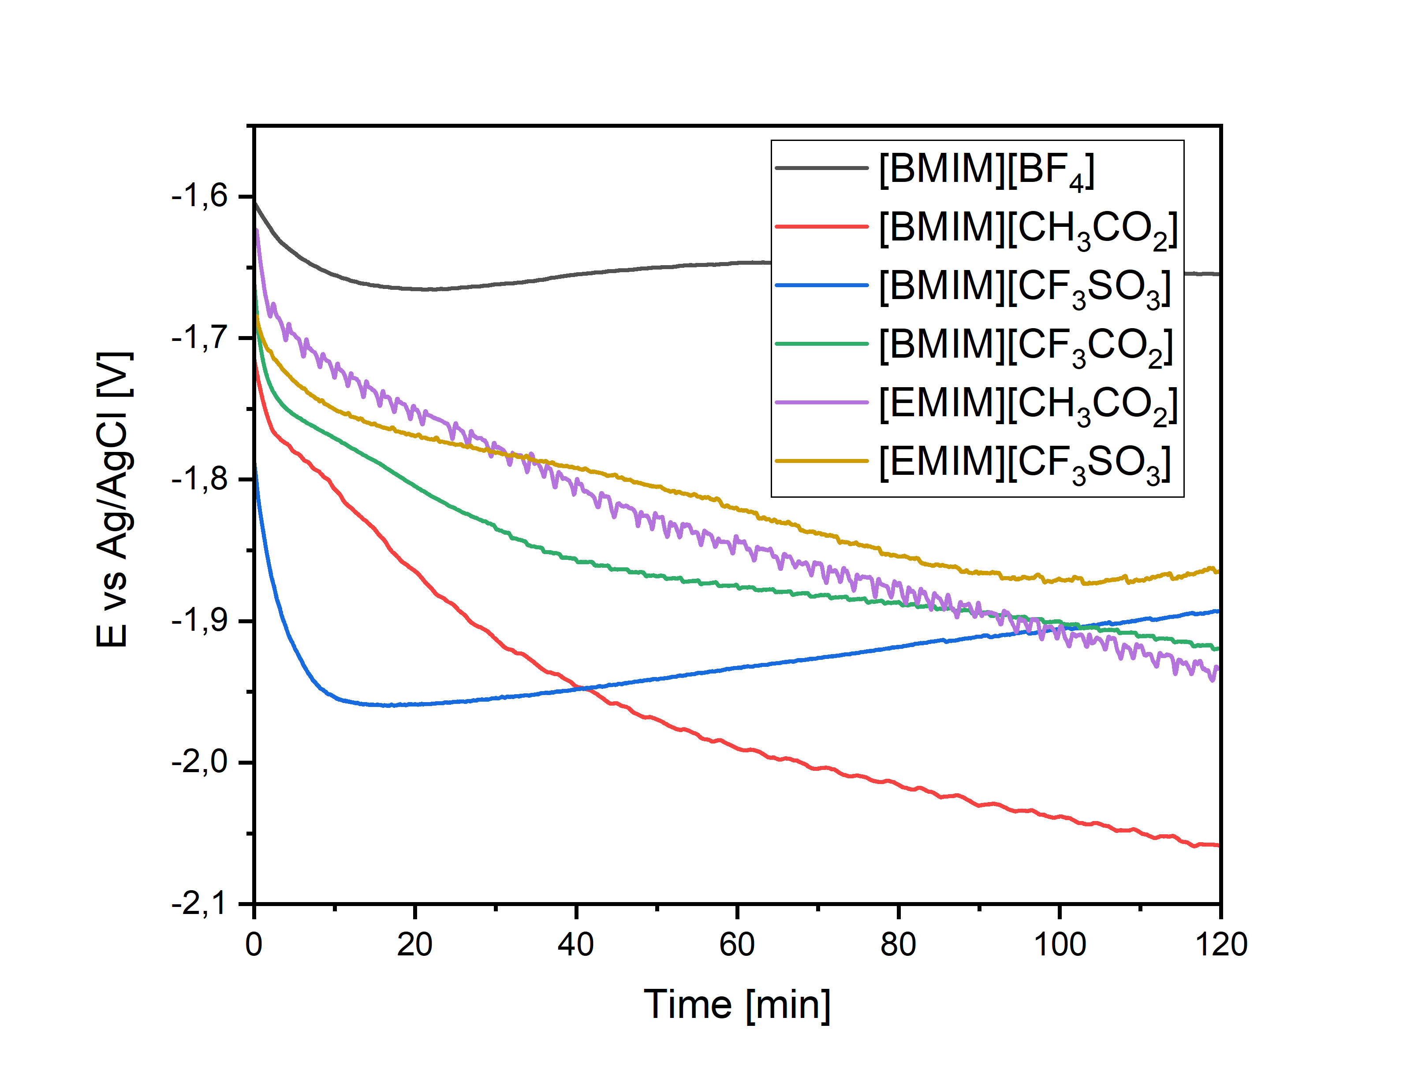
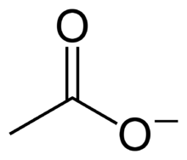
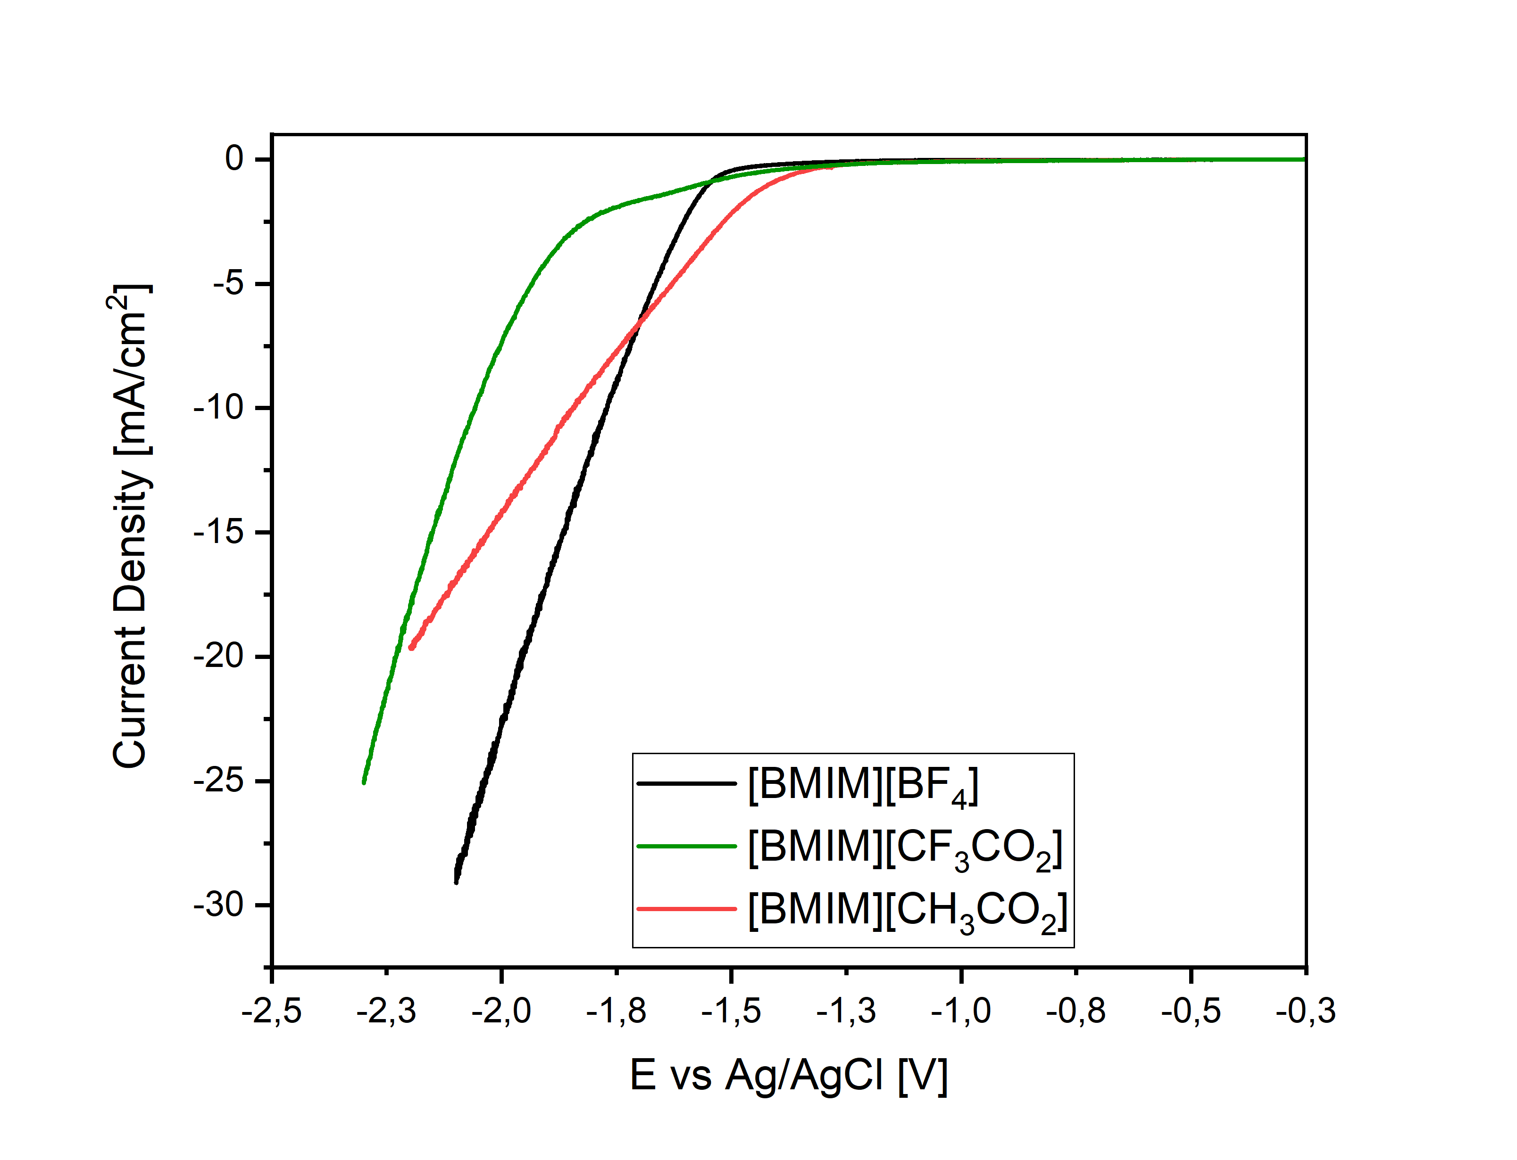
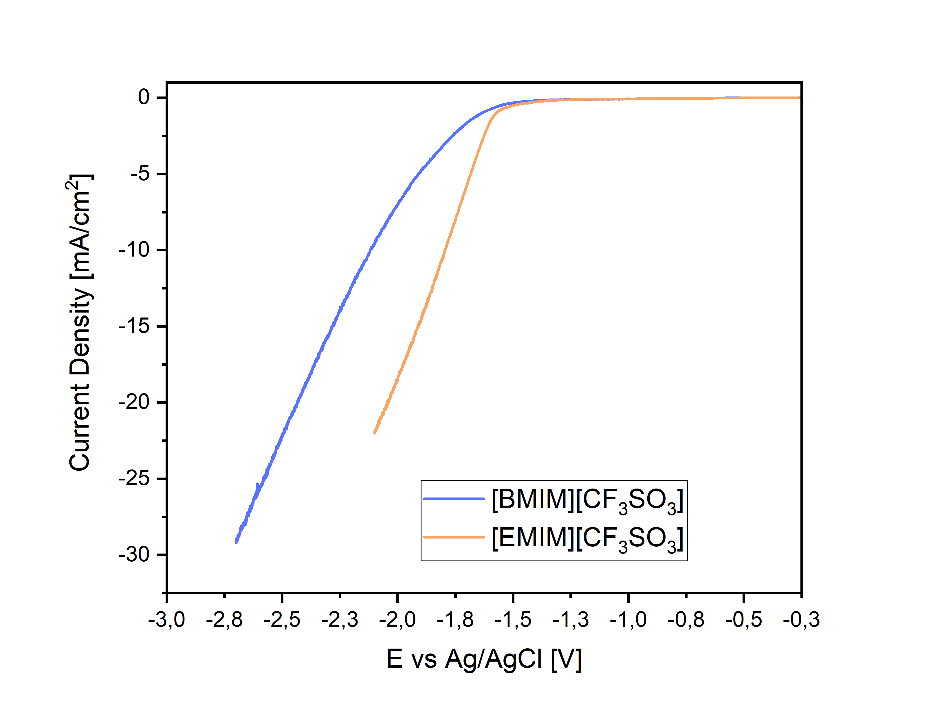
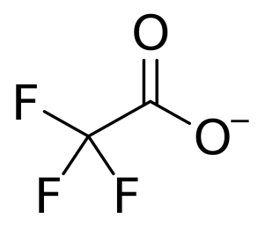
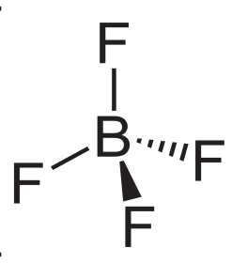









CARBON DIOXIDE CAPTURE AND ELECTROCHEMICAL CONVERSION
WITH IONIC LIQUIDS
Alessia Fortunati^{1,*}, María José Rubio¹, Boyan Iliev², Thomas Schubert², Nunzio Russo¹, Simelys Hernández^{1,*}
¹ Department of Applied Science and Technology, Politecnico di Torino, Corso Duca degli Abruzzi 24, 10129, Turin, Italy
² Iolitec Ionic Liquids Technologies GmbH, Salzstraße 184, 74076 Heilbronn, Germany
:
Introduction and aim of the work
Materials and methods
e⁻
Starting Olefine
+ Ru catalyst
Potentiostat
WE
MFC
O₂
CO
Oxo-Products
CE
RE
Gas In
Catholyte | IL in CH₃CN
Anolyte | KOH 0,1M
WE | Silver foil
CE | Ni mesh
RE | Ag/AgCl (Sat)
Membrane | Transparent Bipolar
Gas Out
H₂O
CO₂
µ-GC
The RDS involved in the CO₂ reduction to CO is the formation of the reactive CO2^{•-} anion radical.
E⁰ = -1,9V vs NHE¹ (∼ -2,1 vs Ag/AgCl sat)
The main objective of this work is to evaluate the performance of Ionic Liquids (IL) in lowering the negative potential for the formation of the CO.²
O
C
e⁻
C
180°
O
O
138°
O
An H-type cell configuration with an anodic and cathodic chambers
Chambers separation by a bipolar membrane that prevents the mixing of the anolyte and catholyte solutions. The electrochemical tests involved were cyclic voltammetry (CV), linear sweep voltammetry (LSV) and a chronopotentiometry (CP) in inert gas and pure CO₂.
Results and discussion
Linear Sweep Voltammetry (LSV)
in CO₂ saturated atmosphere
Chronopotentiometry (CP), -20 mA/cm²
in CO₂ saturated atmosphere
[BMIM][BF₄]
[BMIM][CO₂CF₃]
[BMIM][SO₃CF₃]
[V]_{ONSET}
-1,5
-1,4
-1,7
-1,9
-1,3
-1,5
[EMIM][CO₂CH₃]
[BMIM][CO₂CH₃]
ANION ROLE of IL
The solubility of the CO₂ strongly depends on the anion influence. If the IL contains a higher grade of fluorination, it will have a higher CO₂ solubility. It might be related to Fluorine electronegativity³ and, experimentally, leads to high current density values.
CATION ROLE of IL
The alkyl chain of the cation plays an orientation role. The shorter alkyl chain of the IL cation, the greater it allows the anion to approach closely to the solid charged surface,⁴ which leads to lower overpotentials for the electrochemical CO₂ reduction reaction.
Imidazolium salts combined with a silver cathode, represent a decrease on the overpotential needed to overcome the initial step in the reduction of CO₂.
The acetate anion is more selective towards the production of H₂ than CO, which supports the fact that the CO₂ presents the lowest solubility in non-fluorinated salts.
IONIC LIQUID | Ratio CO/H₂
[BMIM][BF₄] | 6.97
[BMIM][CF₃CO₂] | 5.72
[BMIM][CF₃SO₃] | 46.85
[BMIM][CH₃CO₂] | 0.13
[EMIM][CH₃CO₂ ] | 0.05
[EMIM][CF₃SO₃] | 37.95
[V]_{ONSET}
-1,5
-1,9
-1,4
[V]_{ONSET}
-1,7
-1,5
Conclusions
Acknowledgements
The study of the performance of five imidazolium salts as ionic liquids in the electrochemical reduction of CO₂ to CO over a silver electrode, was performed. Their electrocatalytic behavior in lowering the negative potential needed to overcome the first step of the CO₂ electrochemical conversion process, which includes the formation of the CO₂^{•-} anion radical, has been studied in a H-type cell.
CO₂ solubility depends mainly on the anion of the imidazolium salt, which tends to be higher for fluorinated anions because of their increased electronegativity. Using the Pauling electronegativity scale, a hint of the anion electronegativity can be found, and in this way, it is possible to predict in which ions the carbon dioxide would present a better affinity.
The cation has a steric effect and an orientation role. When the alkyl chain decreases, the imidazolium ring finds a more convenient position in the cathode to reduce and form the complex with the carbon dioxide molecule, which might be translated into a less negative onset potentials, as it was here observed. Differences in the current density are determined by the molecular weight of the salt, while the cation increases its size, the interaction between the anion and the cation is weaker, increasing distance between them and hence the free molecular space for the CO₂ gas to be absorbed.
The research leading to these results has received funding from the European Union’s Horizon 2020 Research and Innovation Action programme under the SunCoChem project (Grant Agreement No 862192).
References
^{[1]} Wang, Y. et al, (2015), Activation of CO₂ by ionic liquid EMIM-BF₄ in the electrochemical system: a theoretical study. Physical Chemistry Chemical Physics, 17(36)
^{[2]} S. Hernández, M. A. Farkhondehfal, F. Sastre, M. Makkee, G. Saracco and N. Russo, Green Chem., 2017, DOI:10.1039/C7GC00398F.
^{[3]} Dębski, B. et al (2019). Thermodynamic interpretation and prediction of CO₂ solubility in imidazolium ionic liquids based on regular solution theory. Journal of Molecular Liquids, 291
^{[4]} Lockett, V. et al, (2008). Differential capacitance of the electrical double layer in imidazolium-based ionic liquids: Influence of potential, cation size, and temperature. Journal of Physical Chemistry C, 112(19), 7486–7495
Email addresses: alessia.fortunati@polito.it; simelys.hernandez@polito.it

