Slide 1
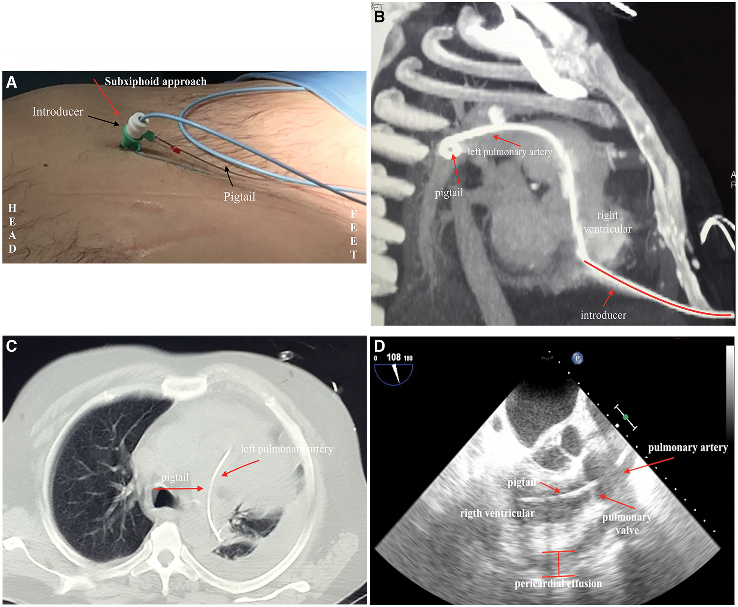

Figure 1: (A) Percutaneous pericardiocentesis. A pigtail catheter was introduced by a subxipoid approach. (B) ...
Notes:
Figure 1: (A) Percutaneous pericardiocentesis. A pigtail catheter was introduced by a subxipoid approach. (B) CT-angiography: introducer has pierced the right ventricular wall. The pigtail catheter has been advanced through the right ventricle, the pulmonary valve and the pulmonary artery. (C) CT-angiography: the pigtail catheter in the left pulmonary artery. (D) Transoesophageal echocardiogram (three-chamber-view): the pigtail catheter crosses the right ventricular outflow tract, the pulmonary valve and ends up in the main pulmonary artery.
Unless provided in the caption above, the following copyright applies to the content of this slide: © The Author 2017. Published by Oxford University Press on behalf of the European Association for Cardio-Thoracic Surgery. All rights reserved.

