Slide 1



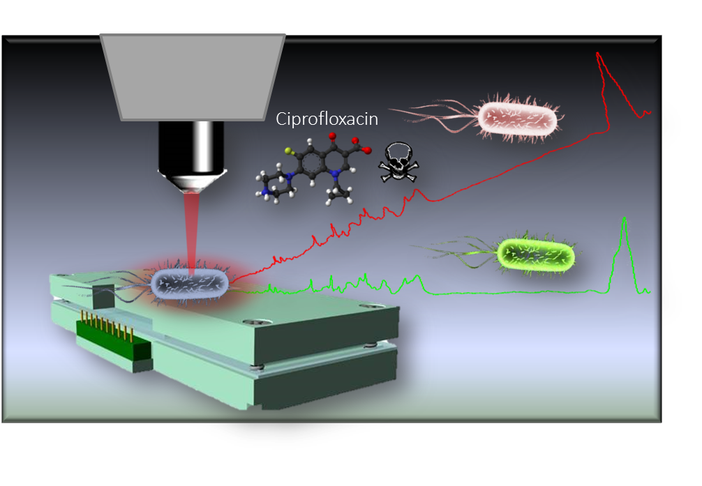
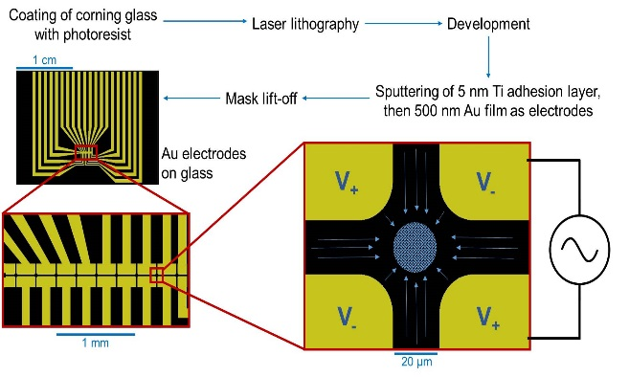
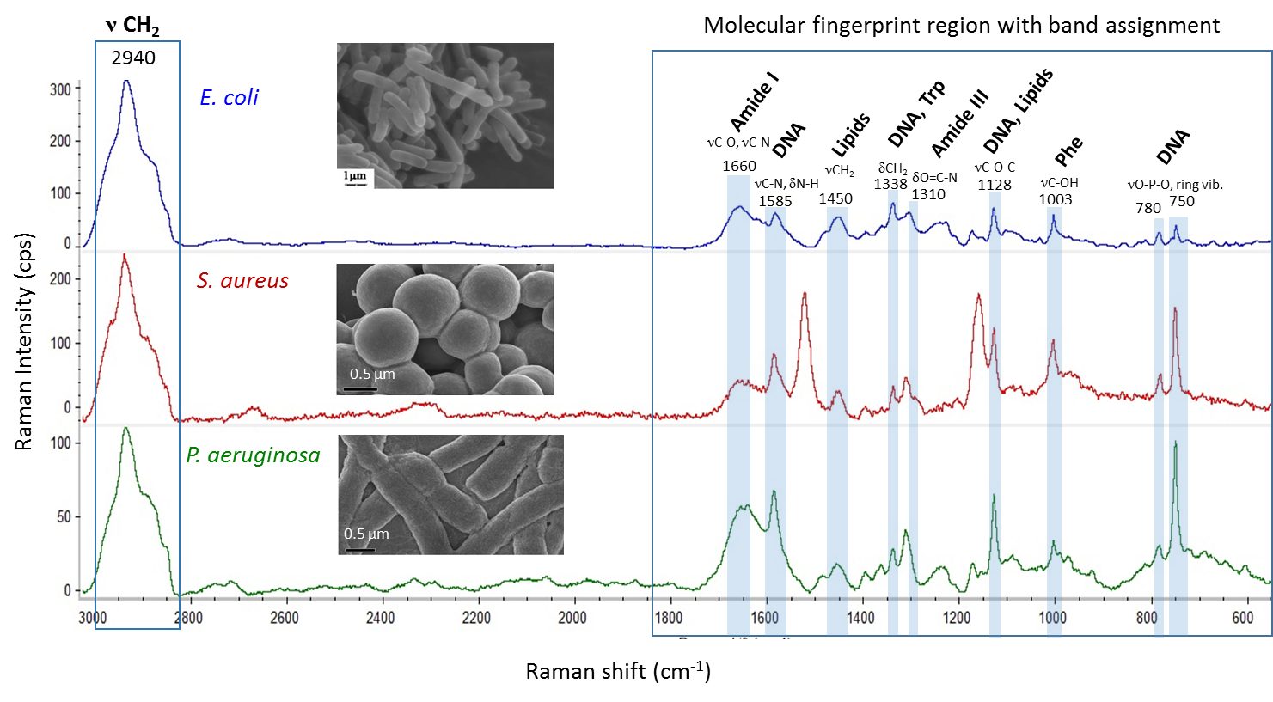
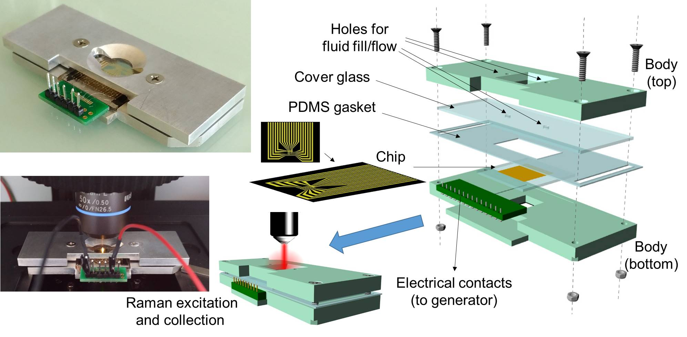
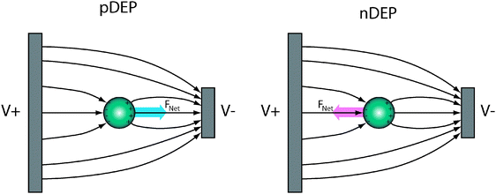
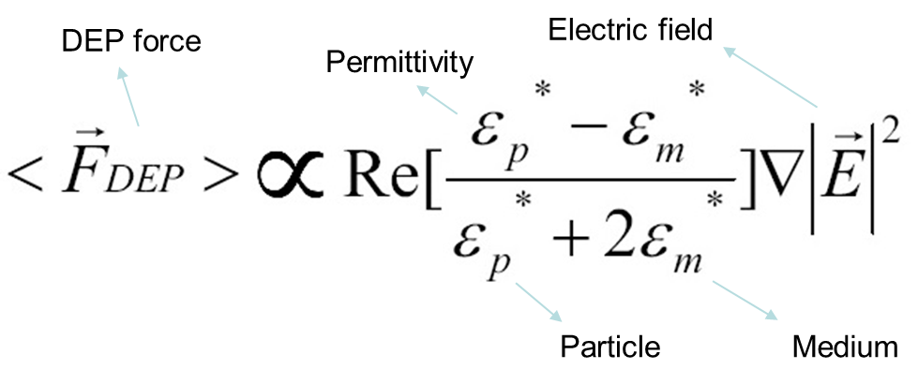
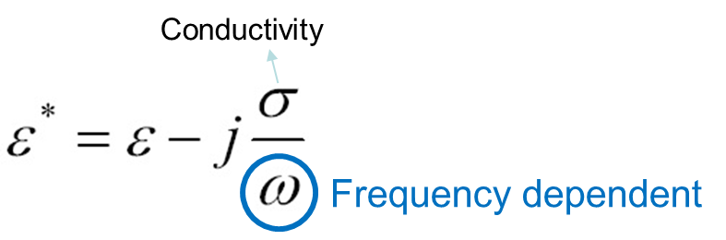
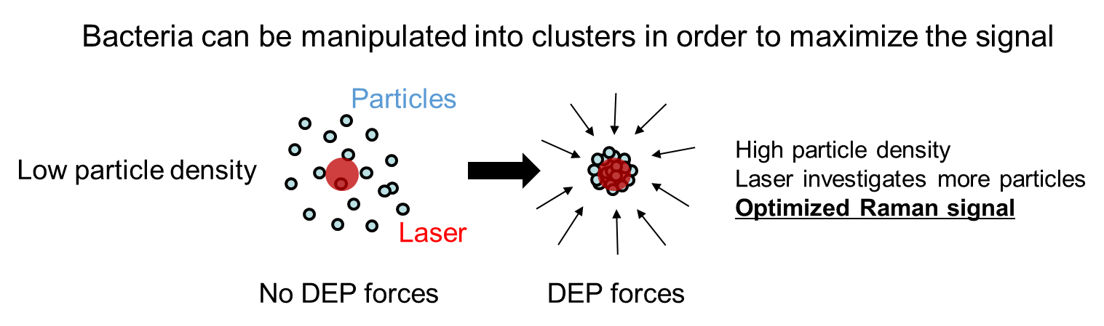
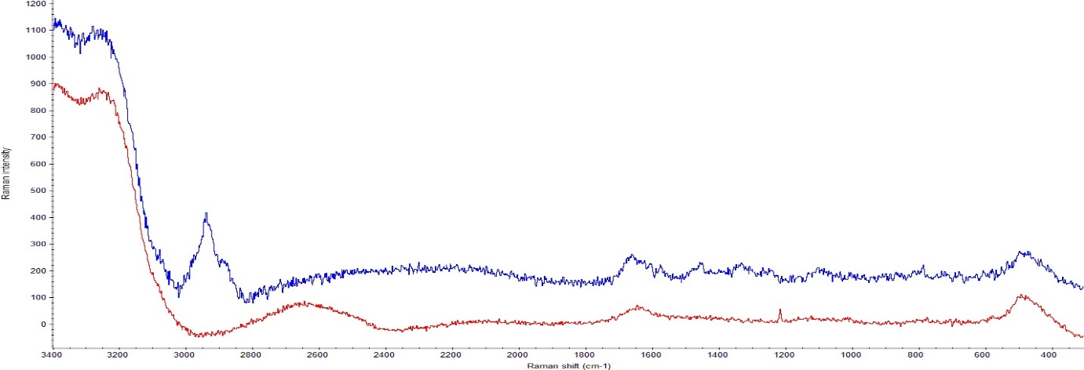
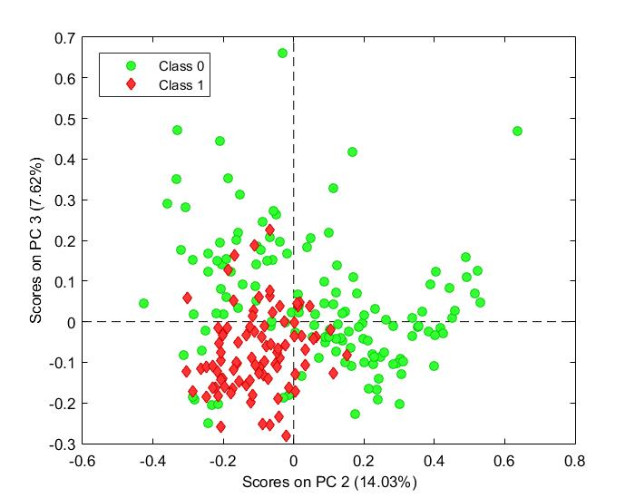
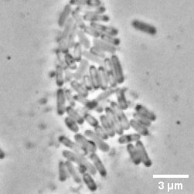
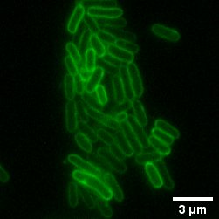
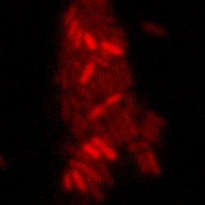
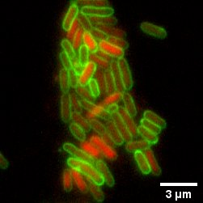
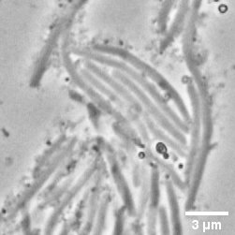
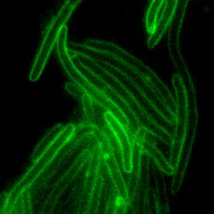
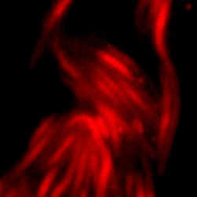
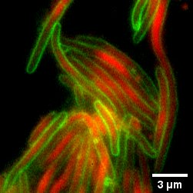
Combining Raman Spectroscopy and Dielectrophoresis for rapid determination of bacterial antibiotic susceptibility
G. Barzan^{ab}, A. Sacco^{ab}, L. Mandrileª, A. M. Giovannozzi^{a*}, C. Portesiª and A. M. Rossiª
*contact: a.giovannozzi@inrim.it
a) Quantum Metrology and Nano Technologies division, Istituto Nazionale di Ricerca Metrologica (INRiM), Strada delle Cacce, 91, 10135 Turin, Italy
b) Departement of Electronics and Telecommunications , Politecnico di Torino, Corso Duca degli Abruzzi, 24, 10129 Turin, Italy
Introduction
The development of rapid, sensitive and specific methods to determine antibiotic susceptibility of bacteria is required to help reduce the widespread misuse of antibiotics and the growing multidrug-resistance problem [1]. This study presents a combined Raman spectroscopic and dielectrophoretic (DEP) approach to obtain direct, real-time measurements of a suspension of planktonic bacteria without the need of any labelling or other time-consuming sample preparation processes. Thanks to the spatial non-uniform DEP fields, bacteria are easily captured and concentrated under the laser spot of the Raman apparatus, increasing the sensitivity of the Raman technique [2]. Optimizing the setup conditions we were able to characterize different bacterial strands with high specificity. Using our Raman-DEP device, we demonstrated the susceptibility of E. coli towards the commonly prescribed second-generation fluoroquinolone [3] ciprofloxacin (CP), after only one hour of treatment, by monitoring spectral changes in the chemical fingerprint of the bacteria, which are related to the mode of action of the drug. Comparison between treated and untreated samples were performed at the MIC (minimum inhibitory concentration) and sub-MIC levels for different time points over a 3 hour span, and the Raman data were processed by supervised multivariate tools, such as PLS-Discriminant Analysis and PLS-Regression, for the calibration of descriptive models of cellular modifications. The models were validated using the cross-validation strategy. Simultaneously, standard microbiological assays based on cell viability, turbidity test and fluorescence microscopy, were carried out as reference methods to correlate the observed Raman response and to build strong predictive models.
The DEP device for Raman analysis
Dielectrophoresis (DEP)
Raman-DEP device
Raman spectra of Bacteria
Dielectric particles in a non-uniform electric field Net force
Magnitude of the force depending on permittivity of both particle and medium
Can be positive or negative depending on which electrical permittivity is higher
Polarity of the electric field is irrelevant! Variable (in time) electric field (AC)
A dielectric particle placed in an electric field becomes electrically polarized as a result of partial charge separation, which leads to an induced dipole moment. The dipole moment is a consequence of the generation of equal and apposite charges at the boundary of the particle. In a non-uniform electric field, the particle experiences a net dielectrophoretic force. The magnitude of the induced dipole depends on the polarizability of the particle with respect to that of the medium. Applying the correct voltage and frequency, dielectric particles, such as bacteria, can be manipulated into clusters to increase their local concentration.
DEP forces
Raman characterization of: E.coli, S. Aureus and P. Aeruginosa using our DEP device. Optimized setup conditions for the cell: sinusoidal wave V = 5 Vpp, f = 800 kHz, aggregation time: 360 s. Optimized setup conditions for Raman microscope: laser line: 532 nm, laser power: 10 mW, objective: 60x water immersion, integration time: 2.5 s for 24 scans (1 min per spectrum).
No DEP forces
E. coli susceptibility to ciprofloxacin measured by Raman-DEP
Experimental setup: Bacteria were treated with 1 μg/ml of ciprofloxacin in the middle of their exponential growth phase, when their OD_{600nm} was 0.3, during which they are more sensitive to the antibiotic.
Canonical microbiology tests results
Raman results
E. Coli MG1655 growth curve (CFU/ml vs OD_{600nm})
E. Coli MG1655 untreated and treated with 1 µg/ml and 0.015 μg/ml of ciprofloxacin over a 3 hour span.
Raman spectra of CTRL and treated bacteria collected over time with the DEP device
Stationary phase
Six Raman spectra were collected for each experimental point
Differences between the mean spectra of CTRL and Treated bacteria were detected.
CTRL
Treated
Principal Components Analysis (PCA) helps in the visualization of non random variation in spectral data of CTRL and Treated bacteria.
The spectra of E. coli treated with CP are grouped in the PCA scores plot.
DNA, Lipids
DNA
DNA, Lipids
DNA
Lag phase
DNA
DNA
C-O
1585
750
1128
1585
Exponential (log) phase
750
1128
1175
a
b
c
Morphological changes of E. coli due to the effects of the CP treatment are already visible after 1 hour by bright field and Fluorescence Microscopy
PCA also revealed that Raman spectra captured changes related to the passage of time in both CTRL and Treated samples.
This effect was taken into consideration for subsequent classification analysis.
Untreated E. coli
(a)
(b)
(c)
(d)
Elongation of the membrane of E. coli treated with CP (e, f) is evident compared to the untreated sample (a, b). Also the DNA seems to be more widespread in the CP treated (g) than in the control (c).
Lipids, DNA, RNA
Amide III, DNA
DNA, Trp
Lipids
1338-1310
E. coli treated with
1 µg/ml of ciprofloxacin after 1 hour
(e)
(f)
(g)
(h)
1100
1240
1480
Brightfield
Membrane (FM1-43)
DNA (DAPI)
Overlay
Partial least square-Discriminant Analysis (PLS-DA) model was used to classify the spectra of bacteria according to their response to antibiotic treatment.
MBC of CP in E.coli MG1655 (OD_{600nm} = 0.3): 1 µg/ml
PLS-DA model after 1 hour of CP treatment (1μg/ml)
MIC of CP in E.coli MG1655 (OD_{600nm} = 0.3): 0.5 µg/ml
 | 1 h | 2 h | 3 h
Sensitivity (Prediction) | 0.67 | 1.00 | 1.00
Specificity (Prediction) | 1.00 | 0.50 | 0.33
Class. Error (Prediction) | 0.17 | 0.25 | 0.33
[4 LVs, Model validated by independent set external validation]
CTRL
Treated
Six independent experiments were conducted for the construction of the model, five were used for the training and one for the validation.
Raman spectra of the samples treated with sub-MIC concentration of CP (0.015 μg/ml) are classified by the model as not-treated bacteria.
References
Conclusions
[1] World-Health-Organisation in Antimicrobial resistance, global report on surveillance, Vol. 2014, 2014.
[2] U.-C. Schröder et al. “On-Chip spectroscopic assessment of microbial susceptibility to antibiotics”, J. Biophotonics 10, 1547–1557, 2017.
[3] O. Fasugba, A. Gardner, B. G. Mitchell, G. Mnatzaganian, BMC Infect Dis 15, 2015.
The Raman-DEP device here described allows to characterize different bacterial strains with high specificity and to follow dynamic interactions of the bacteria with antibiotics.
Raman data processed with supervised multivariate data analysis are able to detect subtle spectral differences at a molecular level between treated or untreated bacterial cells after only 1 hour of treatment.
This Raman-DEP method could open the way to rapid bacterial antibiotic susceptibility test without the necessity of time consuming sample preparation and overnight incubation required by classical microbiological techniques.
Acknowledgements
The present work has been supported by the project “15HLT01 MetVBadBugs” which has received funding from the EMPIR programme co-financed by the Participating States and from the European Union's Horizon 2020 research and innovation programme.
Part of this work was carried out in with the Centre for Biomolecular Science of Nottingham University (UK).

