Slide 1



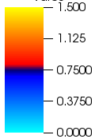
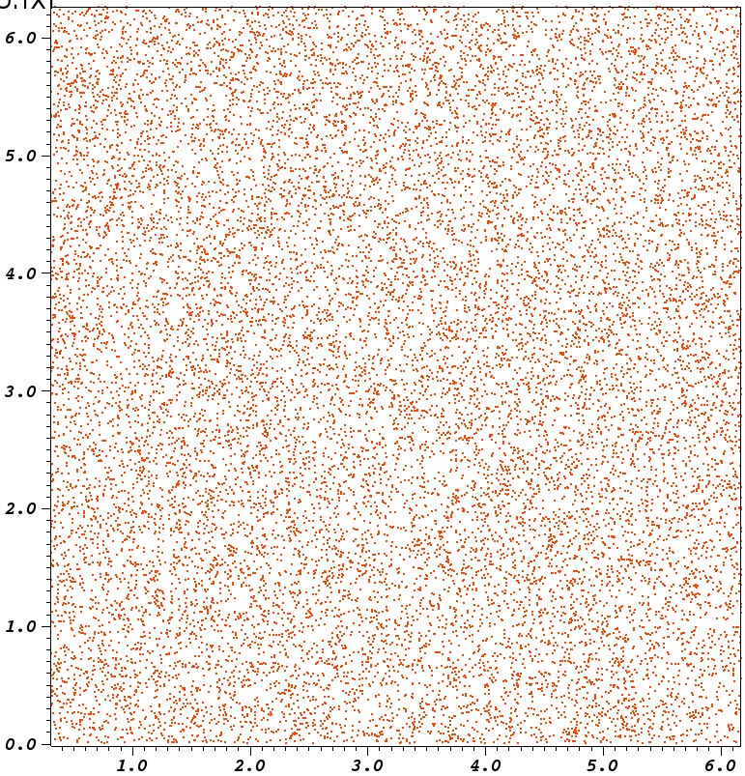
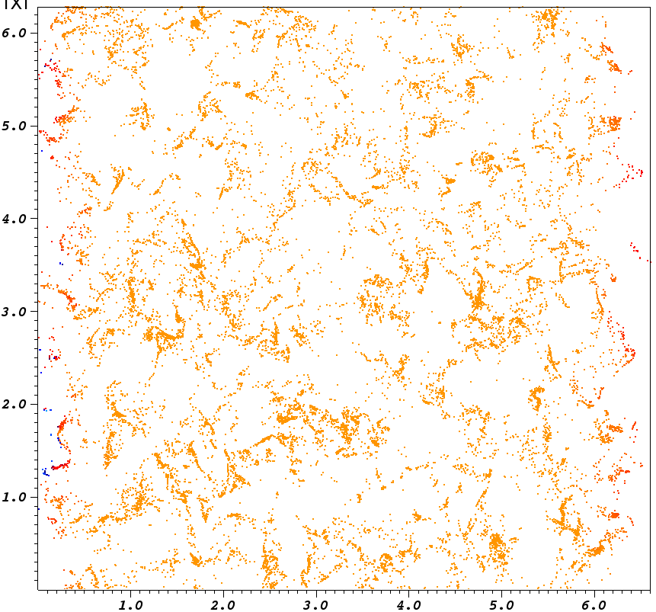
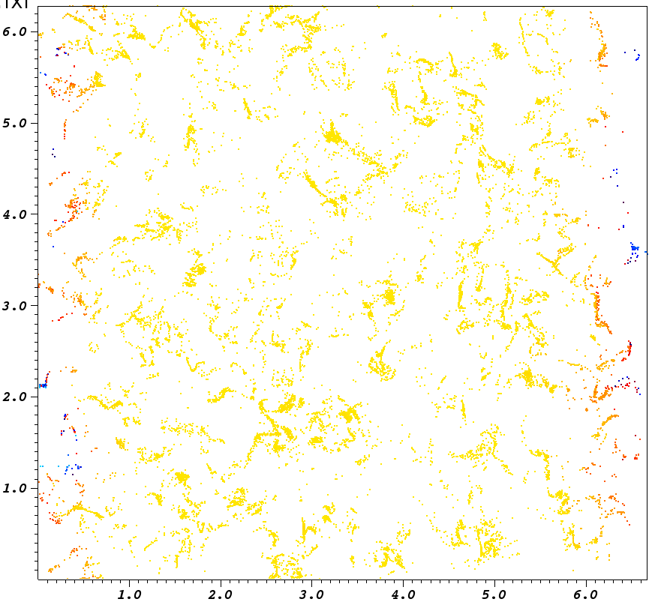
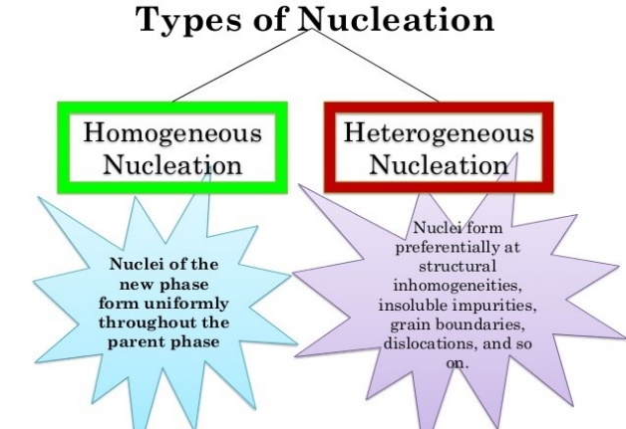
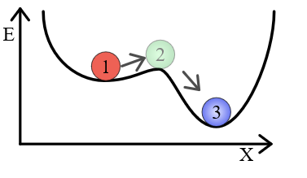
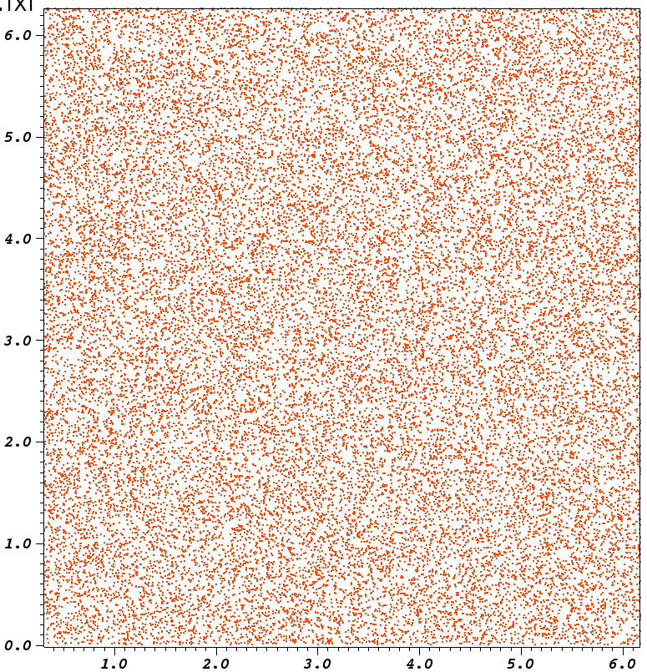
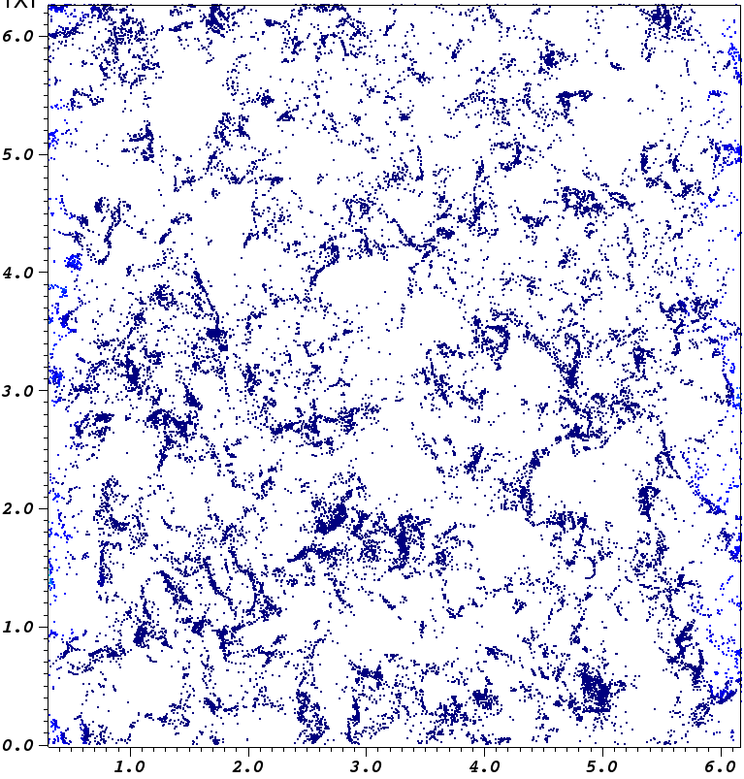
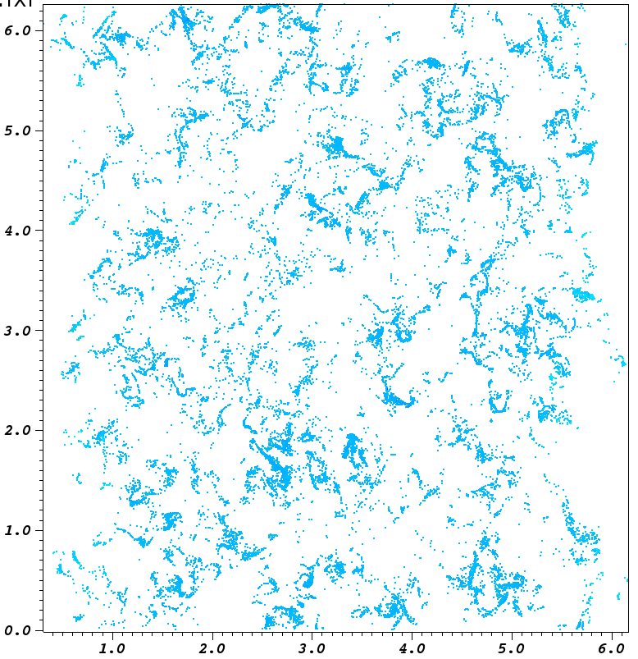
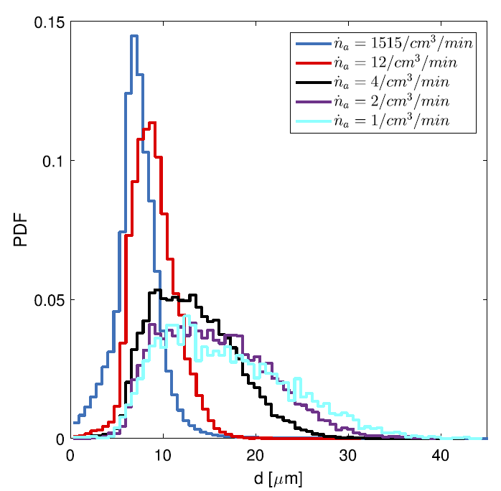
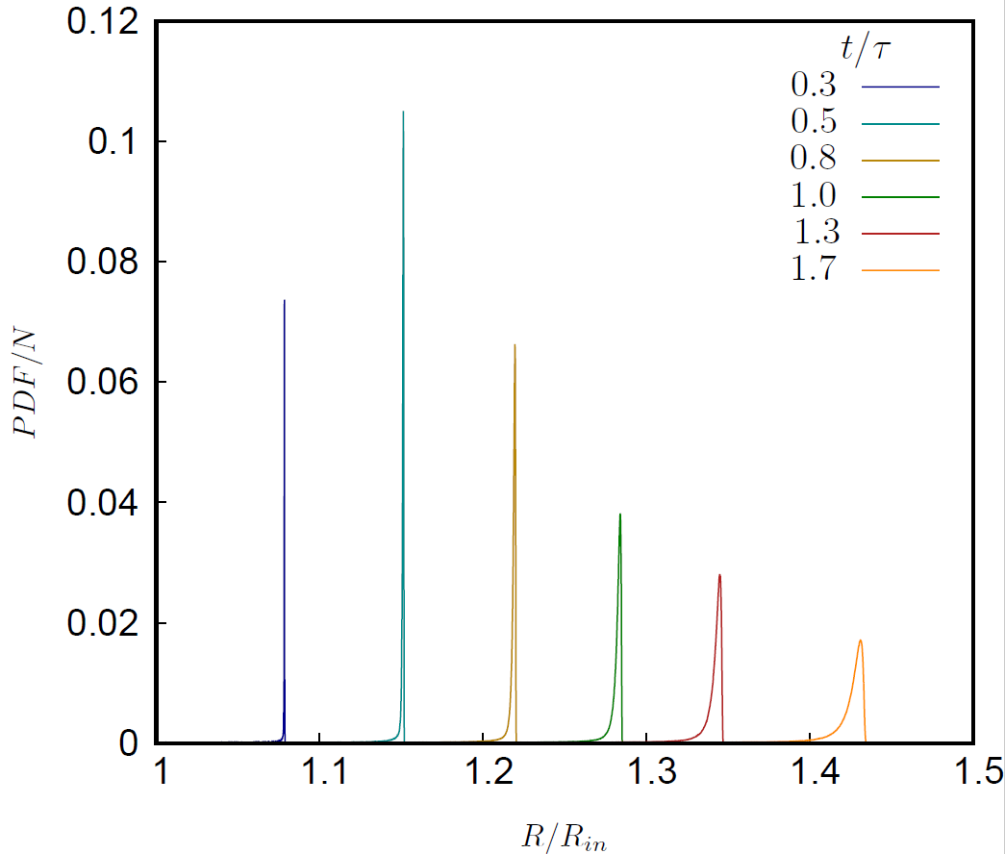
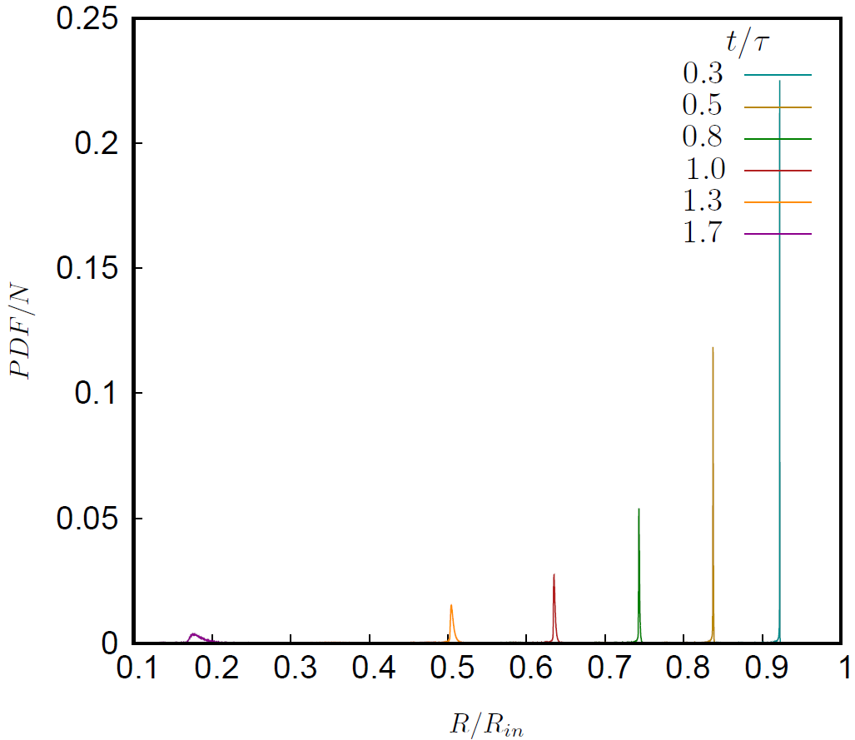
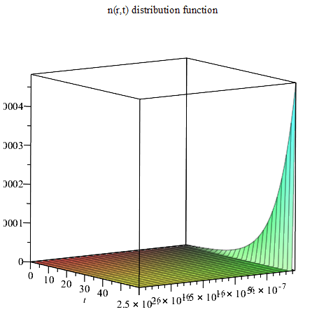

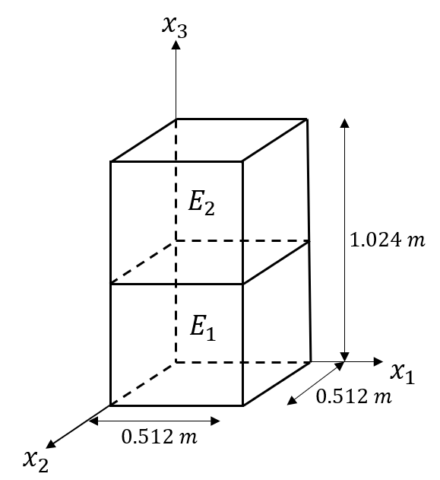
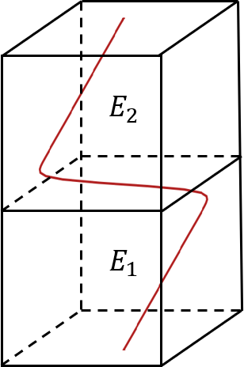
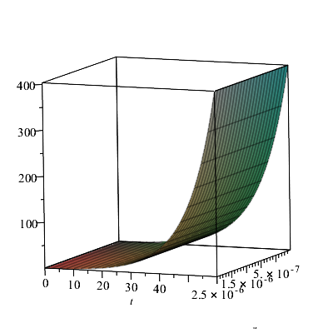
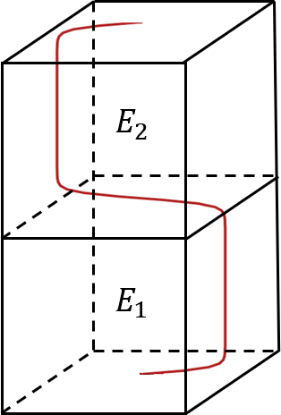
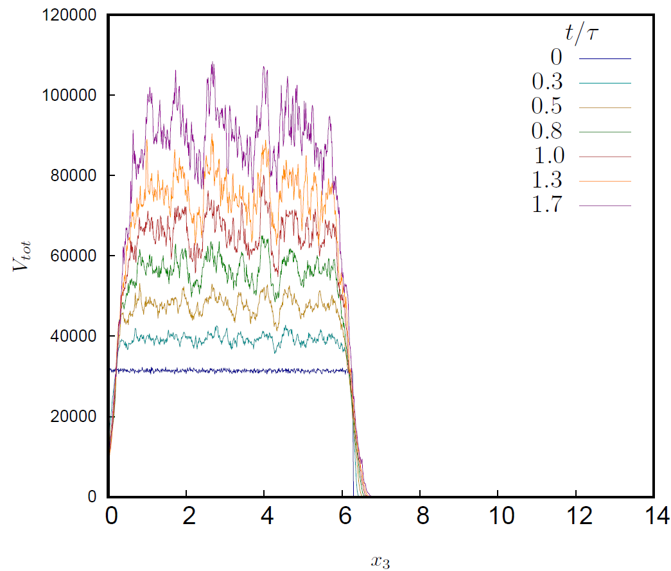
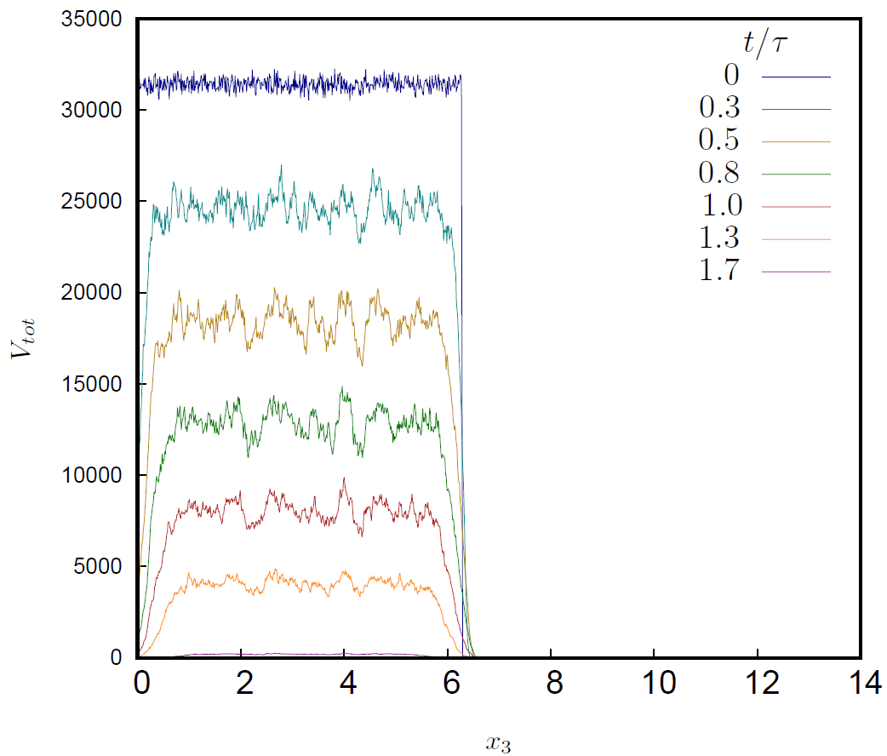
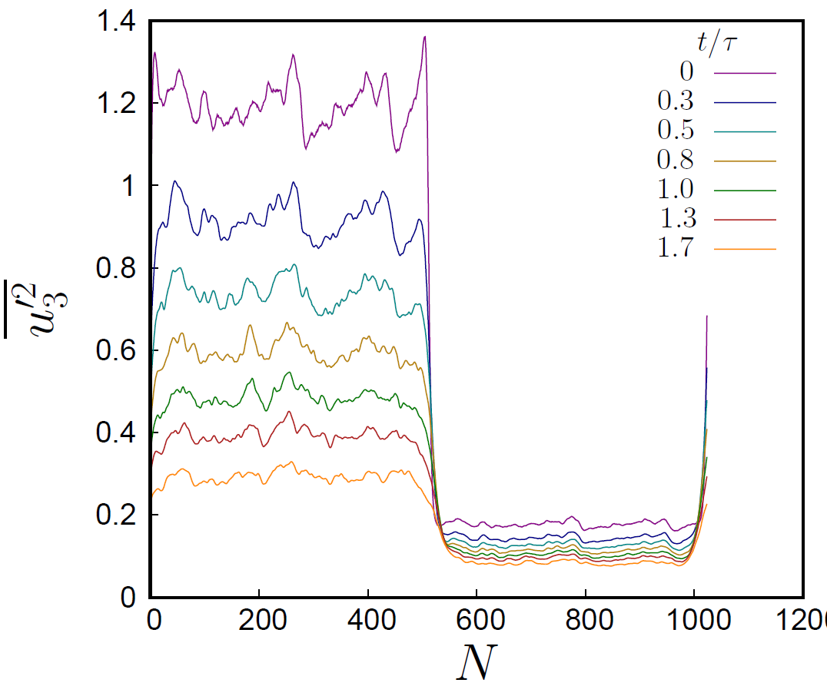
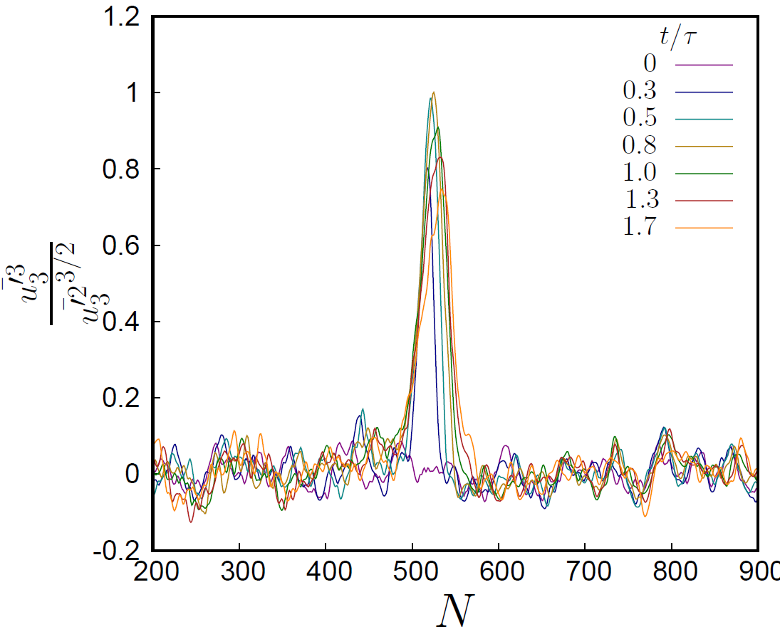
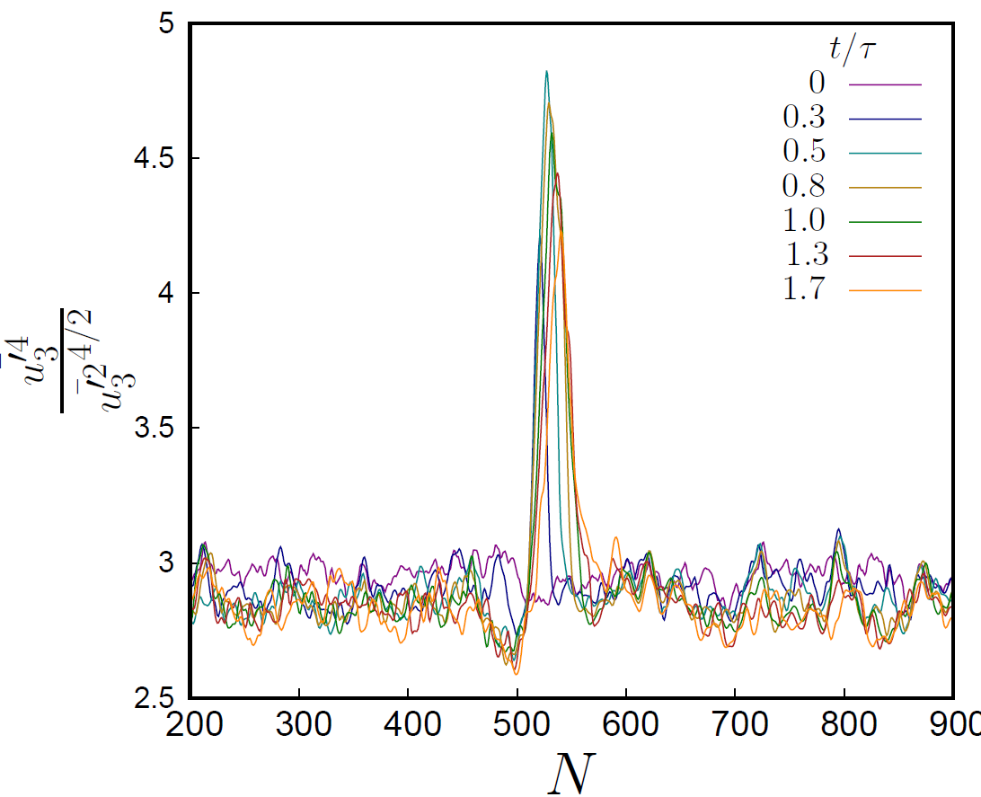
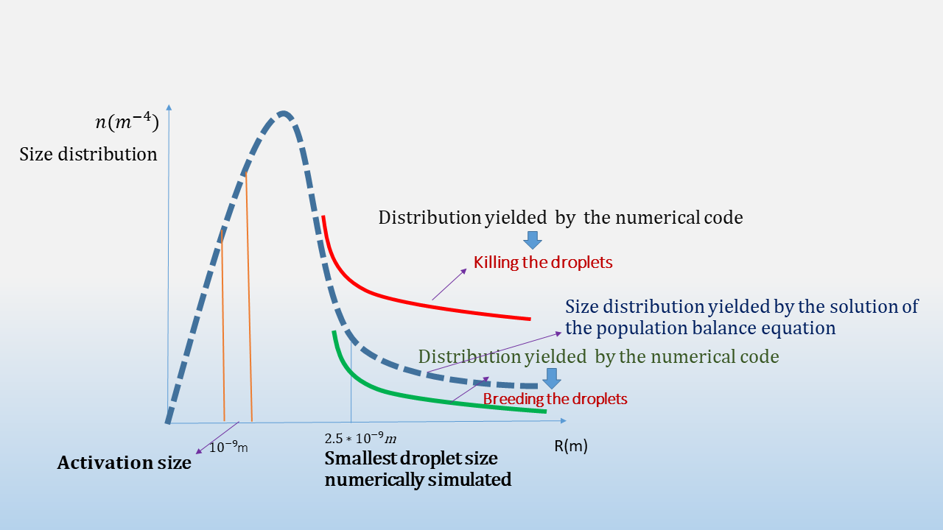
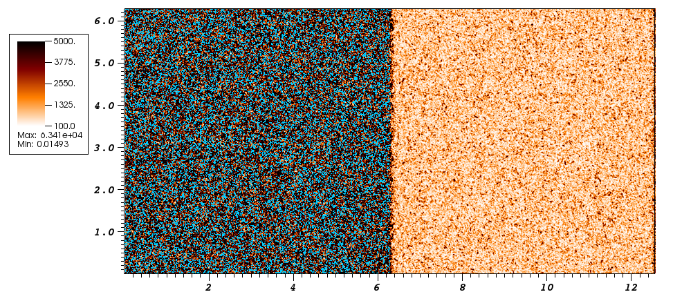
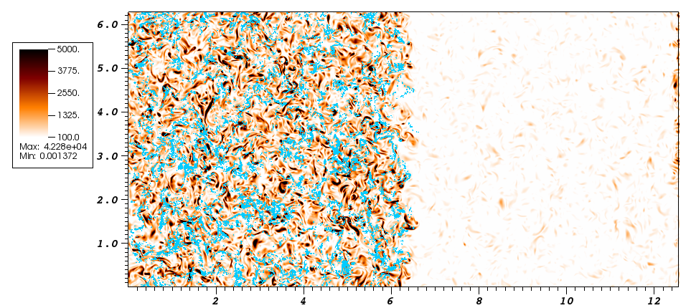
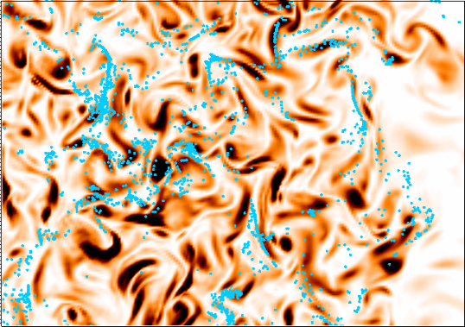
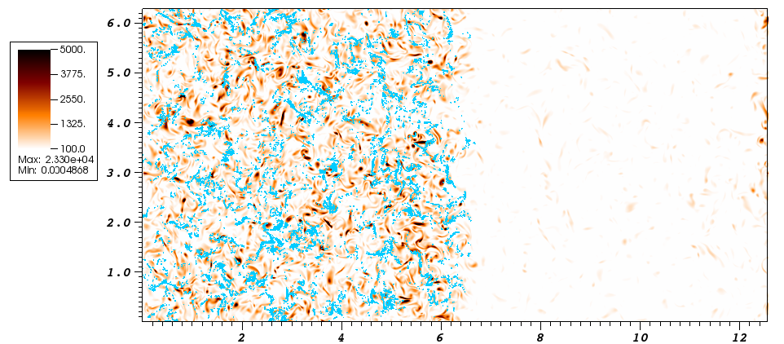
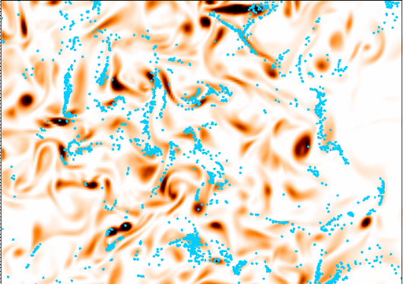
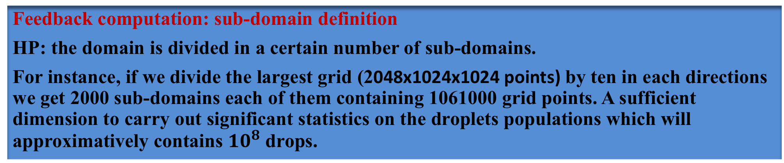

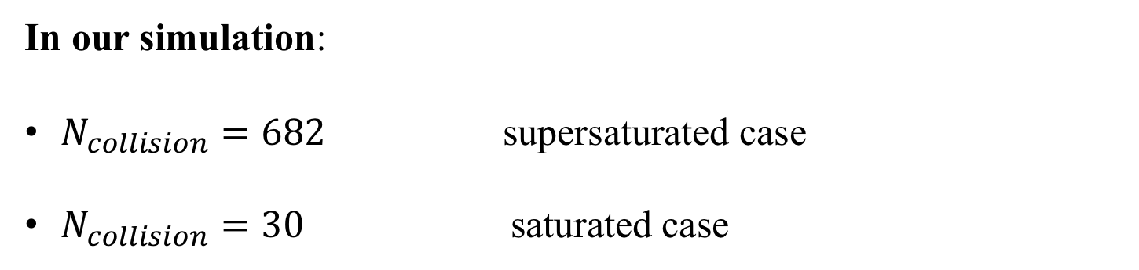

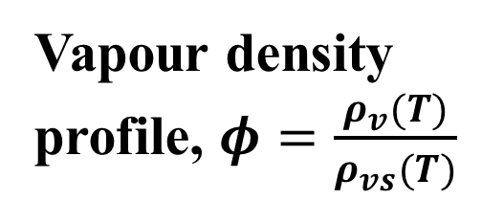


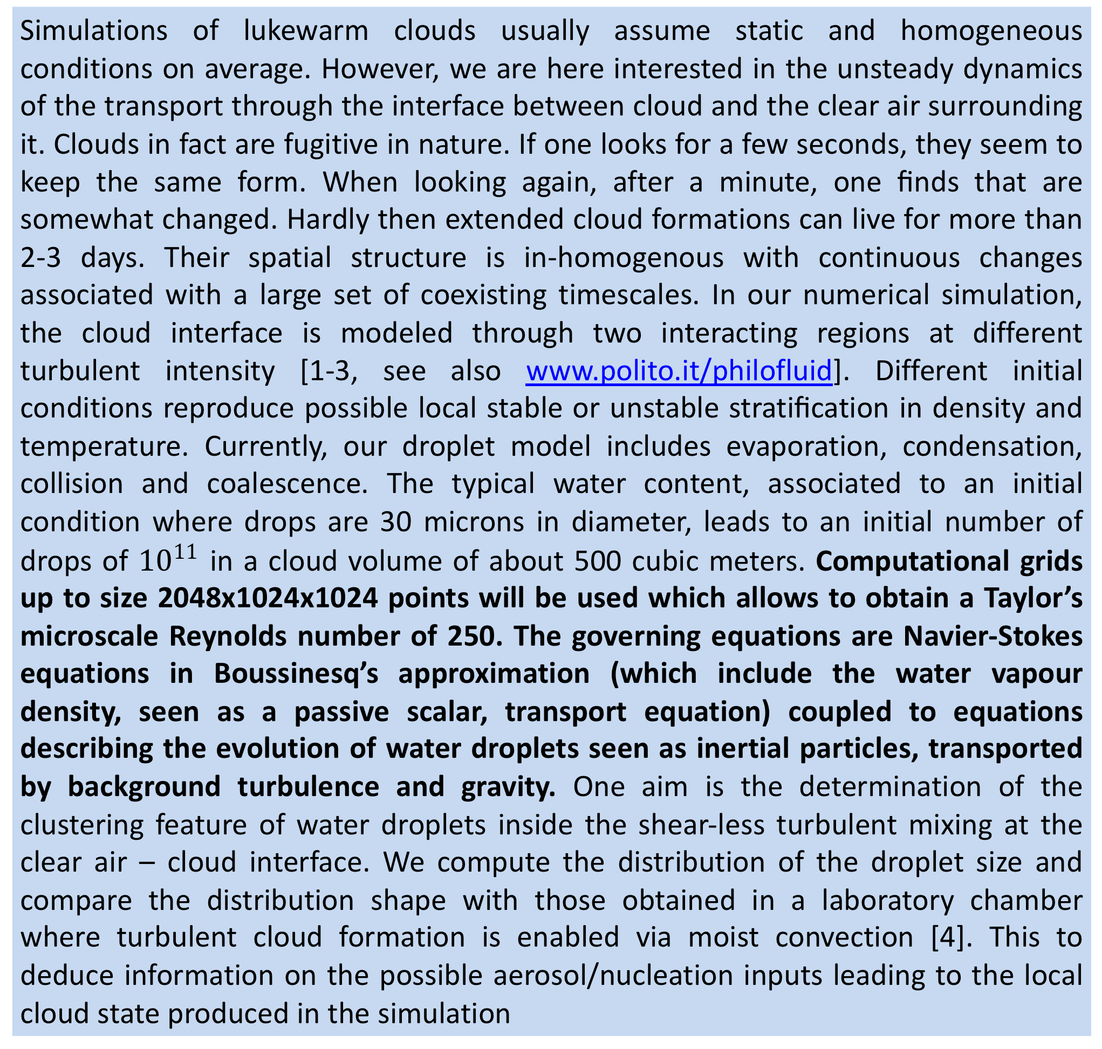
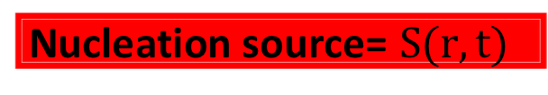





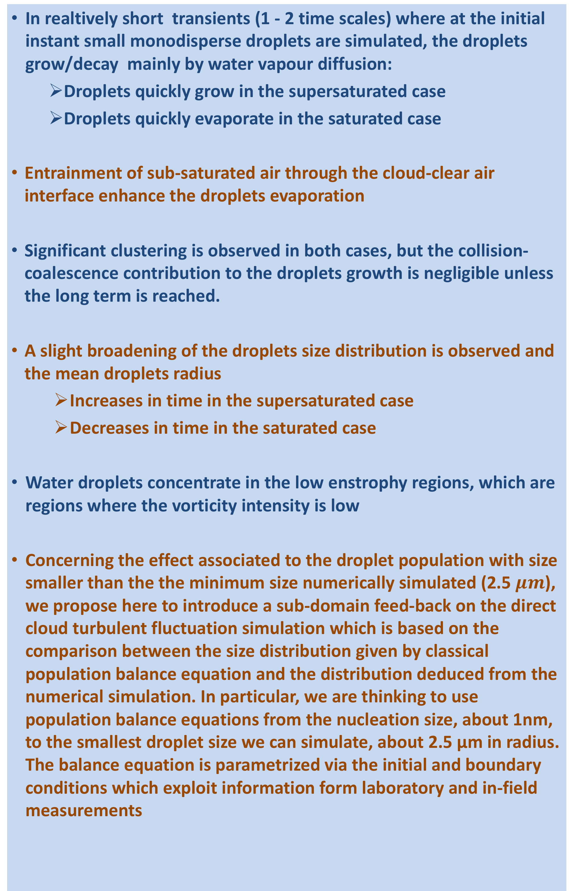
Water droplets simulation in a warm cloud like ambient
David Codoni, Mina Golshan, Vittorio Ruggiero, Marco Vanni, Daniella Tordella
1. Politecnico di Torino, DISAT, 10129 Italy ,2. CINECA, SCAI Rome
Abstract
Water droplets dynamics
Nucleation
Results and conclusion
Simulations of lukewarm clouds usually assume static and homogeneous conditions on average. However, we are here interested in the unsteady dynamics of the transport through the interface between cloud and the clear air surrounding it. Clouds in fact are fugitive in nature. If one looks for a few seconds, they seem to keep the same form. When looking again, after a minute, one ﬁnds that are somewhat changed. Hardly then extended cloud formations can live for more than 2-3 days. Their spatial structure is in-homogenous with continuous changes associated with a large set of coexisting timescales. In our numerical simulation, the cloud interface is modeled through two interacting regions at different turbulent intensity [1-3, see also www.polito.it/philofluid]. Different initial conditions reproduce possible local stable or unstable stratiﬁcation in density and temperature. Currently, our droplet model includes evaporation, condensation, collision and coalescence. The typical water content, associated to an initial condition where drops are 30 microns in diameter, leads to an initial number of drops of ${10}^{11}$ in a cloud volume of about 500 cubic meters. Computational grids up to size 2048x1024x1024 points will be used which allows to obtain a Taylor’s microscale Reynolds number of 250. The governing equations are Navier-Stokes equations in Boussinesq’s approximation (which include the water vapour density, seen as a passive scalar, transport equation) coupled to equations describing the evolution of water droplets seen as inertial particles, transported by background turbulence and gravity. One aim is the determination of the clustering feature of water droplets inside the shear-less turbulent mixing at the clear air – cloud interface. We compute the distribution of the droplet size and compare the distribution shape with those obtained in a laboratory chamber where turbulent cloud formation is enabled via moist convection [4]. This to deduce information on the possible aerosol/nucleation inputs leading to the local cloud state produced in the simulation
Water droplets clustering
Preferential drops concentration due to the turbulent transport was observed in both cases. In the supersaturated case an increase in the droplets radius was observed
while the opposite trend was observed in the saturated case where a strong drops radius reduction is shown
In both case an initial homogeneous and monodisperse droplets distribution is considered with an intial radius of $2.5 μm$.
Water droplets size distribution
The figures representing the droplets size distribution for the supersaturated case (left panel) and for the saturated case (right panel) show a slight broadening of the drops radius distribution.
Total liquid water volume distribution
The strong evaporation observed in the saturated case (right panel) shows an almost complete dissolution of the cloud. The figure on the left panel shows instead an important water vapour condensation which increases the liquid water content
Enstrophy and water droplets concentration
It has been observed that the due to their iniertia, the water particles move towards regions with lower enstrophy.
What is the nucleation : Nucleation is the onset of a first-order phase transition by which a metastable phase transforms into a more stable one. Such a phase transition occurs when an initial system initially in equilibrium is destabilized by the change of an external parameter like the temperature or the pressure. If the perturbation is small enough, the system does not become unstable but rather stays metastable. In diffusive transformations, the system then evolves through the nucleation, the growth and the coarsening of a second phase. Such a phase transformation is found in a lot of situations in materials science like condensation of liquid droplets from a supersaturated vapor, precipitation from a supersaturated solid solution [14].
Types of nucleation:
Cloud condensation nuclei(CCN)
Aerosol particles which are capable of
initiating drop formation at the weak
super-saturation observed in the atmosphere
are called cloud condensation nuclei, CCN.
These have been subdivided into three classes of
the diameter range, from about 0.06 µm to
2 µm [12]
Clustering does not mean that water droplets grow very much even if collision-coalescence is strongly enhanced. it has been recently observed in the laboratory [4] that a high particle concentration narrows the drops size distribution spect
population balance equation models
Model which contains nucleation and the growth of a single particle.(based on Population balance equation PBE) which Considering 3 types of PBE:
$\frac{∂n}{∂t}+G\frac{∂n}{∂r}=$0 G is constant, no aggregation no nucleation
IC: t=0 , n(r, 0) =$e^{λ(−2.27.{10}^{9}r)}$
BC: r=${10}^{−9}$m, n(${10}^{−9}$, t) =$e^{λ(t−2.27.{10}^{9})}$
2. $\frac{∂n}{∂t}+\frac{∂(G.n)}{∂r}=0$ G is not constant, no aggregation no nucleation
IC: t=0 , n(r, 0) =$e^{λ(−2.27.{10}^{9}r)}$
BC: r=${10}^{−9}$m, n(${10}^{−9}$, t) =$e^{λ(t−2.27.{10}^{9})}$
3. $\frac{∂n}{∂t}+G\frac{∂n}{∂r}=S(r,t)$ G is constant, no aggregation
Exponential nucleation.
Our aim is to achieve a local dynamical adjusting of the water particle density by killing or breeding water droplets from the simulation threshold size 2.5 µm up to the maximum droplet size reached in the evolving simulation. The sub-domain volume sought for the feedback is one order of magnitude smaller along each linear dimension than the entire domain of the simulation.
Idea for a possible sub-domain feedback from population balance equation models
If the size distribution which is given by the code is lying above the one given by the population model, we have too high a concentration. In this case, we may consider it appropriate to suppress (kill) the droplets in surplus as indicated by the PBE feedback.
Instead, if the size distribution which is given by the numerical simulation is lying below the one given by the population model, we have too low a concentration. So, we can consider it proper to breed an amount of the droplets compensating the deficit as indicated by the PBE feedback.
In realtively short transients (1 - 2 time scales) where at the initial instant small monodisperse droplets are simulated, the droplets grow/decay mainly by water vapour diffusion:
    Droplets quickly grow in the supersaturated case
    Droplets quickly evaporate in the saturated case
Entrainment of sub-saturated air through the cloud-clear air interface enhance the droplets evaporation
Significant clustering is observed in both cases, but the collision-coalescence contribution to the droplets growth is negligible unless the long term is reached.
A slight broadening of the droplets size distribution is observed and the mean droplets radius
    Increases in time in the supersaturated case
    Decreases in time in the saturated case
Water droplets concentrate in the low enstrophy regions, which are regions where the vorticity intensity is low
Concerning the effect associated to the droplet population with size smaller than the the minimum size numerically simulated (2.5 $μm$), we propose here to introduce a sub-domain feed-back on the direct cloud turbulent fluctuation simulation which is based on the comparison between the size distribution given by classical population balance equation and the distribution deduced from the numerical simulation. In particular, we are thinking to use population balance equations from the nucleation size, about 1nm, to the smallest droplet size we can simulate, about 2.5 µm in radius. The balance equation is parametrized via the initial and boundary conditions which exploit information form laboratory and in-field measurements
$$t/τ=0$$
$$t/τ=0.8$$
$$t/τ=1.7$$
$$t/τ=0$$
$$t/τ=0.8$$
$$t/τ=1.7$$
Giant nuclei ≈ larger than 2$μm$
Giant nuclei ≈ larger than 2𝝁𝒎
Large nuclei ≈ 0.2 – 2$μm$
Large nuclei ≈ 0.2 – 2𝝁𝒎
Small or Aitken nuclei ≈ 0.06 – 0.2 $μm$
Small or Aitken nuclei ≈ 0.06 – 0.2 𝝁𝒎
CCN
Introduction and method
In our simulation:
$N_{collision}=682$ supersaturated case
$N_{collision}=30$ saturated case
The Navier-Stokes equations in the Boussinesq approximation coupled with the water vapour density advection/diffusion equation are solved by the MPI parallelized DNS code together with the water droplets Lagrangian tracking equations. Water droplets feedback on the velocity, temperature and water vapour density fields are taken into account.
A small portion of the atmosphere in-between a warm cloud and the clear air above, is simulated in a parallelepiped domain. The cloud-clear air interface is modelled as a turbulent shearless mixing in stratified condition. The turbulent shearless mixing is generated by joining two homogeneous and isotropic turbulent field with different turbulent kinetic energy, but with the same integral scale. The initial energy ratio simulated is $\frac{E_{1}}{E_{2}}=6.7$, while the initial water vapour density and temperature profiles are represented in figure below.
In the figures below the time decay of the mean energy associated with the component $u_{3}$ along the $x_{3}$ direction is shown together with the normalized third (skewness) and fourth (Kurtosis) single –points moments of the velocity component $u_{3}$. Outside the mixing layer the skewness and Kurtosis values agree with a Gaussian distribution (homogeneous and isotropic turbulent fields, $S=0$ and $K=3$), while they differ inside the mixing indicating a very large flow intermittency. Furthermore the skewness and Kurtosis maxima move towards the low energy region, due to the energy gradient, representing the penetration of the turbulent mixing [1-2-3].
Two cases are considered: supersaturated case ($Re_{λ}=43 , φ=1.2$ in cloud region) and saturated case ($Re_{λ}=53 ,φ=1 \text{in} \text{cloud} \text{region}$).
time
time
Vapour density profile, $φ=\frac{ρ_{v}(T)}{ρ_{vs}(T)}$
Temperature profile
g
Nucleation source= $S(r,t)$
References
Feedback computation: sub-domain definition
HP: the domain is divided in a certain number of sub-domains.
For instance, if we divide the largest grid (2048x1024x1024 points) by ten in each directions we get 2000 sub-domains each of them containing 1061000 grid points. A sufficient dimension to carry out significant statistics on the droplets populations which will approximatively contains $10^{8}$ drops.
[1] D. Tordella and M. Iovieno, Physical Review Letters, 107, 194501 (2011)
[2] Iovieno, M., Savino, S. Di, Gallana, L. & Tordella, D., Journal of Turbulence 15 (5), 311–334 (2014)
[3] Tordella, Daniela, Iovieno, Michele & Bailey, Peter Roger , Physical Review E 77, 016309 (2008)
[4] K. K. Chandrakar,W. Cantrell,K. Chang, D. Ciochetto, D. Niedermeir, M. Ovchinnikov, R. Shaw, F. Yang, PNAS, Vol 113, n 50, 10.1073 (2016)
[5] S. Ghan, H. Abdul Razzak, A. Nenes, Y. Ming, X. Liu, M. Ovchinnikov, B. Shipway, N. Meshidze, J. Xu and X. Shi, JAMES, Vol 3, M10001 (2014)
[6] V. Ruggiero, D. Codoni and D.Tordella, PRACE, white paper, Type C project 2010PA3699 (2018)
[7] J. Curtius, The European Physical Journal Conferences, 10.1140 (2009)
[8] B. Kumar and J. Schumacher and R. Shaw, Theory Compute Fluid Dynamic, 10.1007 (2012)
[9] Sh. Qamar and G. Warnecke, Computer and Chemical Engineering, 10.1016 (2007)
[10] B. Kumar and J. Ramkrishna and R. Shaw, Chemical Engineering Science, 4659-4679, (1997)
[11] J. Devenish, P. Bartello, J. Brenguier, L.R. Collins, W.W. Grabowski, R.H.A. Ijzermans, S.P. Malinowski, M.W. Reeks, J.C. Vassilicos, L.P. Wang and Z. Warhaft, RMetS, 101002 (2012)
[12] Y. Yin, Z. Levin, T.G Reisin, Sh. Tzivion, Atmospheric Researcher 53 (2000)
[13] T. Gotoh, T. Suehiro and I. Saito, New Journal Physics. 18, 043042 (2016)
[14] E. Clouet, ASM Handbook, Fundamentals of Modeling for Metals Processing, Vol 22A, pp.203-219 (2009)
Aknowledgements
This project has received funding from the Marie-Sklodowska Curie Actions (MSCA) under the European Union’s Horizon 2020 research and innovation programme (grant agreement n 675675), PRACE preparatory access 2017-2018 Type C project 2010PA3699.
Energy
skewness
Kurtosis
Objectives
Introduce a feedback from the statistical models describing the droplets population dynamics (PBE population balance equations, see third column in this poster, that depends on two parameters: the initial conditions on the droplets concentration rate at the nanoscale droplet size and the boundary condition on the minimum drop size which our code can simulate.
Study of the microphysics at the cloud edge which includes condensation/evaporation, collision and coalescence
Check the role of turbulence in droplets dynamics and viceversa.

