Slide 1

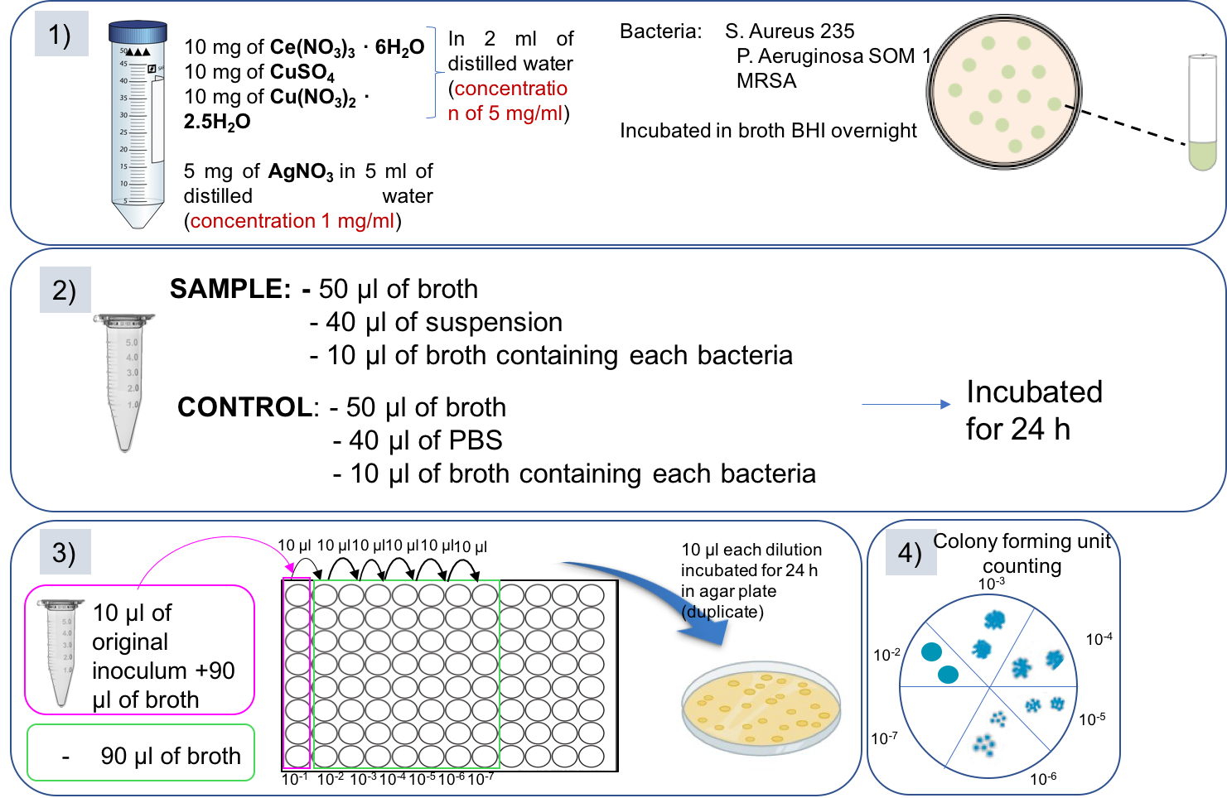
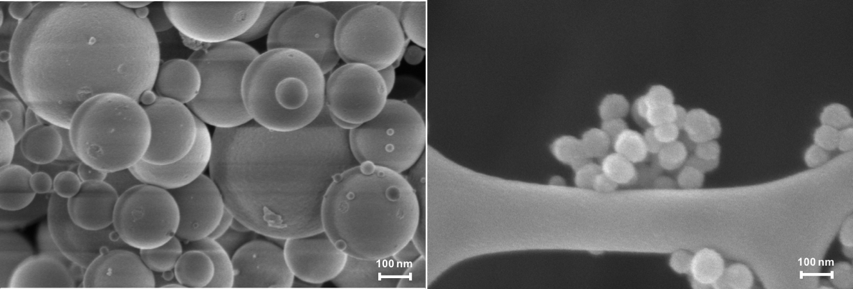
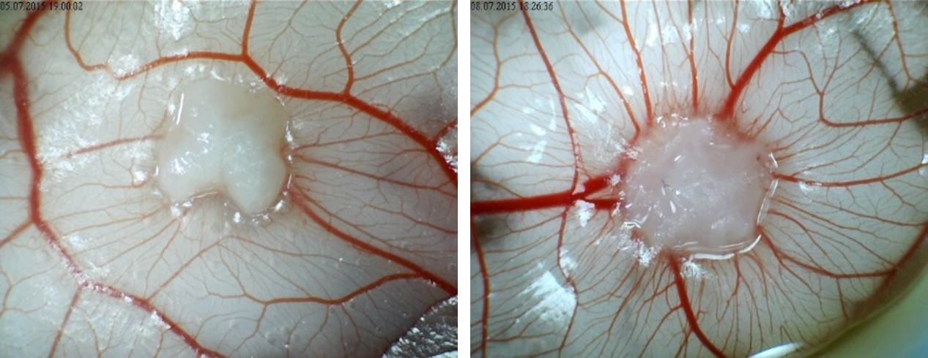
Ion-doped mesoporous bioactive glass nanoparticles for wound healing applications
Alessandra Bariª, Sonia Fiorilliª, Carlotta Pontremoliª, Joanna Shepherd^{b}, Anthony J. Bullock^{c}, Sheila MacNeil^{c}, Chiara Vitale- Brovarone*ª
ª Department of Applied Science and Technology, Politecnico di Torino, Corso Duca degli Abruzzi 24, 10129 Torino, Italy
^{b} School of Clinical Dentistry, The University of Sheffield, 19 Claremont Crescent, Sheffield S10 2TA, UK
^{c} Department of Engineering Materials, Kroto Research Institute, University of Sheffield, Broad Lane, Sheffield S3 7HQ, UK
Bioactive glasses (BGs) have been extensively studied for bone repair. Besides, recent research has also shown their positive effects on wound healing. Among BGs, mesoporous bioactive glasses (MBGs) are receiving increasing attention as tissue-regeneration systems. Their high surface area and accessible pore volume give the possibility of incorporating and releasing therapeutic ions to impart biological properties, such as pro-angiogenic effects (cerium [1], copper [2]) or antibacterial activities (copper) [3].
The aim of this work is to develop mesoporous bioactive glasses doped with cerium and copper in order to obtain a multifunctional platform for tissue regeneration.
To evaluate ions antimicrobial potential, MIC and viable count test were run with copper and cerium salts.
Materials & Methods
Salts
Ce(NO₃)₃ · 6H₂O
Cu(NO₃)₂ · 2.5H₂O
AgNO₃
CuSO₄
Bacteria strains:
S. Aureus S235 (Gram-positive)
P. Aeruginosa SOM1 (Gram-negative)
MRSA-Methicillin Resistant Staphylococcus Aureus (Gram-positive)
1) MIC test
Antibacterial test: Salts
2) Viable count test
Nanoparticles
Base-catalyzed sol-gel method [4]
Ce US 2% MTG: 85 SiO₂/ 13 CaO/ 2 CeO (%mol)
Cu US 2% MTG: 85 SiO₂/ 13 CaO/ 2 CuO (%mol)
Spray-drying procedure [5]
Ce SD 2% MTG: 85 SiO₂/ 13 CaO/ 2 CeO (%mol)
Cu SD 2% MTG: 85 SiO₂/ 13 CaO/ 2 CuO (%mol)
Why Ce and Cu?
Cerium Copper
Pro-angiogenic - Antibacterial
Antibacterial
Introduction & Aim of the work
Nanoparticles
FESEM
XRD
N₂ adsorption-desorption analysis
Release test in Tris-HCl (3h, 1, 3, 8 days)
Viable count
Results
MIC test
Ag salt is more effective compared to copper and cerium salt
The MIC values for Gram + and Gram - are almost the same for Ag and Cu salts
Ce salt seems to be more effective against Gram -
Salts
Spray dryer samples:
500-5000 nm
Nanoparticles
Sample | S. Aureus 235 | P. Aeruginosa SOM 1 | MRSA
Ce(NO₃)₃ · 6H₂O | 6.250 mg/ml | 3.120 mg/ml | 6.250 mg/ml
AgNO₃ | 0.078 mg/ml | 0.078 mg/ml | 0.078 mg/ml
CuSO₄ | 1.560 mg/ml | 3.125 mg/ml | 3.125 mg/ml
Cu(NO₃)₂ · 2.5H₂O | 3.125 mg/ml | 3.125 mg/ml | 3.125 mg/ml
Sample | Pore size (nm) | Surface area - BET (m²/g) | Pore volume (cc/g)
Ce US 2% MTG | 5.7 | 505 | 0.6
Cu US 2% MTG | 4 | 535 | 0.5
Ce SD 2% MTG | 8.7 | 470 | 0.6
Cu SD 2% MTG | 5.5 | 189 | 0.3
Sol-gel samples: 100 nm
Viable count
No oxidic form
Release test
From the viable count, it is possible to notice that:
Cu salts have the same effect against Gram + and Gram -
Ag is more effective against Gram +
Ce showed not satisfying results against all strains considering the values of cfu/ml (higher than the limit of 10^⁵ CFU/ml regarded as “infection”) [6]
From viable count, it is possible to notice that:
Antibacterial effect against Staphylococcus Aureus S.235 is more evident and still present after 3 days
Survival rate increases after 3 days of soaking against MRSA and SOM1, suggesting that ions probably created some compounds with other elements present in the medium which are not able to act against these bacteria strains.
Antibacterial studies on salts showed that silver and copper have good antimicrobial properties against Gram Positive and Gram negative strains.
These ions, incorporated in the mesoporous glass frameworks, obtained by two different synthesis routes, imparted good antibacterial properties.
The Angiogenesis capacity of the nanomatrices will be tested on fertilised chick eggs by Chorionic Allantoic Membrane assay (CAM).
Conclusion
On going
[1] J.P. Garner, P.S. Heppell., Burns 31 (2005) 539–547
[2] A. Hoppe et al., Biomaterials 32 (2011) 2757-74
[3] C. Wu et al., Biomaterials 34 (2013) 422-433
[4] M. Shi et al., Acta Biomater. 30 (2016) 334–344
[5] C. Vitale-Brovarone et al., KeyEngMat 631 (2015) 43-47
[6] P.G. et al., Clinical Microbiology Reviews (2001)
[7] O. Zeions et al., Nanotoxicology 3 (2009) 284–295
Kroto Research Institute, University of Sheffield, Sheffield
References
Acknowledgements
The activity leading to this work has received funding from H2020-NMP-PILOTS-2015 under grant agreement no. 685872 (MOZART).
chiara.vitale@polito.it
alessandra.bari@polito.it

