Slide 1

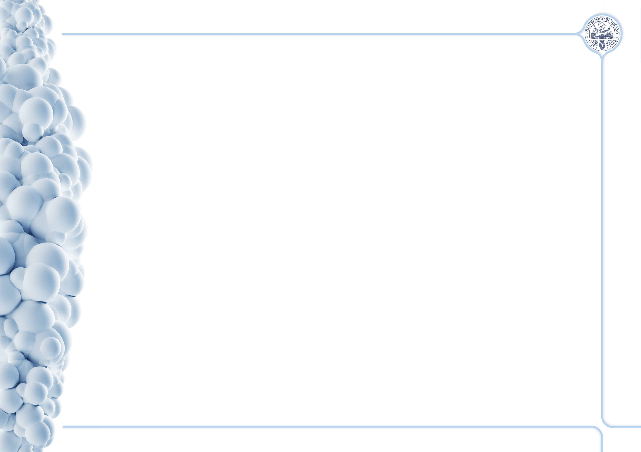


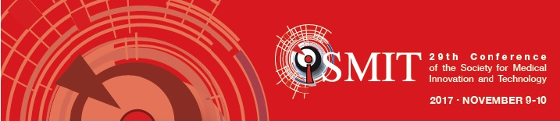

Ion-doped mesoporous bioactive glasses as antibacterial agents in tissue regeneration
Alessandra Bari¹, Carlotta Pontremoli¹, Sonia Fiorilli¹, Joanna Shepherd², Giorgio Iviglia³, Sheila MacNeil⁴, Chiara Vitale- Brovarone*¹
¹ Department of Applied Science and Technology, Politecnico di Torino, Corso Duca degli Abruzzi 24, 10129 Torino, Italy
² School of Clinical Dentistry, The University of Sheffield, 19 Claremont Crescent, Sheffield S10 2TA, UK
³Nobil Bio Ricerche Srl, 14037 Portacomaro, Italy
⁴ Department of Engineering Materials, Kroto Research Institute, University of Sheffield, Broad Lane, Sheffield S3 7HQ, UK

Slide 2
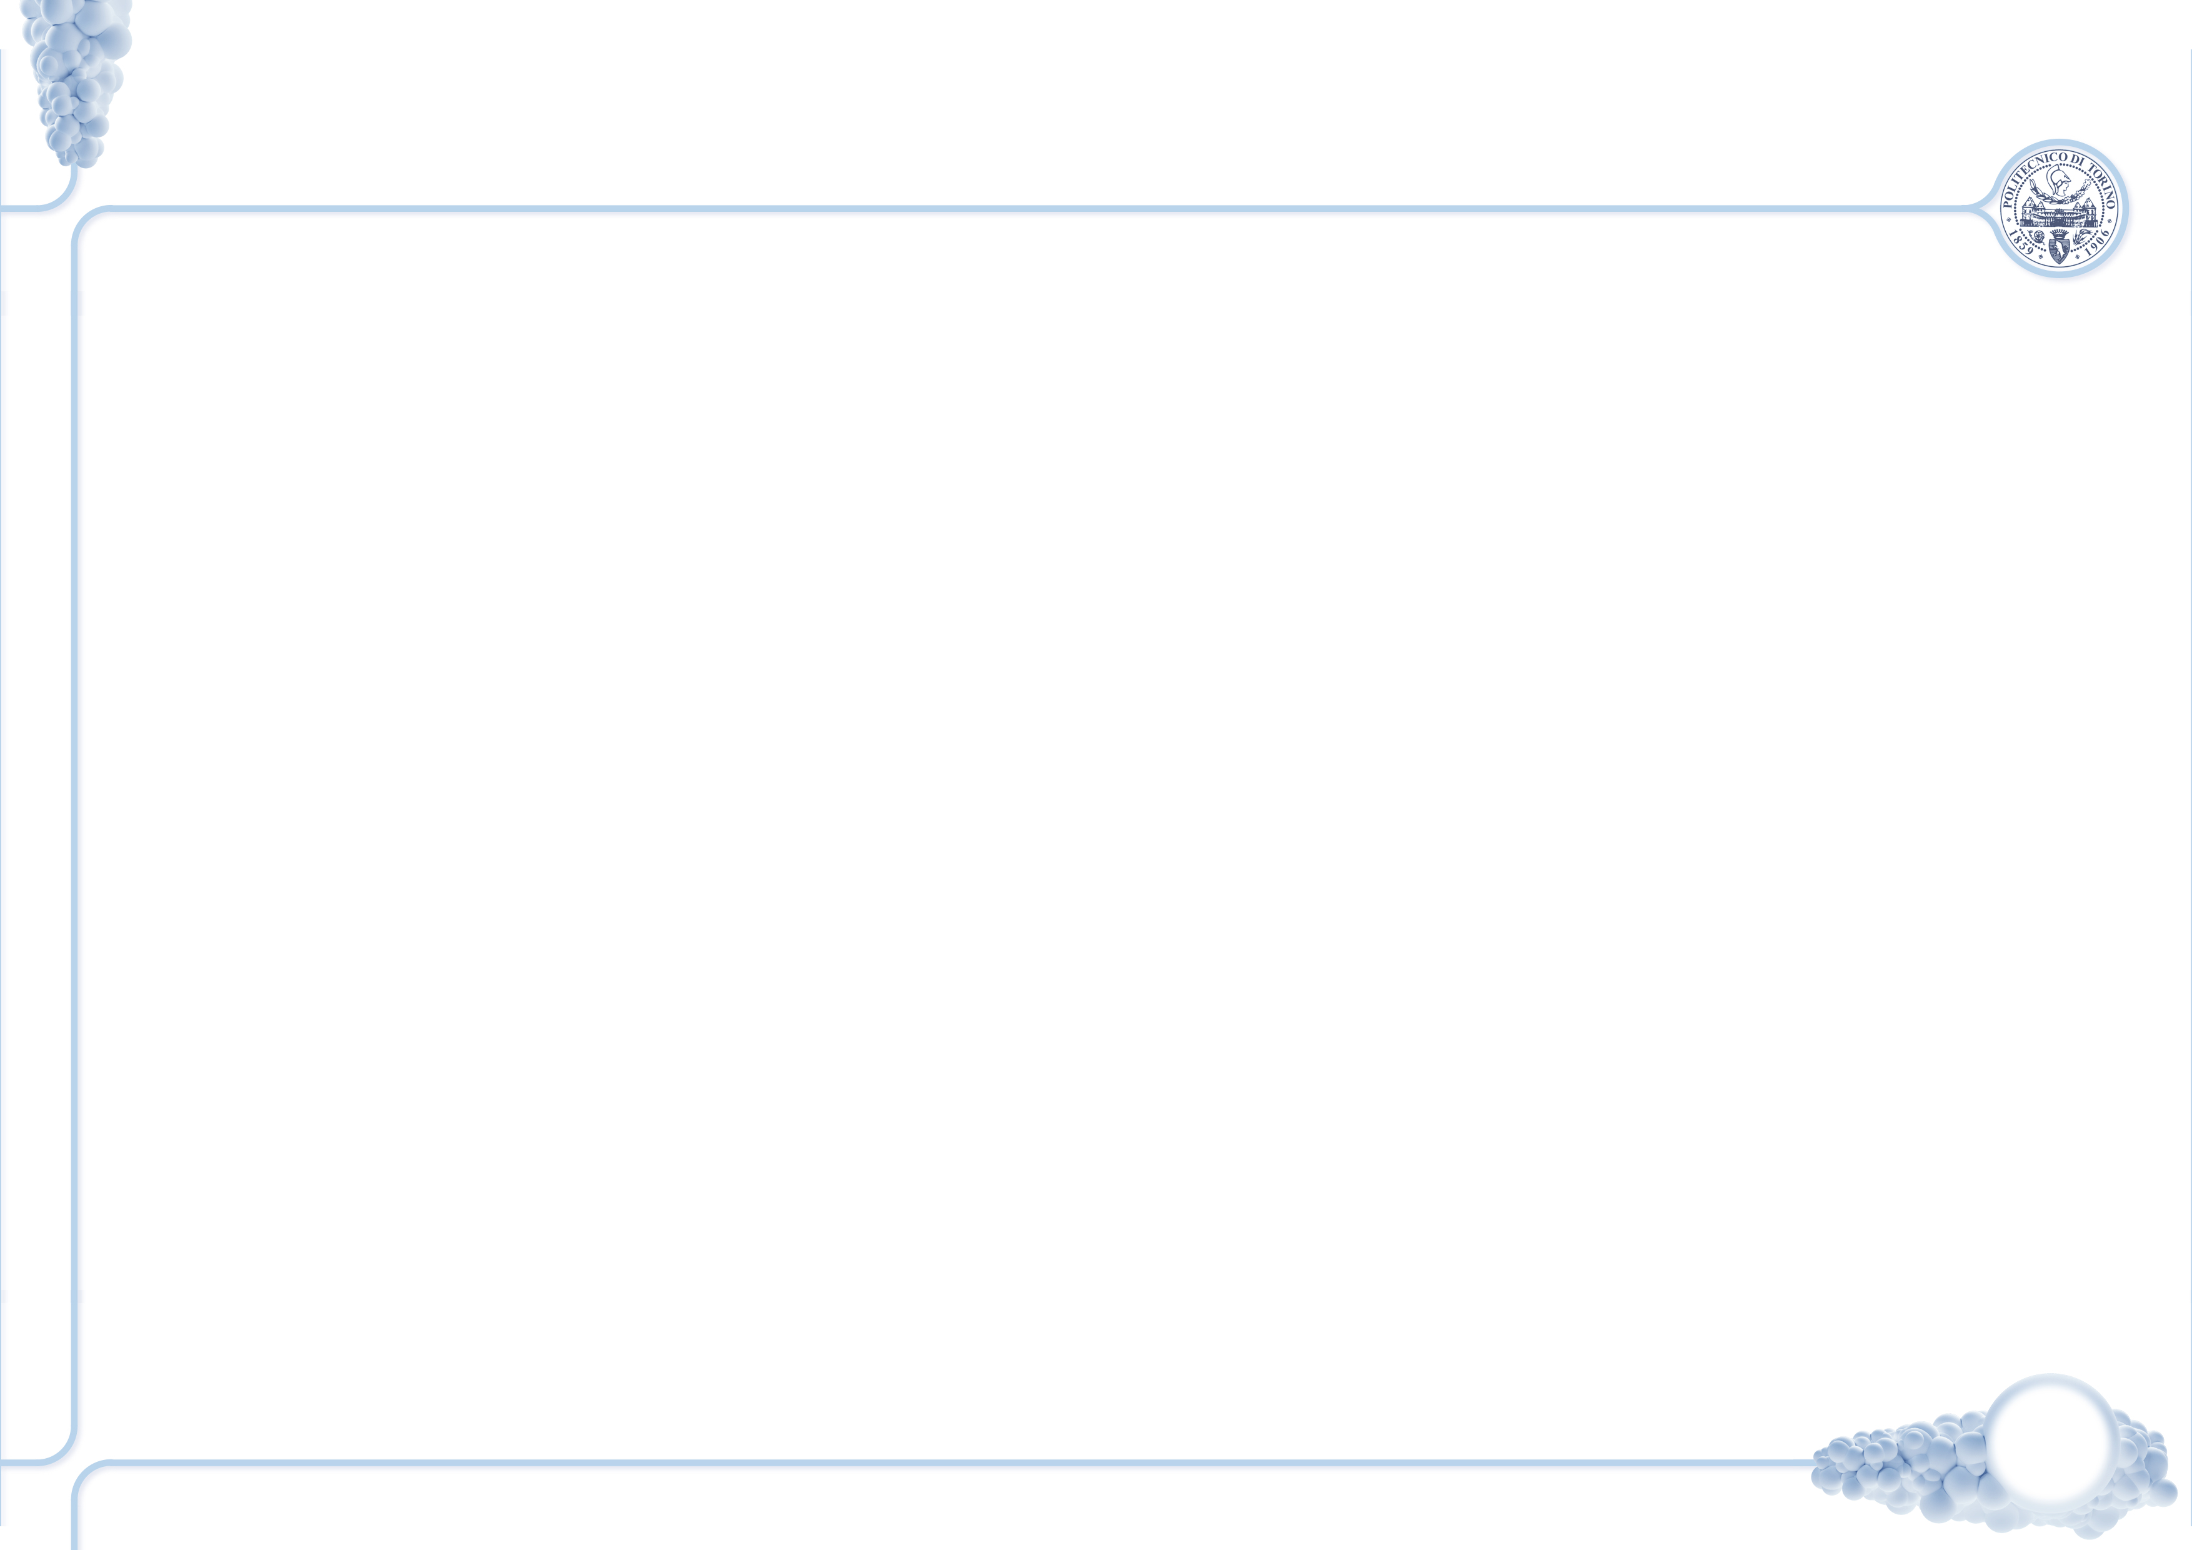

Outline
Mesoporous Bioactive Glasses (MBGs)
Ion-doped MBGs synthesis methods
Morphological and structural characterization of the samples
Ion release test
Antibacterial tests
Conclusion and remarks
Viable count test
Disk diffusion test
Alessandra Bari_10th November 2017

Slide 3
Mesoporous Bioactive Glasses (MBGs)
Excellent specific surface area values
Large accessible volume
Uniform pores (range 2-8 nm)
High surface concentration of hydroxyl groups (-OH): surface modification and drug incorporation
Ion-doped MBGs
+
Therapeutic ions
The aim of the MOZART project is to develop mesoporous nanomatrices doped with therapeutic ions and drugs to be used as smart platform in the treatment of delayed bone healing and non-healing skin wounds.
C. Wu, J. Chang J, Controlled Rel (2014) 193, 282-295.
Alessandra Bari_10th November 2017

Slide 4
Ion-doped MBGs particles
SiO₂-CaO system doped with therapeutic ions (Cu²⁺, Ce³⁺, Ag⁺)
Aerosol-assisted Spray drying synthesis
Base catalyzed Sol-gel synthesis
Ion | Ion precursor | Biological function
Copper^{[1]} | Copper chloride (CuCl₂) | Antibacterial Pro-Osteogenic Pro-angiogenic
Silver^{[2]} | Silver nitrate (AgNO₃) | Antibacterial
Cerium^{[3]} | Cerium chloride (CeCl₃ · 7H₂O) | Antibacterial Pro-Osteogenic
Silica precursor: | TEOS
Templating agent | P123
Polar solvent | Distilled water in HCl (pH 2)
Calcium precursor | CaNT
Silica precursor: | TEOS
Templating agent | CTAB
Polar solvent | Distilled water in NH₄OH
Calcium precursor | CaNT
3 h
Under stirring
Atomizing of the solution
Quick solvent evaporation by heating a carrier gas (nitrogen)
Calcination of the obtained powder
Mixing CTAB, NH₄OH in distilled water
Addition of TEOS and calcium precursor
Calcination of the obtained powder
[1] C. Wu, Y. Zhou, M. Xu, P. Han, L. Chen, J. Chang, Y. Xiao, Biomaterials 34 (2013) 422–433.
[2] M. Kawashita, S. Tsuneyama, F. Miyaji, T. Kokubo, H. Kozuka, K. Yamamoto, Biomaterials 21 (2000) 393-398
[3] D. S. Morais, S. Fernandes, P. S. Gomes, M. H. Fernandes, P. Sampaio, M. P. Ferraz, J. D. Santos, M. A. Lopes, N. Sooraj Hussain, Biomed. Mater. 10 (2015) 055008
L. Pontiroli, M. Dadkhah, G. Novajra, I. Tcacencu, S. Fiorilli, C. Vitale-Brovarone, Mater. Lett. 190 (2017) 111–114.
C. Wu, J. Chang, W. Fan, J. Mater. Chem. 22 (2012) 16801–16809.
Alessandra Bari_10th November 2017

Slide 5
Aerosol-assisted Spray drying synthesis
N₂ adsorption-desorption analysis @77K of MBG_Cu2%_SD
Specific surface area * | 226 m² g⁻¹
Pore size ** | 8-11 nm
Pore Volume | 0.05 cm³ g⁻¹
FE-SEM analysis
EDS mapping analysis
MBG_Cu2%_SD
*calculated through the BET model
** DFT method
Average size: 1-5 μm
Homogeneous element distribution
Incorporation of ions confirmed by EDS measurements
MBG_Cu2%_SD
IV type isotherm
Wide angle XRD analysis of MBG_Cu2%_SD
No crystalline phases
Intensity [a.u.]
2Theta [degree]
Alessandra Bari_10th November 2017

Slide 6
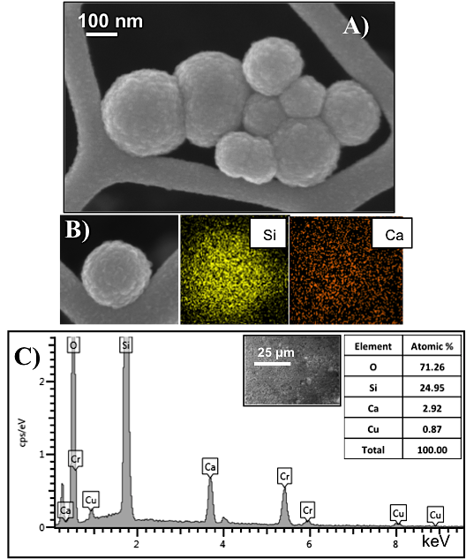
Base catalyzed Sol-gel synthesis
FE-SEM analysis
N₂ adsorption-desorption analysis @77K of MBG_Cu2%_SG
Specific surface area* | 740 m² g⁻¹
Pore size** | 4 nm
Pore Volume | 0.5 cm³ g⁻¹
MBG_Cu2%_SG
Excellent specific surface area value
*calculated through the BET model
** DFT method
Average size: 100-150 nm
Incorporation of ions confirmed by EDS measurements
MBG_Cu2%_SG
IV type isotherm
Wide angle XRD analysis of MBG_Cu2%_SG
No crystalline phases
Intensity [a.u.]
2Theta [degree]
Alessandra Bari_10th November 2017

Slide 7
Ion release test
Medium: Tris HCl 0.1 M (pH 7.4)
Concentration: 250 μg/mL
Time points: 3 h, 24 h, 3 d, 7 d and 14 d
MBG_Cu 2%_SG
Sample | Release (%)
MBG_Cu2%_SD MBG_Cu2%_SG | 48.8% 95.4 %
MBG_Ag0.1%_SD MBG_Ag0.1%_SG | 100% 100%
4.77 ppm
MBG_Cu 2%_SD
Cu²⁺ concentration (ppm)
2.44 ppm
MBG_Ag 0.1%_SD
1.30 ppm
Burst release of copper ions
within 3 h of soaking in buffer
1.13 ppm
MBG_Ag 0.1%_SG
Sustained release of silver ions from samples containing 0.1 %mol and 2%mol
Alessandra Bari_10th November 2017

Slide 8
Antibacterial test: Viable count test
Chronic wounds = wounds locked into a state of chronic inflammation and bacterial infection.
Research of Sheila MacNeil’s group is focused on tissue engineering of soft tissues and the antimicrobial scenario in chronic wounds
[1] M. Fazli et al. J Clin Microbiol 47 (2009) 4084–4089
[2] R. Köck et al. Euro Surveill 15 (2010) 19688
[3] Sheila MacNeil, NATURE 445 (2007) 874
Two different experimental conditions
2 mg/mL of each samples were incubated for 24h with the bacterial suspension
Several dilutions of this medium were placed in the agar plates
After 24 h, the number of formed colonies were counted
SUSPENSION→ to evaluate the antibacterial effect due to the direct contact with the particles
SUPERNATANT 1 day and SUPERNATANT 3 days → to evaluate the antibacterial properties ascribable to the released ions
S. Aureus S235 (Gram +) and P.Aeruginosa SOM1 (Gram -) : most common bacteria isolated from chronic wounds. ^{[1]}
MRSA-Methicillin Resistant Staphylococcus Aureus (Gram +) : accounts for a large portion of hospital-acquired infections. ^{[2]}
Alessandra Bari_10th November 2017

Slide 9
Antibacterial test: Viable count test
MBG_Cu2%_SD
Direct contact with spray drying particles → survival rate ~ 0%
MBG_Cu2%_SG
Released ions from sol-gel sample more effective than direct contact with particles
Alessandra Bari_10th November 2017

Slide 10
Antibacterial test: Viable count test
MBG_Ag2%_SD
MBG_Ag2%_SG
Direct contact with silver-doped particles → Survival rate of all bacteria strains ~ 0%
SUPERNATANT 1 day and SUPERNATANT 3 days
Ongoing
Alessandra Bari_10th November 2017

Slide 11
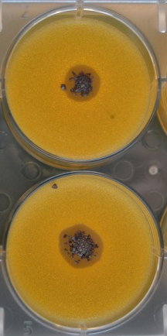
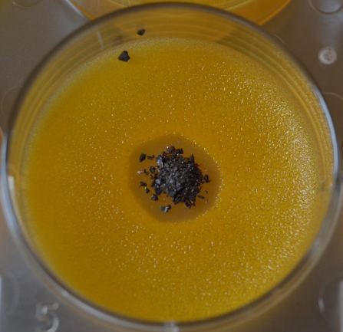
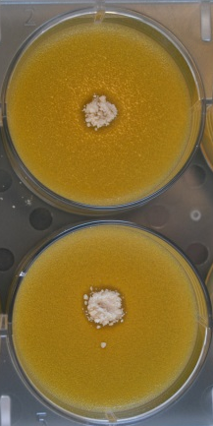
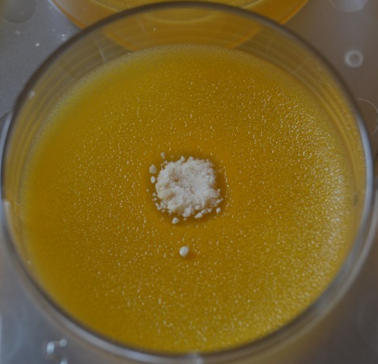
Antibacterial test: Disk diffusion test
MBG_Ag 2%_SG
500 𝜇g/mL
Agar plates were inoculated with Staphylococcus epidermidis RP62A (ATCC 35984) (10 mL of 10x10⁹ CFU/mL)
500 µg/mL and 1000 µg/mL of Ag-containing samples were placed on the agar surface
After incubation (37°C for 72 h), growth inhibition zone was evaluated
1000 𝜇g/mL
Antibacterial effect proportional to ionic concentration and particles concentration
500 𝜇g/mL
1000 𝜇g/mL
MBG_Ag 0.1%_SG
Alessandra Bari_10th November 2017

Slide 12
Conclusion and remarks
Novel copper, cerium and silver-doped MBGs characterized by very high surface area values, tunable pore size and spheroidal shapes were produced by two different routes
The release kinetics and the final amount of released ions depended on the ion and the synthesis method
The amount of released ion was sufficient to ensure a significant reduction of Gram-positive and Gram-negative viable colonies
The non-specific mode of action of these matrices against both Gram + and Gram - bacteria strains and the ability to incorporate drugs make these samples powerful multifunctional materials for biomedical application.
Alessandra Bari_10th November 2017

Slide 13
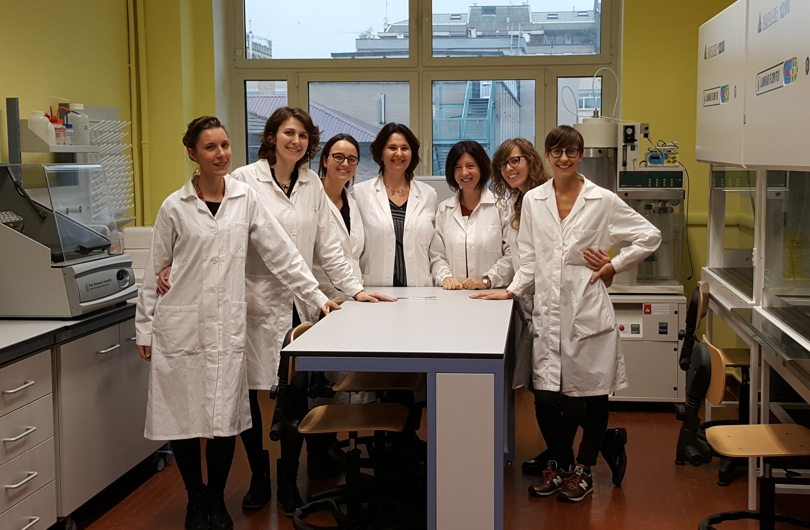
Thanks for your
kind attention
IRIS group
Chiara Vitale Brovarone
Sonia Fiorilli
Giorgia Novajra
Alessandra Bari
Carlotta Pontremoli
Giulia Molino
Giorgia Montalbano
alessandra.bari@polito.it
chiara.vitale@polito.it
Ackowledgments
This activity has received funding from MOZART project H2020-NMP-PILOTS-2015
Alessandra Bari_10th November 2017

Slide 14
Ion release test
Medium: Tris HCl 0.1 M (pH 7.4)
Concentration: 250 μg/mL
Time points: 3 h, 24 h, 3 d, 7 d and 14 d
10.5 ppm
Silver
7.53 ppm
Alessandra Bari_10th November 2017
Copper
Silver
Copper
Silver
10.5 ppm
10.5 ppm
7.53 ppm
7.53 ppm

Slide 15
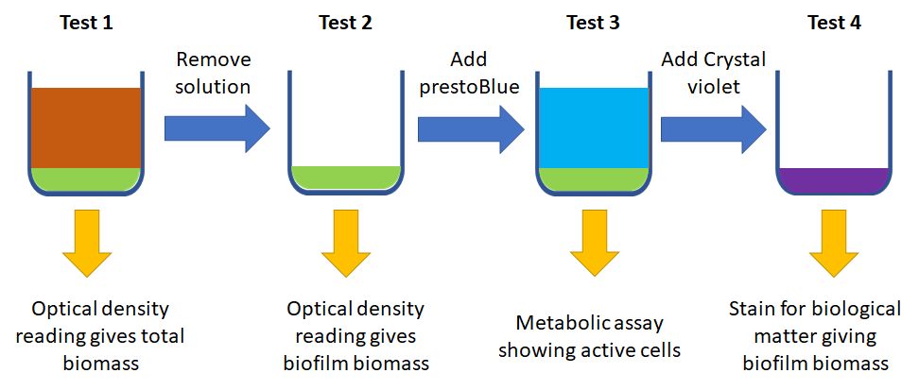
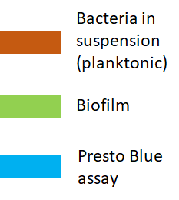
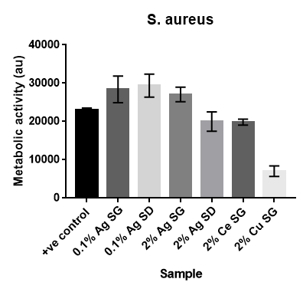
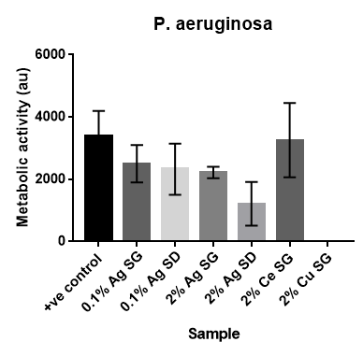
Effects of ions on biofilm formation
Alessandra Bari_10th November 2017
Copper
Silver
Copper
Silver
10.5 ppm
10.5 ppm
7.53 ppm
7.53 ppm

