Slide 1

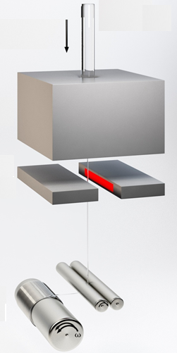

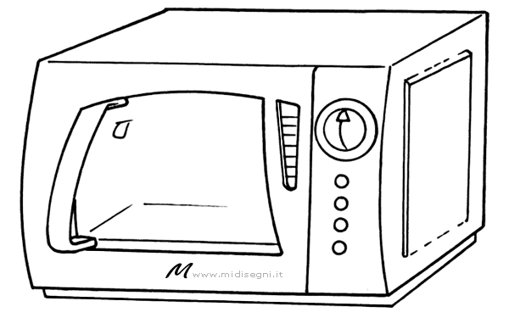
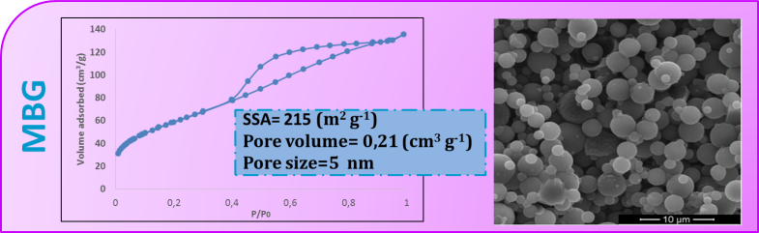
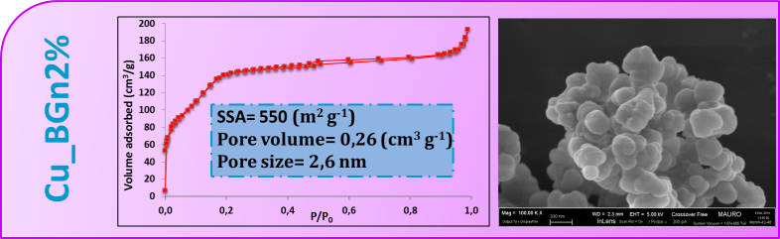
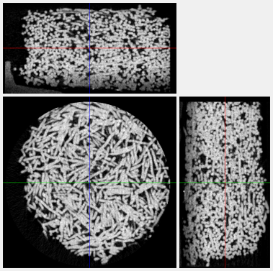
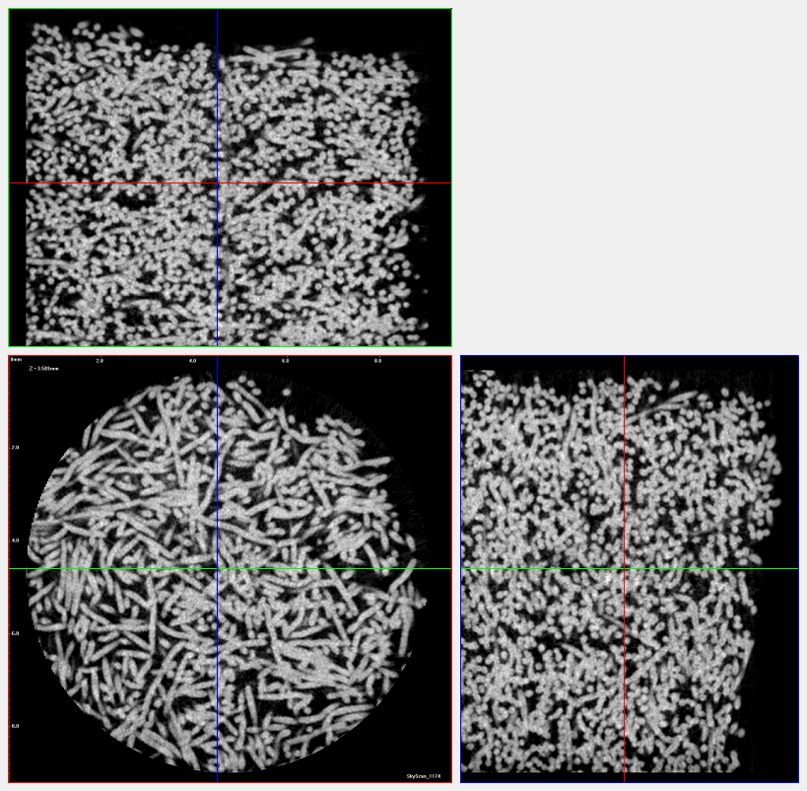
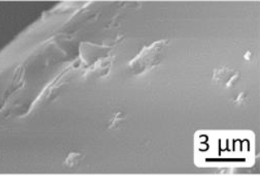
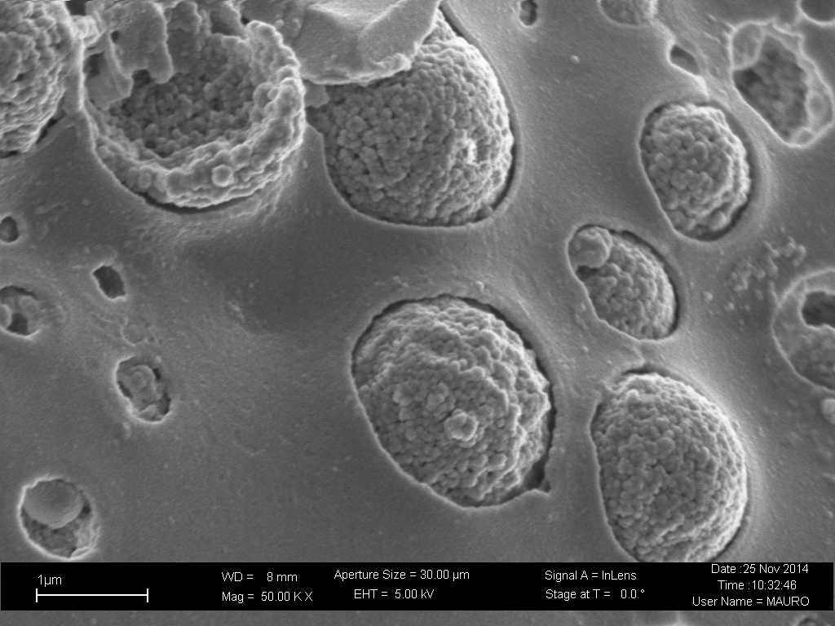
Incorporation of mesoporous glass particles in a resorbable glass fibrous scaffolds: a strategy to improve its bioactivity
A. Bariª, G. Novajra^{a,} N.G. Boetti^{b}, J.Lousteau^{c}, S. Fiorilliª, D. Milaneseª, Chiara Vitale Brovaroneª
ªDepartment of Applied Science and Technology, Politecnico di Torino, Corso Duca degli Abruzzi 24, 10129 Torino, Italy
^{b} Istituto Superiore Mario Boella, Via P. C. Boggio 61, 10134, Torino, Italy
^{c} Optoelectronics Research Centre, University of Southampton, SO17 1BJ, Southampton (UK)
Introduction
Porous 3-D scaffolds are proposed as an alternative to the use of bone grafting technique in the situations of not-sufficient spontaneous bone regeneration. In this work, resorbable phosphate fibres and bioactive mesoporous particles (i.e. specific surface area up to 800 m²/g, adjustable pore size between 2 and 50 nm, large pore volume [1]) with different morphology and size were selected to combine the resorption property of the fibres with bioactive property of the powders.
Phosphate glass fibers
Bioactive powder
TiPS2.5
Fibres of a TiO2-containing phosphate glass fabricated following the preform drawing approach [2].
CEL2
Dense silica-based bioactive glass (45SiO₂, 3P₂O₅, 26CaO, 7MgO, 15Na₂O, 4K₂O mol.%) produced by melt quenching technique [3], as reference sample
SD_MBG
Micro-sized mesoporous glass based on SiO₂-CaO (80SiO₂, 20 CaO mol.%) system produced by an aerosol-assisted spray-drying technique [4].
Cu_BGn2%
Cu-containing mesoporous glass nanoparticles (85SiO₂, 13 CaO, 2CuO mol.%) synthetized by an ultra-sound assisted sol-gel method.
Scaffold preparation
Mesoporous Powder characterization
FIBRE DRAWING
CUTTING
SHAPING
SINTERING
Structural analysis: N₂ adsorption/desorption technique
Morphlogical analysis: FESEM
Ɵ 110 µm
L= 3 mm, 6 mm
The structure shape is maintained after mould removal
(D 13mm, h 12 mm)
Scaffold characterization
ADDITIONAL STEP: INTRODUCTION OF THE BIOACTIVE POWDER
Morphological analysis: FESEM
Inner structure: Micro-CT
Scaffold bioactivity: SBF soaking test
Suspension of bioactive powder in ethanol
Evaporation of ethanol
DEPOSITION OF THE BIOACTIVE PARTCILES ON THE GLASS FIBRES
≈
≈
≈
Ultrasound treatment
≈50° C
Results and discussion
S110_CEL2 [5]
3 wt.% bioactive powder
Fibres: 3 mm
CEL2 are not well incorporated on fibre surface.
Total porosity: 58%
Mean tr. Thick :111 µm
Mean tr. Sep.: 162 µm
S110_MBG [5]
S110_Cu_BGn2%
5 wt.% bioactive powder
0.5 wt.% bioactive powder
Fibres: 70% 3mm fibres / 30% 6mm fibres
Fibres: 6 mm
Total porosity: 53%
Mean tr. Thick :159 µm
Mean tr. Sep.: 203 µm
Total porosity: 33%
Mean tr. Thick :170 µm
Mean tr. Sep.: 133 µm
4 mm
4 mm
4 mm
Bioactivity test in SBF
Bioactivity test in SBF
Bioactivity test in SBF
7
D
A
y
S
Fully covered with HA layer
Typical "cauliflower-like" morphology
Only few particles still anchored to the scaffold
1
D
A
y
2
D
A
Y
S
1
D
A
y
2
D
A
Y
S
Acknowledgement
Conclusion
The activity leading to this research has received funding from H2020-NMP-PILOTS-2015 under grant agreement no. 685872 (MOZART).
The incorporation of MBG and Cu_BGn2% powder in the phosphate glass fibrous scaffold resulted to be a very interesting strategy to induce hydroxyapatite formation on the scaffold. Their fast bioactive response is due to their mesoporosity: it involves a high surface area available for ion exchange which is responsible for the glass bioactivity
These promising results encourage further investigation in order to fully exploit the ability of mesoporous particles to act as a system for smart release of therapeutic ions and drugs.
References
[1] D. Arcos et al. Chem Mater, 21 (2009), 1000–1009
[2] C. Vitale-Brovarone et al. Mat Sci Eng C 31 (2011) 434–442
[3] C. Vitale Brovarone et al. Acta Biomater 3 (2007) 199–208
[4] C. Vitale Brovarone et al. Key Engineering Materials Vol. 631 (2015) pp 43-47
[5] G. Novajra et al. Mat Sci Eng C 67 (2016) 570-580
alessandra.bari@polito.it

