Slide 1

TWO-PHASE ANNULAR FLOW IN A VERTICALLY MOUNTED VENTURI FLOW METER
G. Monni, M. De Salve, B. Panella
Politecnico di Torino, C.so Duca degli Abruzzi 24, 10129 Torino
grazia.monni@polito.it
HEFAT2014
10th International Conference on Heat Transfer, Fluid Mechanics and Thermodynamics
14 – 16 July 2014
Orlando, Florida
Notes:
Thank you Mr. Chairman
Good afternoon to everybody.
I will present an experimental work on the measurement of the flow rate in two- phase
Annular flow by means of a venturi flow meter in a vertical test section.

Slide 2

Outline
Context
Objective
Experimental Facility and Test Matrix
Venturi Flow Meter (VFM) Experimental Results
VFM Modeling
Two-Phase Flow Mass Flow Rates Estimation
Conclusions
HEFAT2014 14 – 16 July 2014 - Orlando, Florida
Notes:
This talk is about:
the context o the two phase flow measurement.
the objective of the study
The experimental facility and the test matrix;
The experimental results
The modelling of venturi flow meter
The extimation of total and phase flow rates
And some conclusions.

Slide 3
Context
Experimental Facility for thermal-hydraulic simulation of innovative small and medium size PWR → SPES3
Measurement of the mixture mass flow rate → instruments and methodologies to evaluate different two- phase flow parameters need to be developed
Typically a set of instruments (Spool Piece - SP) must be installed: each instrument of the SP has to be sensitive to the different properties of the flow (momentum, velocity, density, void fraction, etc..)
Different number of instruments can be coupled in a SP
HEFAT2014 14 – 16 July 2014 - Orlando, Florida
Notes:
In Italy there is an interesting research and development activity on two phase flow instrumentation.
The aim is to evaluate the mass flow rate of a two phase mixture.
A spool piece with different instrument as venturi flow meter and void fraction meter is considered a good solution to evaluate the liquid and gas mass flow rates and to identify the flow patterns.

Slide 4
Objectives
Analysis of the response of a Venturi Flow Meter (VFM) in two-phase flow
To develop a methodology for the signals interpretation and a “model of the instrument” for the phases mass flow rate estimation
The SP is tested in a vertical test section for air-water flow at very high void fraction
The model and the results are presented and discussed
HEFAT2014 14 – 16 July 2014 - Orlando, Florida
Notes:
The main aim is to analyse the response of a venturi flow meter in two- phase flow by measuring the pressure
drop between the inlet and the throat section and the irreversible pressure drop.

Slide 5
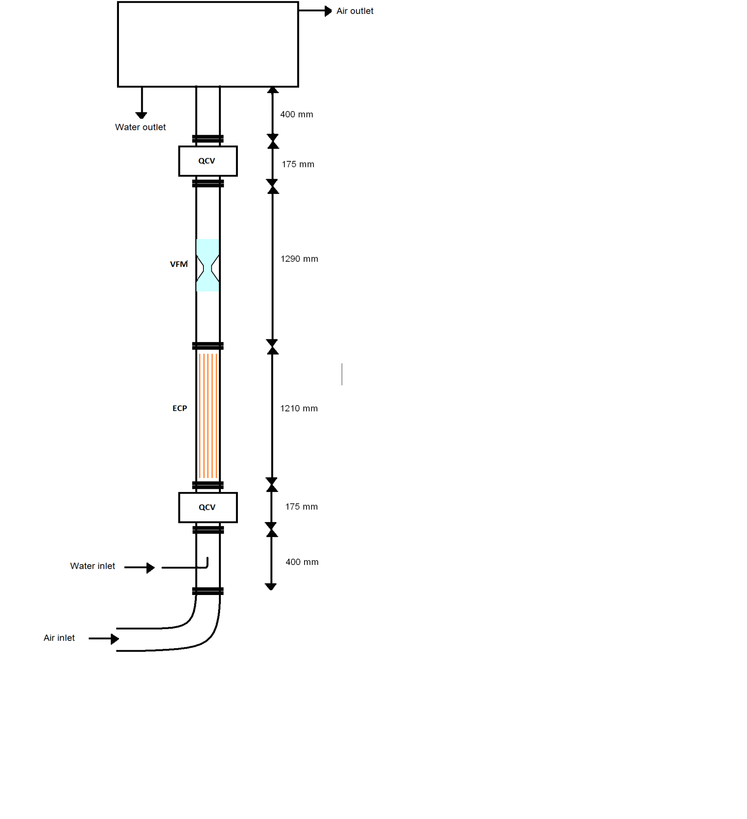
Test Section
Vertical Test section:
D_{i} = 80 mm D_{e} = 90 mm
L ≈ 4 m
VFM placed at L/D~ 30 from the inlet
Test section equipped with pressure transducers
thermocouple and
Quick- Closing Valves
HEFAT2014 14 – 16 July 2014 - Orlando, Florida
Notes:
The venturi flow meter was installed at L/D= 30 from the inlet of test section and at the exit
of a void fraction meter.
The test section is 4 meter long.
Inner and outer diameters of the test section are 80 mm and 90 mm.
Conventional intrumentation as pressure transducers, single phase flow meters and thermocouples are adopted in in the facility.

Slide 6
Experimental Matrix
Fluids:
  Demineralized water
  Air
J_{g} : 14 - 18 m/s
J_{l} : 0.0008 – 0.005 m/s
x : 0.78 – 0.96
α : 0.97 - 1
p : ≈ 1 bar
T : 20 – 25 °C
Very high void fraction corresponding to annular and mist-annular flow
HEFAT2014 14 – 16 July 2014 - Orlando, Florida
Notes:
The experimental matrix consists of a set of air-water runs with constant liquid superficial velocity and different gas superficial velocities.
The flow patterns are annular or mist annular flow.
For every liquid flow rate, the air flow rate is in a range where no flooding occurs and the pressure drop across the test section is
compatible with the blower characteristics.
The void fraction is in the range 0.97 - 1.

Slide 7
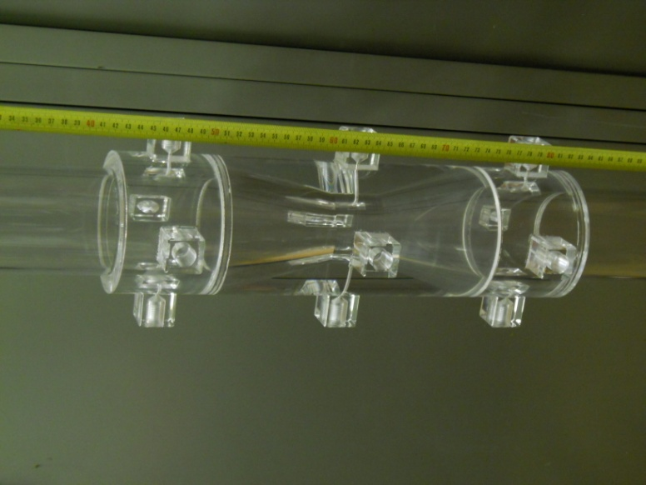
Venturi Flow Meter (VFM)
Estimation of the fluid flow rate from the pressure drop across a pipe restriction
This is perhaps the most commonly used flow measurement technique in industrial applications (low Δp, economic, no moving part, etc…)
Characteristic parameters of the present tests VFM (designed by Polito)
Type | Bi-Directional |  | Fluid | water
D₁ | 80 | mm | θ_{conv.}= θ_{div.} | 21°
D₂ | 40 | mm | L_{up-downstream} | 628 | mm
β | 0.5 | - | L_{tot} | 340 | mm
HEFAT2014 14 – 16 July 2014 - Orlando, Florida
Notes:
The VFM allows the estimation of the fluid flow rate from the pressure drop across a pipe restriction. This is perhaps the most commonly used flow measurement technique in industrial applications.
Because in the experimented range the Re number is lower than 10⁵ and because the sensor geometrical dimensions are not inside the range considered in the EN ISO 5167-1, an in-situ calibration has been performed to obtain the single- phase discharge coefficient for air flow.
In the designed flow meter it is important to measure the pressure drop between the inlet and the outlet of the venturi flow meter.
In two- phase flow, due to the interaction between the gas and the liquid phase, the estimated mass flow rate must to be corrected using available correlations derived from experimental data or semi-empirical models.

Slide 8
VFM Experimental Results: Single-Phase
The air single-phase flow discharge coefficient is evaluated, based on the experimental data
(Y and F_{a} ≈ 1)
Calibration parameters:
a=1.5054
b=-0.0510
HEFAT2014 14 – 16 July 2014 - Orlando, Florida
Notes:
The venturi has been studied in single- phase with air single- phase flow rate at ambient temperature and near the ambient pressure to evaluate the discharge coefficient versus the Reynolds number.

Slide 9
VFM Experimental Results: Two-Phase (I)
Δp_{V}
Δp_{irr}
The two-phase flow pressure drop and losses analyzed at different superficial velocities of the two phases
→ theoretical/experimental modeling
HEFAT2014 14 – 16 July 2014 - Orlando, Florida
Notes:
The dependency of pressure drop on the superficial velocities of the two phases and the small effect due to the liquid flow rate is shown (fig. 6)
The two-phase pressure drops increase with the gas and liquid superficial velocity.

Slide 10
VFM Experimental Results: Two-Phase (II)
The measured Δp_{V} increases of about 10%, if compared to the single-phase flow, the Δp_{V –irr} increases from about 20% to 100% depending on the liquid flow rate
Δp_{V –irr} high sensitivity to the liquid flow rate
(Δp_{TP} / Δp_{g})_{irr}
Δp_{TP-irr} = f(x,J_{g},J_{l})
HEFAT2014 14 – 16 July 2014 - Orlando, Florida
Notes:
the two-phase pressure drop, normalized with reference to the gas single-phase pressure drop, is shown as a function of the gas superficial velocity:
The ratio decreases with the flow quality x.
the two-phase flow value is very close to the gas single-phase flow value, with a maximum increase of about 7%.

Slide 11
VFM Experimental Results: Two-Phase (III)
Notes:
the pressure drop dependence on the total mass flow rate is shown:
the VFM pressure drop is a function of the mass flow rate of the two phases;
introducing the ratio W_{l}/W_{g}, if this ratio is equal to zero the air single phase flow is obtained, while increasing the fraction of water in the mixture an increase of the pressure drops is highlighted.
This is a typical Ventury flow map at high void fraction for annular or mist flow (wet gas).
This is typical at very low void fraction for bubble flow with very high pressure drops range.

Slide 12
VFM Experimental Results: Two-Phase (IV)
VFM pressure drop and VFM irreversible pressure loss vs. total mass flow rate
VFM irreversible pressure loss vs. VFM pressure drop
Notes:
In the present work also the irreversible pressure losses, measured between the Venturi inlet and outlet sections have been analyzed and correlated with the flow parameters.
In the following pictures the dependence of the VFM irreversible pressure loss on the flow parameters are highlighted. The analysis of this component, that usually are not considered in two-phase flow models, allows us to understand better the effect of the dispersed phase in the two- phase pressure drops.
In Figure on the left two VFM pressure drop components are shown as a function of the total mixture mass flow rate.
Figure on the right shows the irreversible pressure loss component with the pressure drop component measured between VFM inlet and throat sections. The circle points highlight the linear relation existing between inlet-outlet (irreversible component) and inlet-throat pressure drops in single-phase flow.
The square points show that for annular flow the relation between the two pressure components is not longer linear;
the difference is clearly due to the liquid phase presence, so that the relation between the two components can be used to analyze the effect of the liquid flow rate and to estimate the liquid mass flow rate itself.

Slide 13
VFM Modeling: ΔpV
A Two-Phase flow Multiplier correlation has been developed, based on experimental data and compared with classical correlations.
The new correlation predicts ΔpV with an error lower than 5%
HEFAT2014 14 – 16 July 2014 - Orlando, Florida
Notes:
The two-phase flow multiplier values evaluated by the best fit correlation (15) are compared with the correlations of Murdock, Chisholm and the present test data:
the classical correlations under estimate the two-phase multiplier.
The experimental points dispersion can be justified by the change of the slip ratio value, that is considered constant in all the analyzed correlations.

Slide 14
VFM Modeling: ΔpV_{irr}
A new correlation has been developed, based on experimental data.
The proposed correlation describes the irreversible pressure loss change as a function of the superficial velocities of the two phases and of the ratio between the liquid and the gas superficial velocities, highlighting the effect of the dispersed phase.
The new correlation predicts ΔpV_{irr} with an error lower than 5%
k₁ = 0.2096 - k₂ = 2 - k₃ = 0.13 - k₄= -2.9786
HEFAT2014 14 – 16 July 2014 - Orlando, Florida
Notes:
The comparison between the predicted irreversible pressure loss and the test data is shown in Figure:
the proposed correlation allows the estimation of the VFM irreversible pressure loss, in annular flow, at high void fraction, with an accuracy of 5%.

Slide 15

Mass Flow Rate Estimation
The Model consists of a set of equations able to derive the mass flow rate of the phases from the instruments signals of:
  Venturi flow meter
  Pressure transducers
  Thermocouples
  An iterative approach is used to estimate the flow parameters of the two phases
Δp_{irr}
T, P
Δp_{V}
x_{guess}
W_{TP}
HEFAT2014 14 – 16 July 2014 - Orlando, Florida
Notes:
Using an iterative approach the flow quality and the mass flow rate of the two phases have been estimated by using only the acquired signals of the VFM and the information concerning the absolute pressure and the temperature of the flow.
The flow quality is evaluated using a best fit correlation (15):
an initial guess value of the parameter is used to evaluate the VFM pressure drops, and the iterative loop goes on until the estimated pressure drop reach the experimental value.
Then the mass flow rates of the two phases are estimated by using the flow quality value and the correlation (16). The reference signals have been obtained as the mean values of the 30 s acquisition time.
The estimated flow quality values are compared with the experimental data, obtained from the measurement of the single phases mass flow rate. The relative error is in each case lower than 5% (fig. 15 of paper).

Slide 16
Results
With the proposed approach the flow quality of the mixture can be evaluated with an accuracy of 5% and the mass flow rate of air and water can be estimated with a minimum accuracy of 2% and 30% respectively
The standard deviations are 1%, 10 % and 2 % for the air flow rate, the liquid flow rate and the quality respectively
HEFAT2014 14 – 16 July 2014 - Orlando, Florida
Notes:
The estimated mass flow rates of air and water are compared with the measured values: the air mass flow rate is estimated with an accuracy of 2% (fig. 16 of the paper), while a lower accuracy characterizes the liquid flow rate prediction (the relative error is lower than 30% for all conditions, fig. 17 of the paper).

Slide 17
Conclusions
In the present research work, the experimental investigation of a vertical upward annular two-phase flow by a Venturi Flow Meter (VFM) has been performed.
The dependence of the pressure drops, evaluated between the VFM inlet and throat sections and between the inlet and outlet sections, on the characteristic flow parameters (flow velocities, quality and void fraction) have been analyzed and discussed.
Correlations describing the relation between velocities and VFM pressure drops have been proposed for the two pressure drops components. For both correlations the error is lower than 5%.
HEFAT2014 14 – 16 July 2014 - Orlando, Florida

Slide 18
Conclusions
The analysis of the VFM irreversible pressure losses shows that important information can be derived concerning the effect of the liquid dispersed phase
The proposed correlation describes the irreversible pressure loss change as a function of the flow rate of the two-phases, highlighting the effect of the dispersed phase.
A model for the estimation of the mass flow rate of the two phases from the instrument signals has been developed: it allows the evaluation of the flow quality with an accuracy of 5% and the estimation of the mass flow rate of air and water with an error of 1% and 10% respectively
HEFAT2014 14 – 16 July 2014 - Orlando, Florida

Slide 19
Thank you for your kind attention
HEFAT2014 14 – 16 July 2014 - Orlando, Florida

